Slide 1
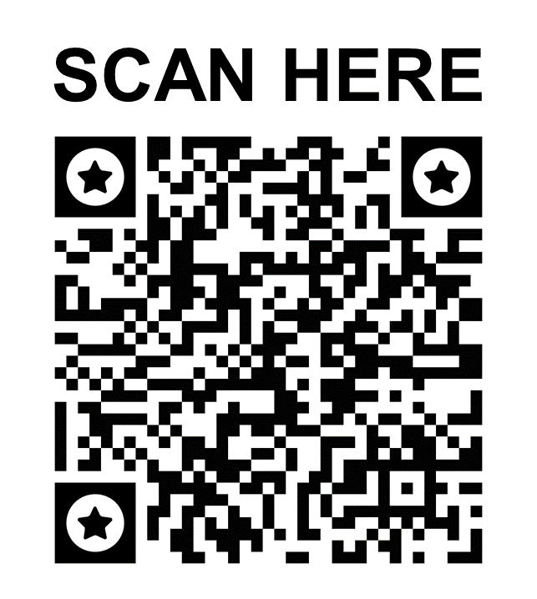
Ethics Hotline
24 Hours A Day • 365 Days A Year
2024
anytime
anywhere
we are here
to listen to you
If you find yourself faced with an ethical dilemma, the Ethics Hotline is here for you. You may report serious concerns like suspected bribery, fraud, potential money laundering, accounting irregularities, antitrust violations, misuse of assets and resources, conflicts of interest, abuse of gifts and entertainment, disclosure of sensitive information, discrimination, retaliation, threats, harassment and similar situations. Any suspected violation of Brink’s Code of Ethics should be reported through the Ethics Hotline.
0800 75 904
Raise your concerns confidentially
You will be protected against retaliation
Contact in Dutch, French, German and English | Contact in het Nederlads, het Frans, het Duits en het Engels |
Contact en néerlandais, français, allemand et englais | Kontakt in Niederländisch, Französisch, Deutsch und Englisch
The Ethics Hotline is operated by an independent company. You can be confident that all claims are treated confidentially by the Brink’s Ethics & Compliance Group. You can also rest assured that if you would like to file an anonymous report, your identifying information will not be provided to Brink’s.

