Slide 1

Enterprise Risk Management (ERM) Starter Kit
Updated: June 2022

Slide 2

Purpose
To introduce ERM concepts down into the organization, we have created an ERM Starter Kit to help you begin to think about risk tolerance within your slice of the organization.
This toolkit can be used for a region or country to a station or down to a department.

Slide 3
TERMINOLOGY

Slide 4
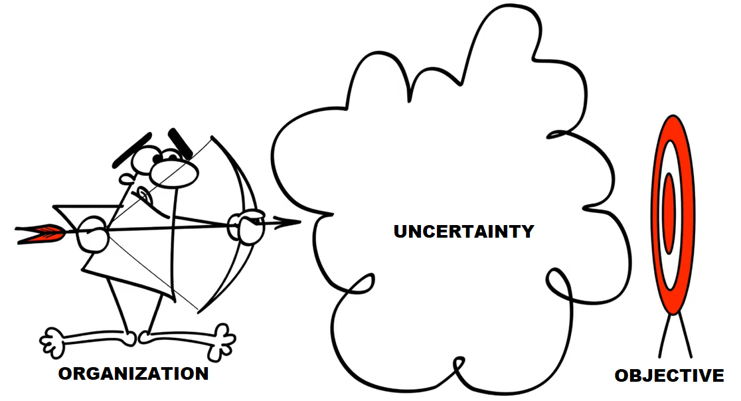
Risk Definition
Clearly outlines the effect of uncertainty on your objectives.
UNCERTAINTY
OBJECTIVE
WATCH THIS 4:53 CLIP ON WHAT IS A RISK? https://www.youtube.com/watch?v=tV9jtS1eJT0

Slide 5



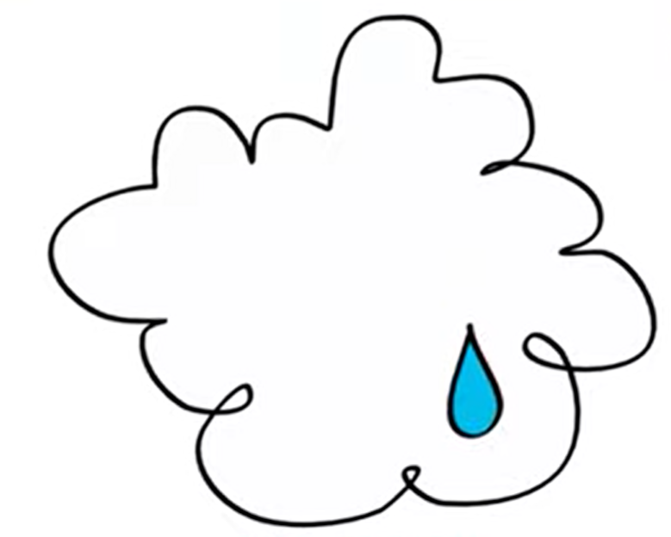


Risk Appetite Statement
The amount and type of risk you are willing to pursue or retain.
UNCERTAINTY
AMOUNT
TYPE
OBJECTIVE
WATCH THIS 2:30 CLIP ON WHAT IS A RISK APPETITE? https://www.youtube.com/watch?v=mjWw4fqGXsc

Slide 6

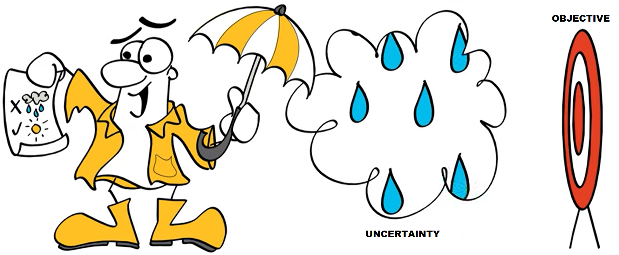

Control / Mitigation Activity
The measure that maintains and/or modifies risk.
Includes any process, procedure, policy, device or practice.
UNCERTAINTY
CONTROLS
OBJECTIVE
WATCH THIS 2:00 CLIP ON WHAT IS A CONTROL? https://www.youtube.com/watch?v=_NKcH1XuDy4

Slide 7
Monitoring Activity / Key Risk Indicator (KRI)
Critical predictors of [the risk materializing] unfavorable events that can adversely impact organizations that allow us to monitor changes in the levels of risk exposure and provide early warning signs that put us in the best position to timely mitigate risk.
Activities or outcomes that signal a particular risk event is becoming more or less likely and may also indicate that a risk event has already occurred and provide a sense of its impact or severity.
Measurement may be quantitative (usually) or qualitative and must be SMART.
Specific – should be direct, detailed and meaningful.
Measurable – ideally can be quantified but should be reasonably measurable.
Reliable – should enable monitoring and measurement on a recurring basis.
Timely – should provide early warning signals of approaching risks or gaps in preparedness.
Actionable – should help management in making decisions and taking action.
S
M
A
R
T

Slide 8
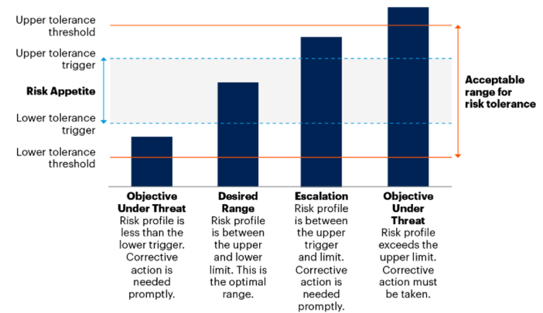
Tolerance Level
Acceptable range or level of performance with respect to a risk.
If performance falls outside preset risk thresholds, risk owners must decide whether they need to change the strategy, modify the control / mitigation activities or reevaluate the tolerance range.

Slide 9
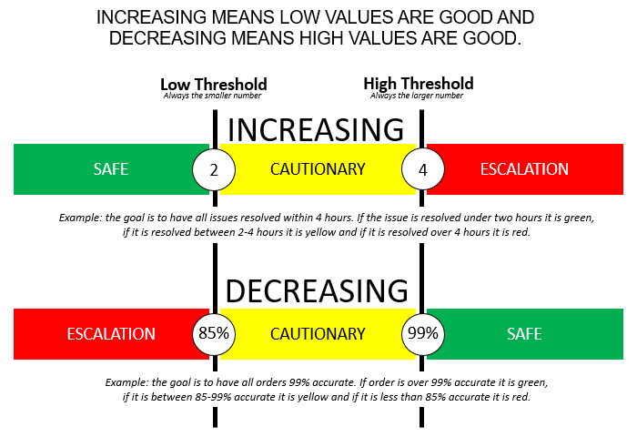
Tolerance Level (Continued)

Slide 10
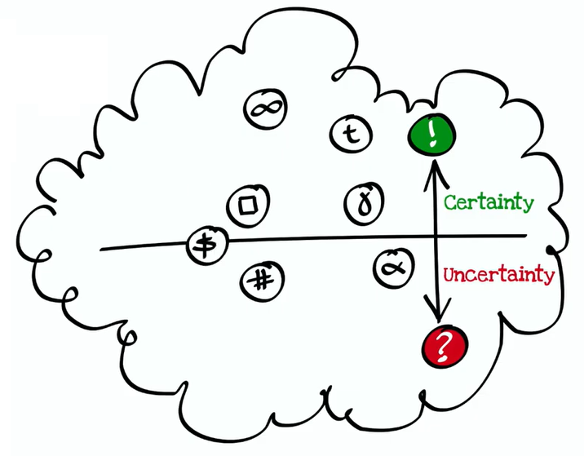

Risk Informed Decision Making
Understanding the risks and tolerance helps to make better decisions by exploring both the knowns and unknowns.
WATCH THIS 1:59 CLIP ON RISK INFORMS DECISION MAKING https://www.youtube.com/watch?v=YJm306Pekg4

Slide 11
APPLICATION

Slide 12
Review the Enterprise Risk Management Documents
Be familiar with the Brink’s Organizational Risk Appetite Statement:
    At Brink’s we recognize that executing our strategy to transform and grow our business requires taking risks while staying aligned to our core values of Safety, Integrity, Customer Focus, Continuous Improvement, Engagement and Diversity & Inclusion.
    We make decisions taking into account the impact on our customers, employees, communities and investors. We are confident in our business model yet are constantly reimagining how to transform the Company.
    As the global leader in secure logistics and cash management services, we actively manage and balance risk and return every day. We drive forward with deliberate speed, never losing sight of our commitment to deliver long-term value for our stakeholders.
Review information on the ERM Program, Risk Register and Risk Appetite Statements which can be found on the Intranet under Enterprise Risk Management:
    Office Users (must be on the Brink’s network onsite or VPN to access this link)
    G-Suite Users

Slide 13
How do I apply this in my area?
Walk through some key questions:
  Is this for a certain country? Determine the scope.
  What is the effect of uncertainty on your objectives? Write down your risk definition.
  What is amount and type of risk you are willing to pursue or retain? Write down your risk appetite statement.
  What activities could you take to mitigate the risk? Write down your controls.
  What events signal a particular risk event is becoming more or less likely? Is it measurable? Is it quantitative or qualitative? What is an acceptable range or level of performance? How often do you need to check on these events? Write down your monitoring activities or KRIs with a tolerance range and measurement frequency. Check each of these against your risk appetite statement and against the Brink’s organizational risk appetite statement to make sure they align.
  Who is best to track this information and who needs to review it? Write down who the owners are to ensure clear accountability.
2. Document it and keep it updated.
3. Use it to make risk informed decisions!

Slide 14
DOCUMENTATION

Slide 15
Risk Template
Download the ERM Starter Kit Template to help document your risks
    Office Users (must be on the Brink’s network onsite or VPN to access this link)
    G-Suite Users
Modify the template to accommodate your needs and situation

Slide 16
QUESTIONS?
For Questions on this Kit or the ERM Program,
Contact Kristina Keller
kristina.keller@brinks.com

