Slide 1
2023 Pinnacle Awards
[DATE]

Slide 2
Agenda
Program overview
Categories and criteria
Eligibility
Nomination process
Winner selection and celebration

Slide 3
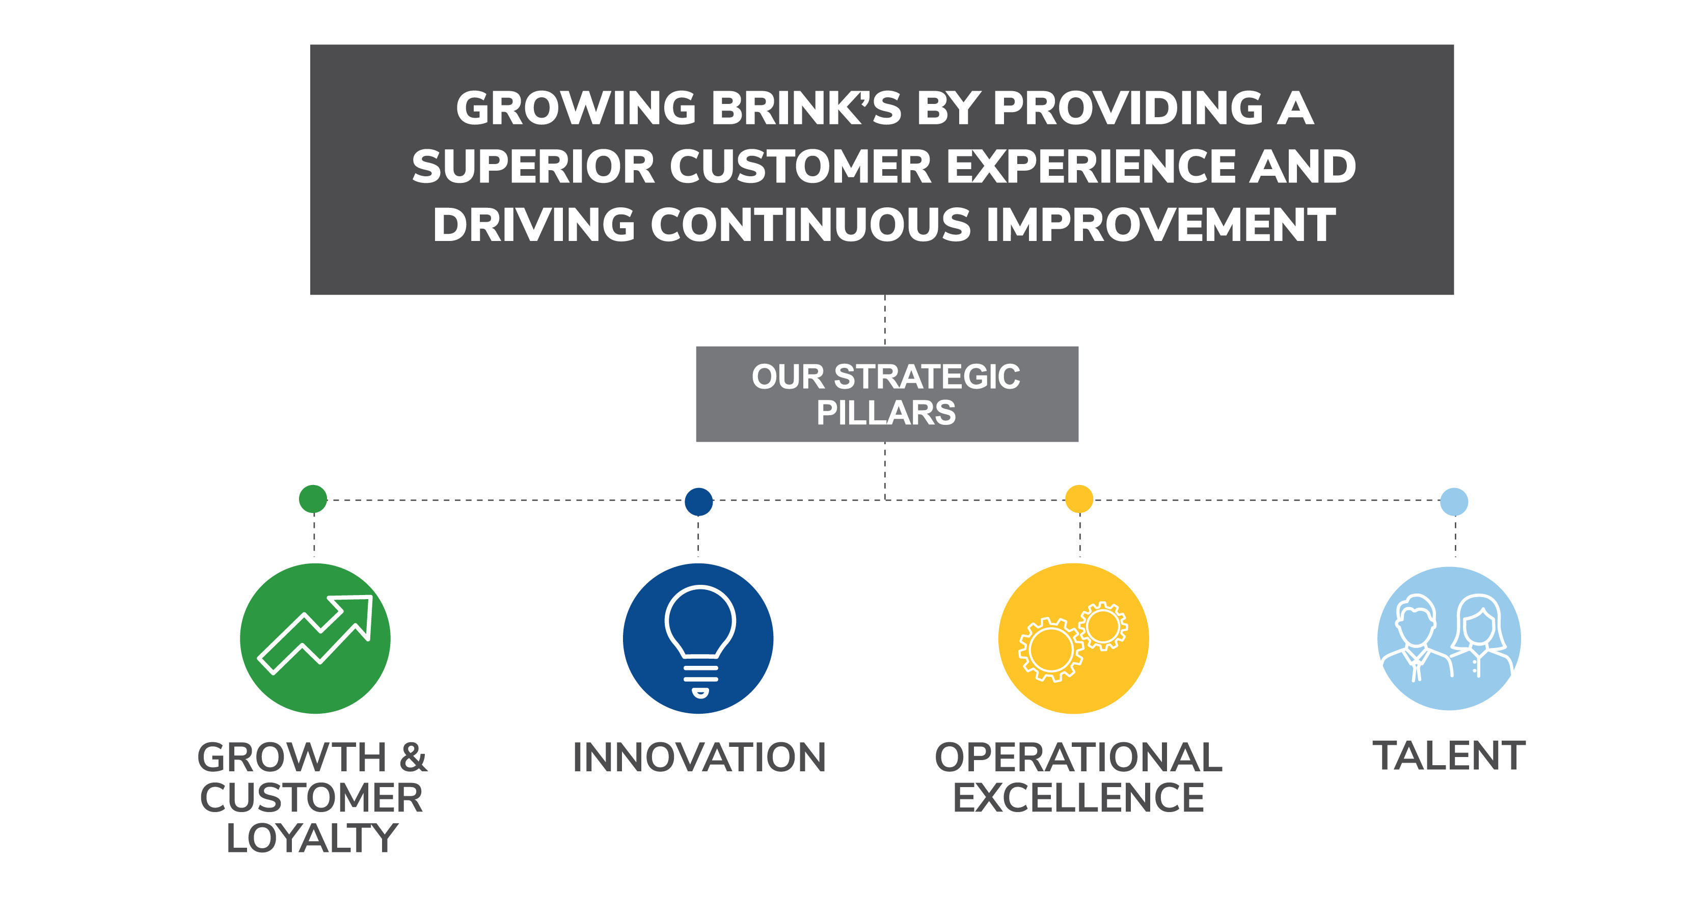
Pinnacle Awards | At A Glance
Global recognition program launched in 2019; categories reflect updated strategy
Celebrates the best of the best
Does not replace local programs
Six categories tied to our strategy:
  Growth & Customer Loyalty
  Innovation
  Operational Excellence
  Talent
  Sustainability
  Ethics & Compliance

Slide 4
Eligibility
All Brink’s employees, excluding members of the Executive Leadership Team, are eligible
Employees may nominate themselves, colleagues or teams
  Teams can be cross-functional within a country or cross-border
  There is no team size limitation
Winning nominations will be based on measurable performance (e.g., success in accelerating growth and improving customer strategy, use of global digital solutions to create value, address challenges), and qualitative factors (e.g., customer and employee feedback, obstacles overcome, situational factors, shared/adopted best practice, etc.).

Slide 5
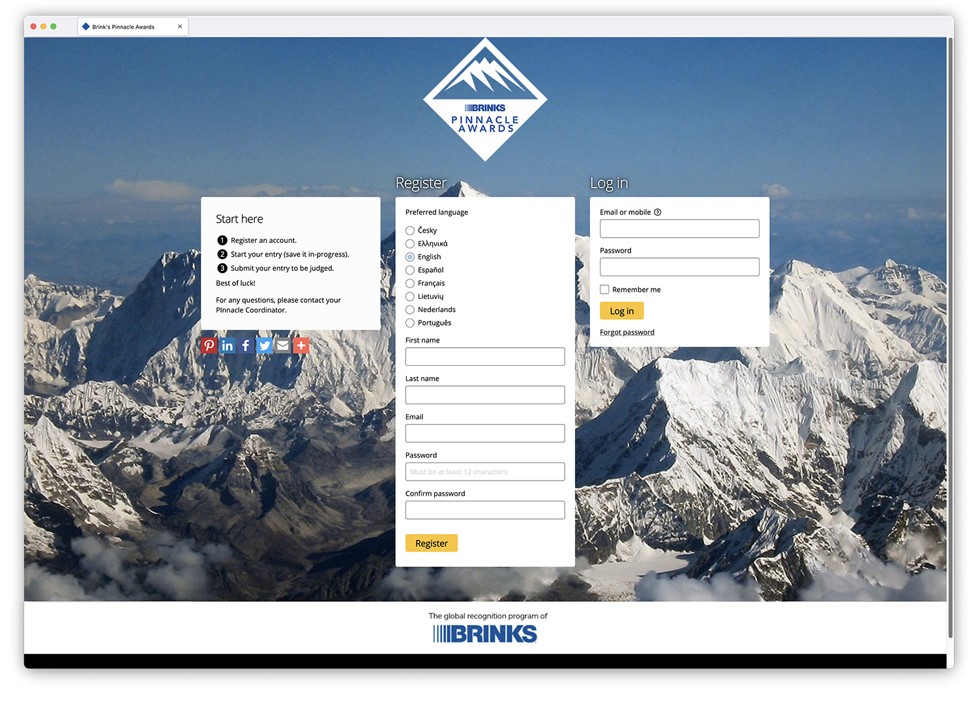
Nomination Process
Employees at any level or in any role can nominate themselves, individuals or teams (excluding the ELT) using our digital nomination form at https://brinks.awardsplatform.com
  User-friendly nomination platform
  Form asks for a summary of the project
  and measurable results
Nominations are due by 11:59 p.m. ET on Jan. 12, 2024

Slide 6

Selection Process
January – March 2024
NOMINATIONS DUE JAN. 12
1
GMs review local nominations and select top 3 to advance to their regional/functional leader
GM/Local Review
Late January
2
Regional and functional leaders choose finalists from their regions/areas
Regional Review
Early February
3
ELT convenes to review/calibrate regional finalists and choose global finalists
ELT Review
Mid February
Mark Eubanks selects and announces winners
4
Mark
March

Slide 7


Winner Announcement and Celebration
Recognition
  Mark Eubanks will make a company-wide announcement in March 2024
  Local Pinnacle Awards celebrations will
  be held in accordance with local health
  and safety guidelines
Awards
  Winners will receive an award to display at head offices or in branches
  Individuals will receive a recognition pin

Slide 8
Nominate great work you observe or participate in!
https://brinks.awardsplatform.com

