Slide 1
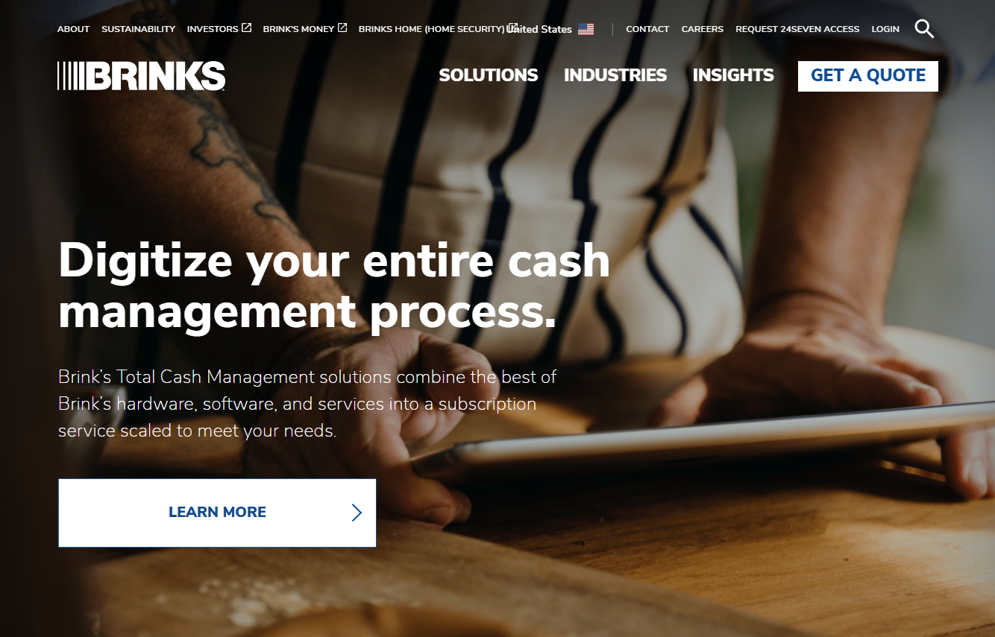
Country Website Training

Slide 2
Outline
Liferay Overview
Signing in to the account
Site and Personal Menus
Site Menu
Personal Menu
Page Content structure
Asset Publishers
Documents and Media
Categories and Tags
Country’s capability and limitations in maintaining the site
Brink’s Guideline
Can and Can’t dos
Country Site Content Workflow
Staging and Live
Different types of contents
Different types of roles
Workflow Example
Site Maintenance Tutorial
Web Contents
Editing Existing Web Contents
Job Opportunities
Insights
Notifications
Financial Statements
Publishing Site

Slide 3
Liferay Overview

Slide 4
Signing in to the account
To sign in to the account, first add “/web/guest” to the end of the base URL of the country.
Note that the extension must be added right after “.com”.
Ex.) us.brinks.com, ca.brinks.com

Slide 5
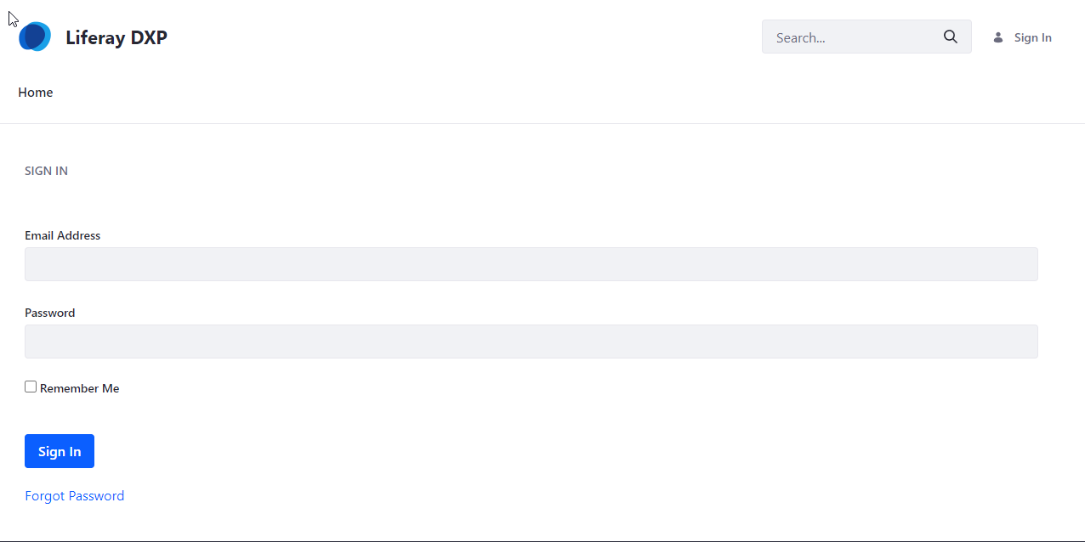
Signing in to the account
Once you load the URL on the previous slide, the Sign In page will be loaded as seen on the left
Roles Associated with the Countries | Summary of the Role
Brinks Country Approver | Has access only to the assigned country site. Able to manage, approve and publish contents.
Brinks Country Writer | Has access only to the assigned country site. Able to manage contents.

Slide 6
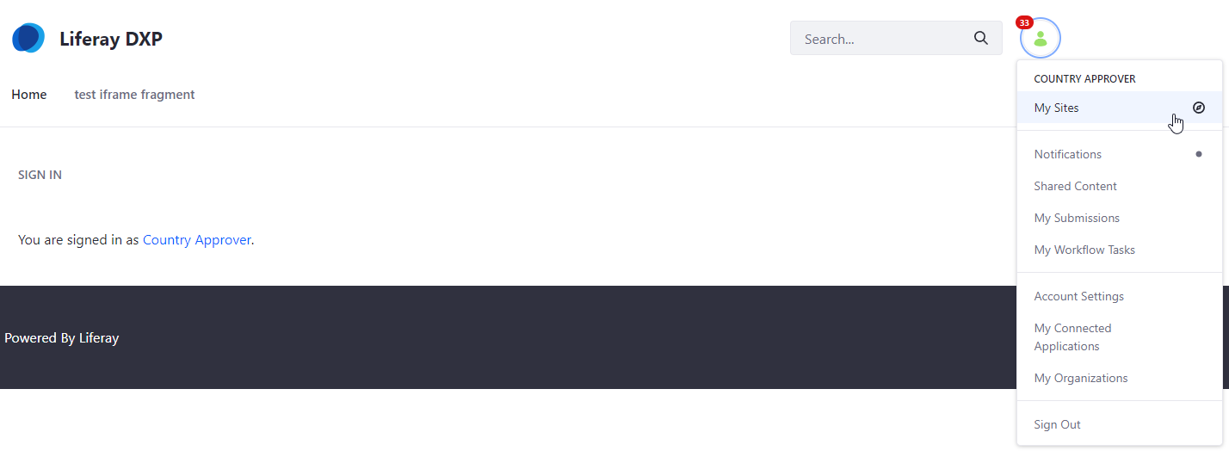
Signing in to the account
After Signing in, click My Sites under the Profile icon.

Slide 7
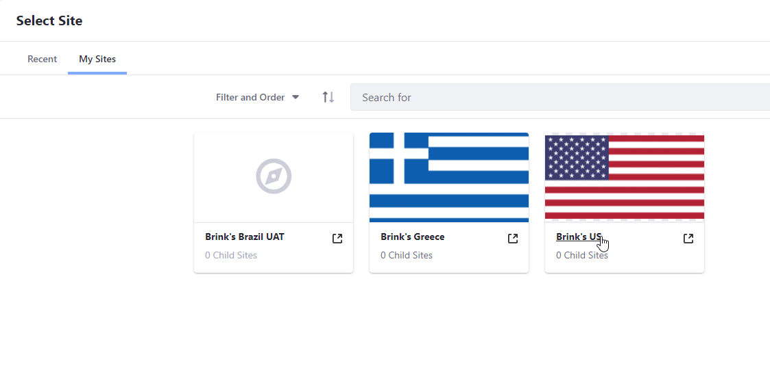
Signing in to the account
Move to My Sites tab and then click the country to work on.

Slide 8
Site and Personal Menus
Site Menu: Contains menus related to site and content management.
Personal Menu: Contains menus related to account and task management.

Slide 9
Site Menu
Site Menu is used to navigate through pages related to the site maintenance.
Site Menu can be closed or expanded by clicking the side panel button.

Slide 10
Site Menu
The compass button in the site menu is used to navigate to different country site, if the user is assigned to more than one country.

Slide 11
Site Menu
After clicking the compass button, Select Site page comes up to let the user navigate to another site.

Slide 12
Site Menu
Content & Data menu is used to maintain the actual content within the page.
Web Content includes all content, structure and template files that are used within a page.
Documents and Media contains the files such as pdf and images that are used within a page.

Slide 13
Site Menu
Categorization menu is used to view the categories and tags that are available to use within web contents.

Slide 14
Site Menu
Publishing menu is used to view the current or past records or page publishment.

Slide 15
Personal Menu
Personal Menu is used to manage the assigned work and account of the user.
Personal Menu can be accessed in Sign In page or in any page under Site Menu through the profile icon.

Slide 16
Personal Menu
My Sites is used to navigate through the assigned sites.
Notifications is used to notify the update on the user’s submitted or assigned works.
My Submissions is used to keep track of the user’s submitted works.
My Workflow Tasks is used to keep track of the user’s assigned works.
Account Settings is where the user view the account information and update the account password.

Slide 17
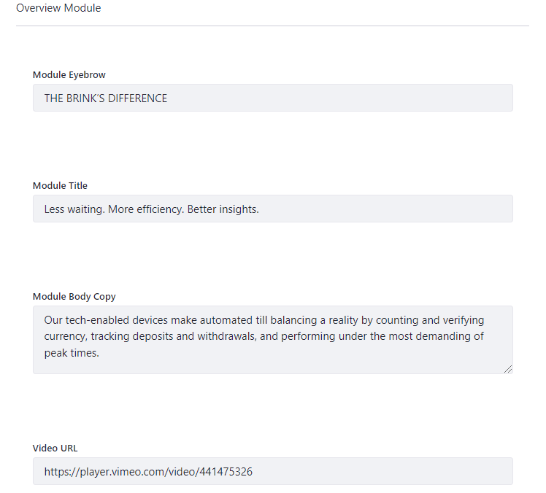
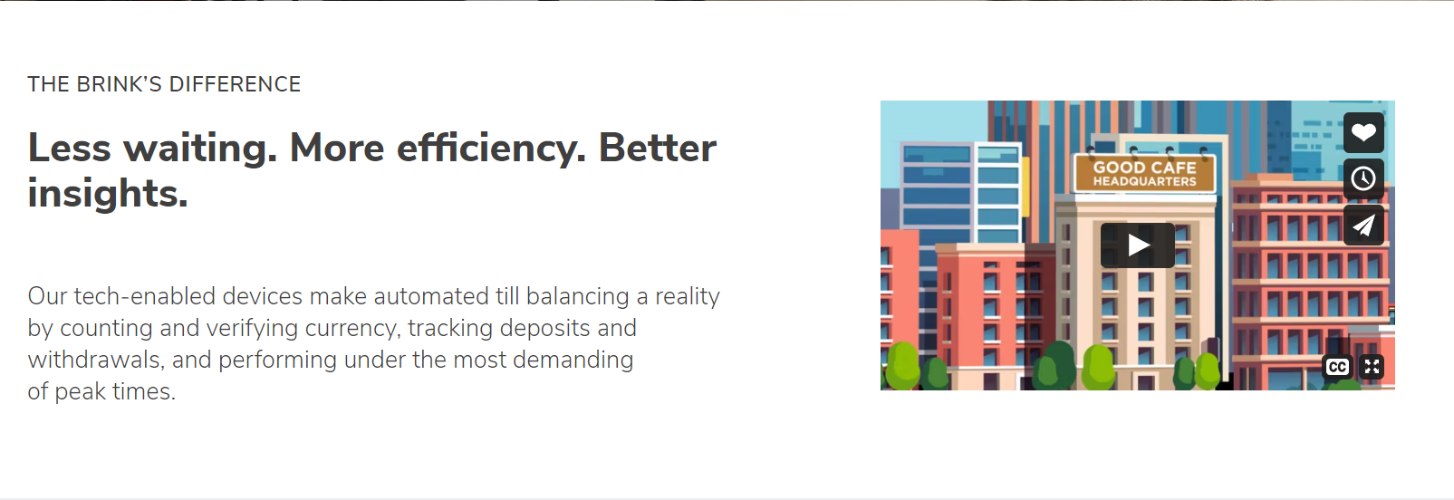
Page Content Structure
A content in page typically consists of three items:
Structures: Structures create the fields used within templates and web contents.
Templates: Templates determines the positioning and the design of each fields for the content.
Web Content: Web Content are the texts, images or files that fill out the fields created by the structures. This is what gets displayed on a page.

Slide 18
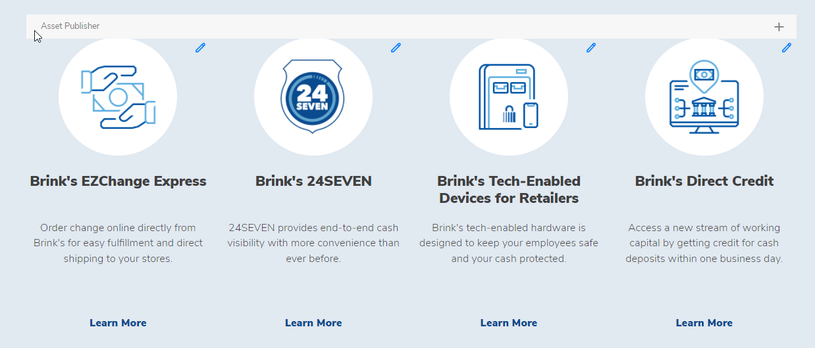
Asset Publishers
Asset Publishers are used to display multiple contents in a list or table format within a page.
There are multiple designs of Asset Publisher available.

Slide 19
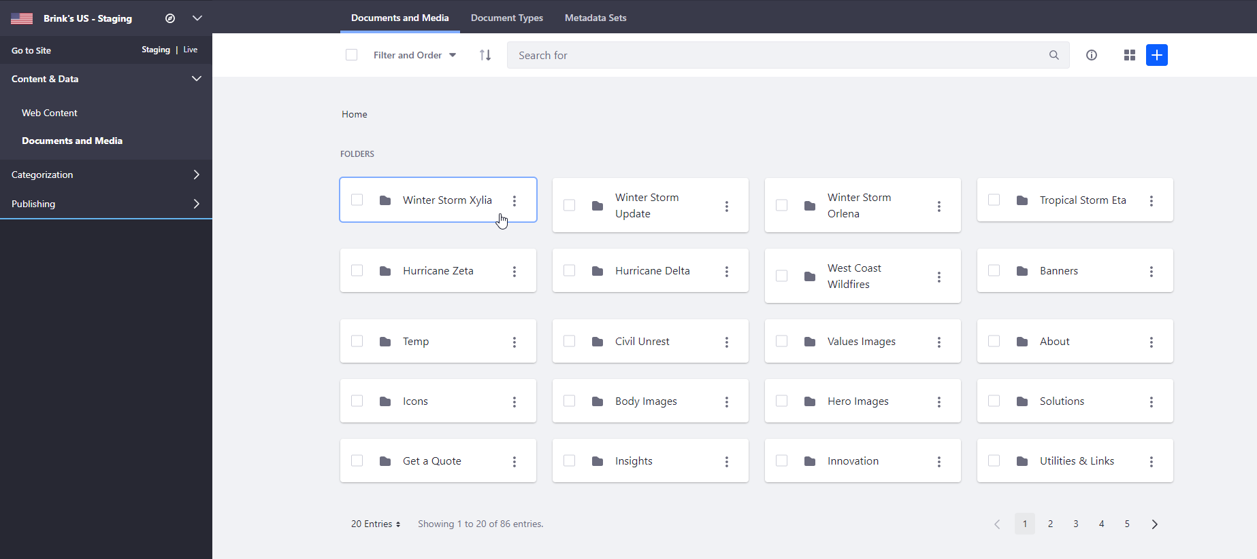
Documents and Media
Documents and Media is used to store files such as PDFs and images in the internal database. These files then can be used in web contents.
Documents and Media can be found under Content & Data in the side panel.

Slide 20
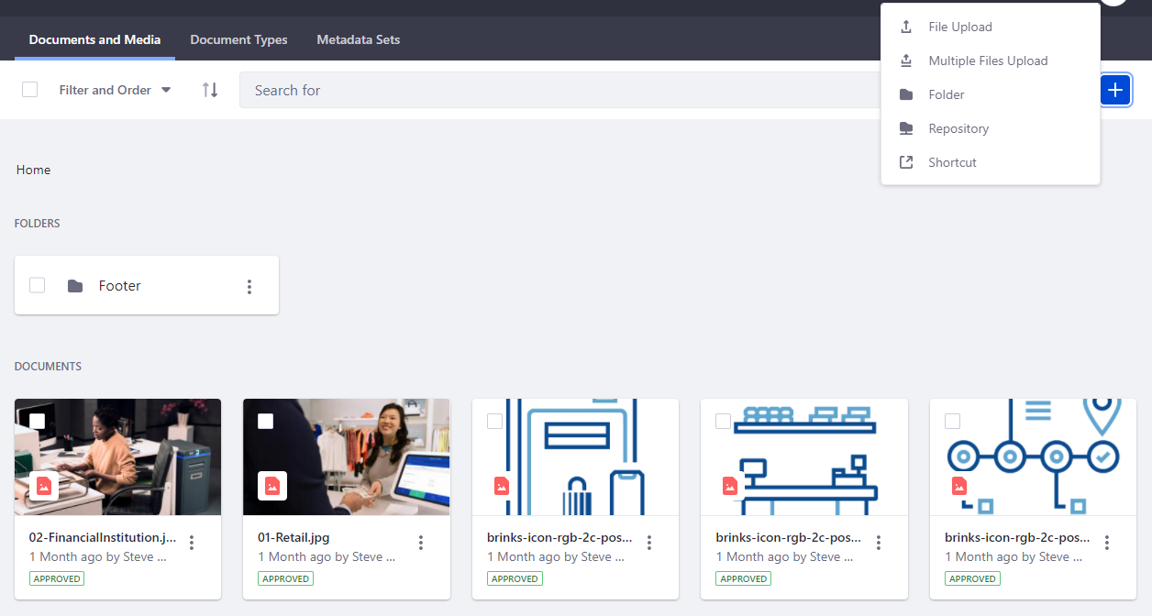
Documents and Media
Documents and Media can be organized using folders.
To upload files or create a new folder, click the plus icon and select the corresponding option.

Slide 21
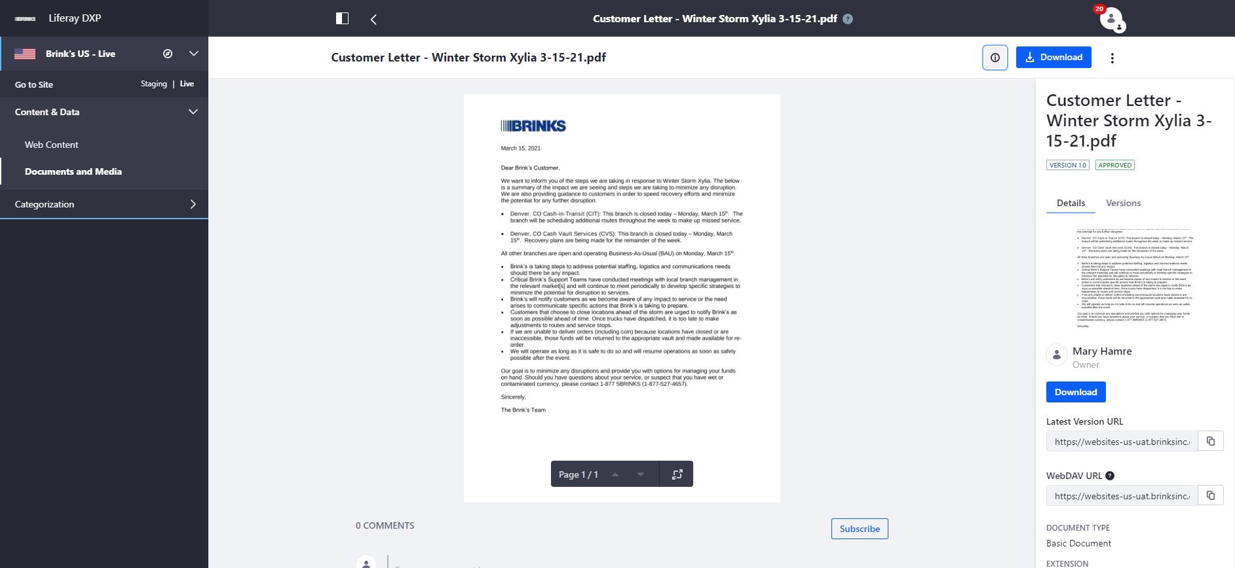
Documents and Media
The files in Documents and Media can also be accessed by external sites through a URL.
URLs are different in Staging and Live for all files in Documents and Media.

Slide 22
Documents and Media
To access the URL of the document, click Info, and then copy the Latest Version URL.

Slide 23
Categories and Tags
Categories and Tags are used to filter or manage the contents.
Categories are useful in filtering a content in Asset Publisher.
Tags are useful in managing the contents based on the tags that the content is associated with.

Slide 24
Categories
To create a new category, go to Categories under Categorization in the side panel.
There are sets already created for country to add different categories.
Click the set that corresponds to the purpose of the category.

Slide 25
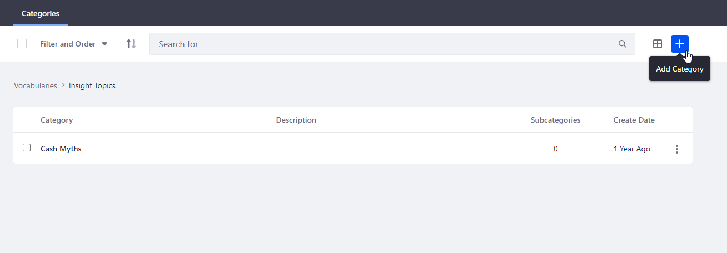
Categories
Within the set, click the plus button to add a new category.

Slide 26
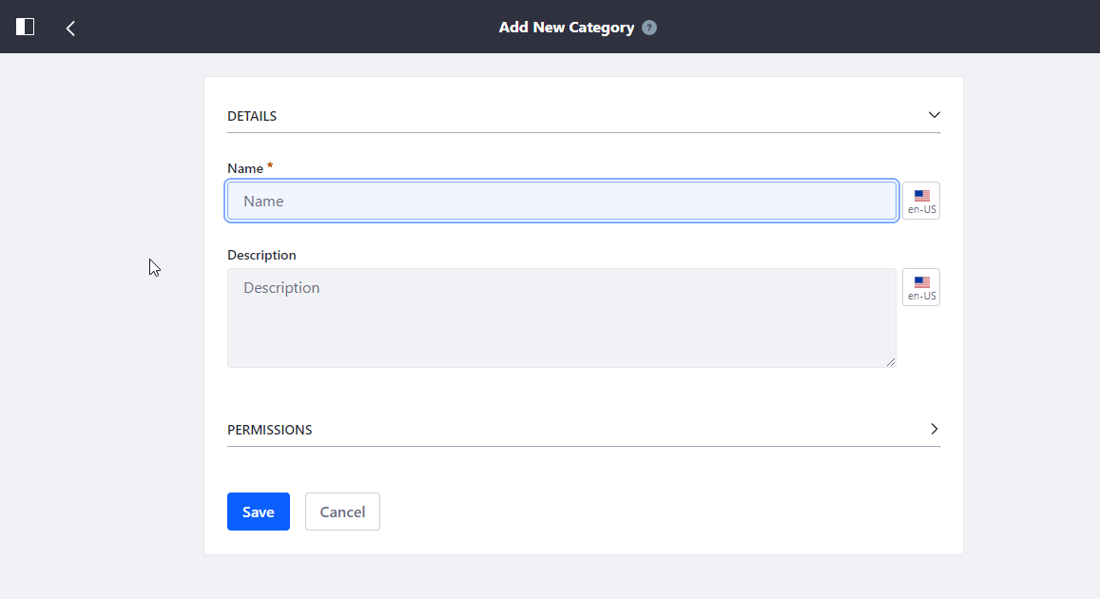
Categories
Insert information for the new category and save.

Slide 27
Tags
To create a new tag, go to Tags under Categorization in the side panel.
Click plus icon to add a new tag.

Slide 28
Tags
Type the name for the tag and click save.

Slide 29
Country’s capability and limitations maintaining the site

Slide 30
Brink’s Guideline
Brink’s goal is to have uniform sites/branding across countries.
Brink’s has a Global site that maintains structures, templates, web contents, files, categories and tags that are shared among all country sites.
To maintain the uniformity among different country sites, there are guidelines on what the country can or can’t do in the site.

Slide 31
Can and Can’t Dos
Can
Edit contents in existing pages (Except for Corporate pages)
Create new Job Opportunity contents
Create new Insight contents
Create new Notification contents
Create new Financial Statements contents
Publish the site (Depends on the role)
Can’t (Without explicit permission from Brink’s Marketing)
Create new pages
Delete pages or contents
Edit Corporate pages
Delete files from Documents and Media
Edit Navigation menus
Edit SEO

Slide 32
Country Site Content Workflow

Slide 33
Staging and Live
Staging: The version of website where updates to the site is made before becoming visible to the users. All the updates in this version must be confirmed through the Brink’s site workflow.
Live: The version of website that is visible to the users. After the updates in Staging is confirmed and becomes ready for publication, the updates are published to Live and become available for the users.
Content is edited or created in staging
Content is approved through a workflow and published to Staging
Content is published to Live

Slide 34
Different types of Contents
Digital: Web Contents in Brinks Digital Content folder (ex. Home, SEO, Privacy Policy, Terms of Use)
Corporate: About – Overview, Strategy, Values, Leadership, History (NOT Local Overview)
Global: Web Contents in Brinks Global Content folder (ex. Brink’s 24SEVEN)
BGS: Web Contents in Brinks BGS Content folder (ex. Brink’s Global Services, Private Client Storage)
Notification: Web Contents in Notifications folder
Country: Everything else
Different countries may have different contents in each folder based on Brink’s guideline.
Each type of contents result in a different workflow.

Slide 35
Different types of Roles
Actor Description | Actor Description | CRUD
Brinks Country Approver | Has access to edit and approve Country content. Site role, so only has access to the site they are assigned to. | Create job opportunities, insights, notifications and financial statements, and can read and update everything else. Can publish site assigned.
Brinks Country Writer | Has access to edit and approve Country content. Site role, so only has access to the site they are assigned to. | Create job opportunities, insights, notifications and financial statements, and can read and update everything else. Can NOT publish

Slide 36
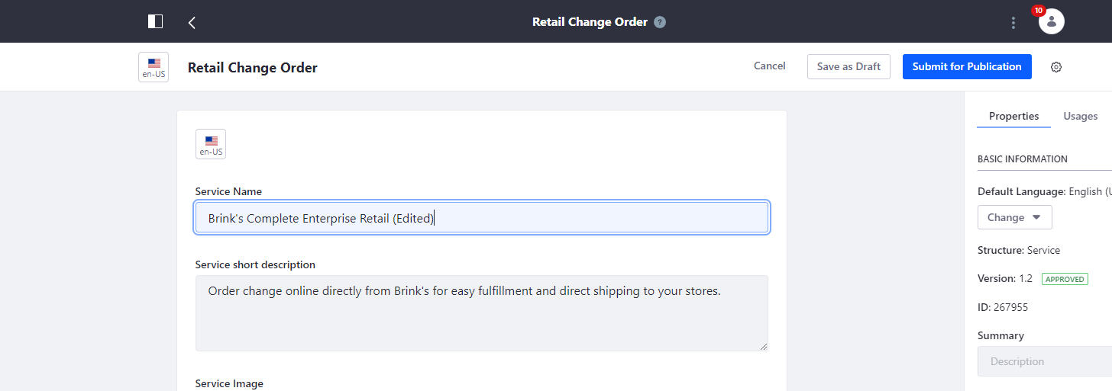
Workflow Example
Country Writer edits a content and submits.

Slide 37
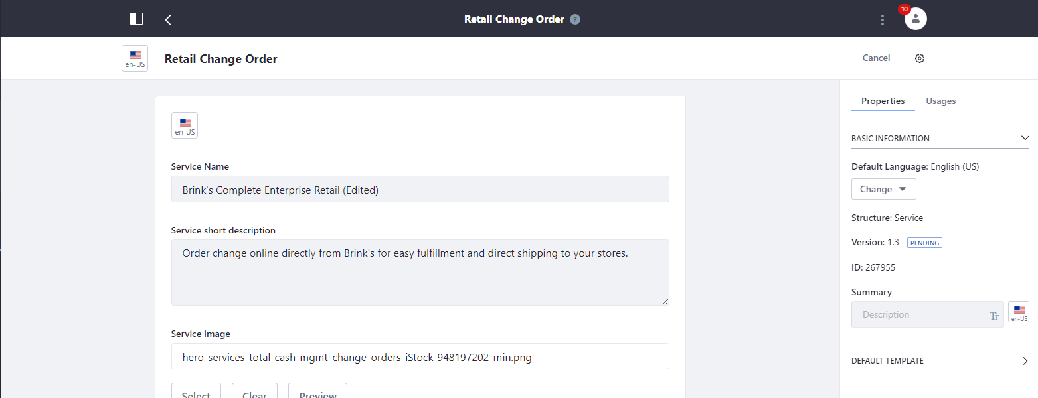
Workflow Example
After the submission, pending status can be seen.

Slide 38
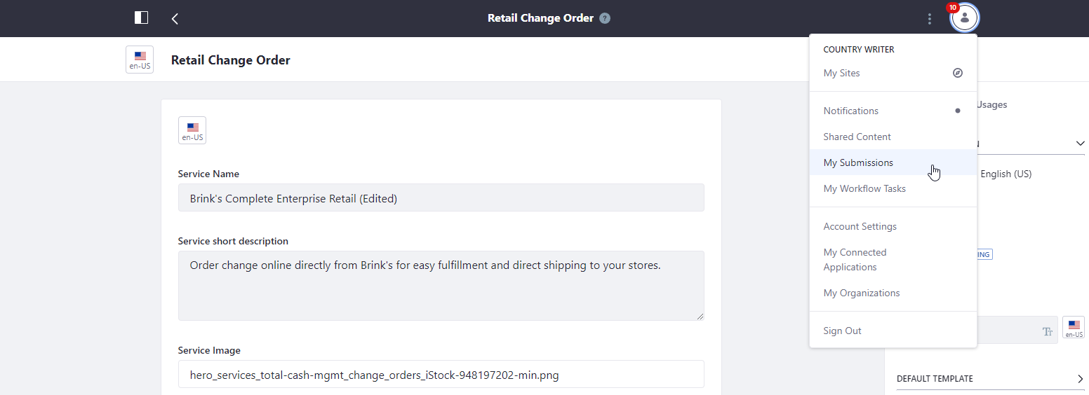
Workflow Example
To check which workflow the submission is in check My Submissions.

Slide 39
Workflow Example
The status of the submission can be seen in My Submissions.

Slide 40
Workflow Example
If the submitted task has to be withdrawn, click three-dotted menu next to the task and click Withdraw Submission.

Slide 41
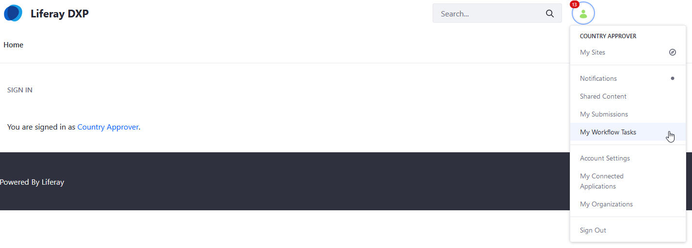
Workflow Example
Country Approver can check the newly submitted tasks in My Workflow Tasks.

Slide 42
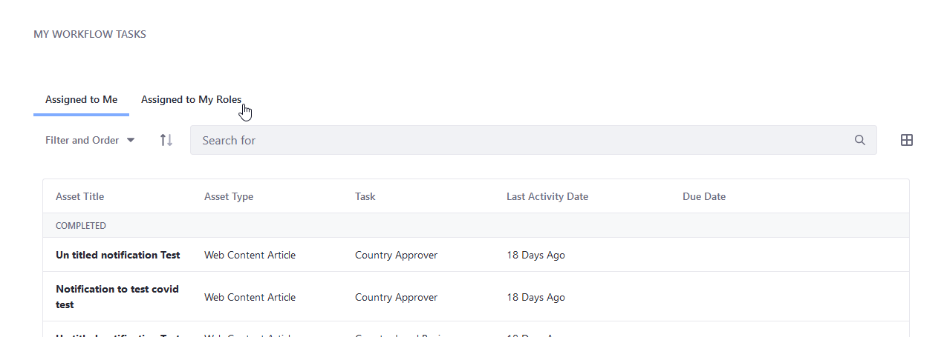
Workflow Example
To check the new tasks, click Assigned to My Roles.

Slide 43
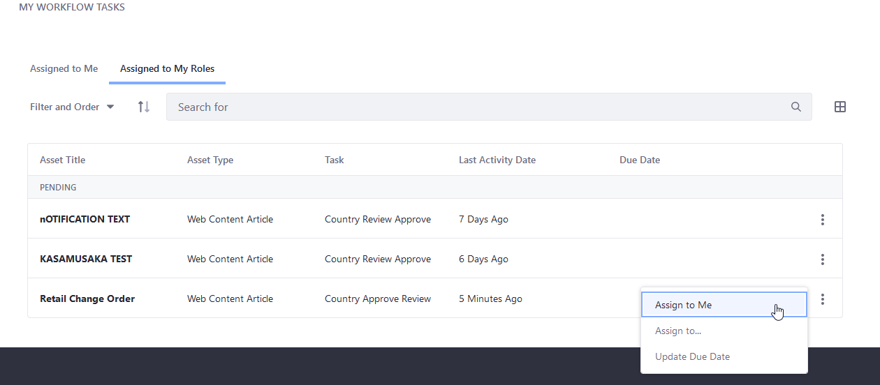
Workflow Example
Select a task to review and click Assign to Me.

Slide 44
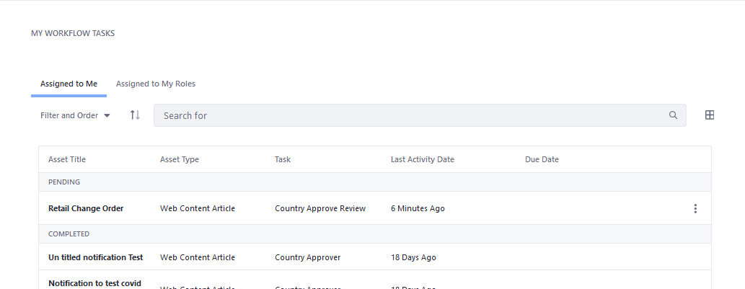
Workflow Example
The task can now be seen in Assigned to Me tab.
Click the task to review it.

Slide 45
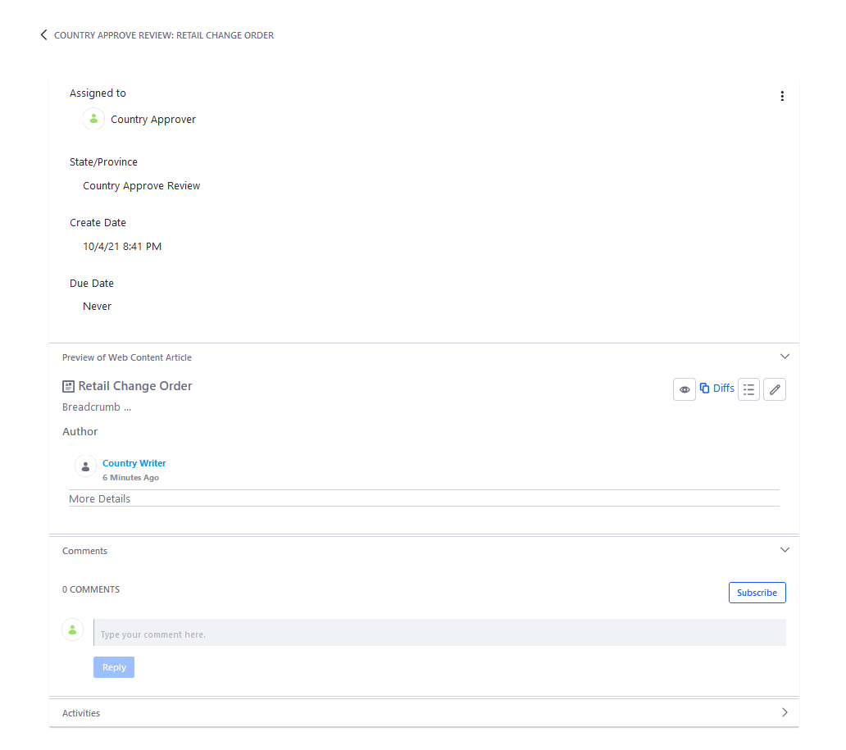
Workflow Example
Current state of the workflow process can be seen in review page.

Slide 46
Workflow Example
There are four buttons to assist in the review process.
View: Allows the approver to see preview of the edited content.
Diffs: Highlights the edited part of the content.
View Usage: Lists out places where the content is being used.
Edit: Allows the approver to edit the content.

Slide 47
Workflow Example
The approver can also leave comments for a feedback or to ask about certain aspects of the edit.

Slide 48
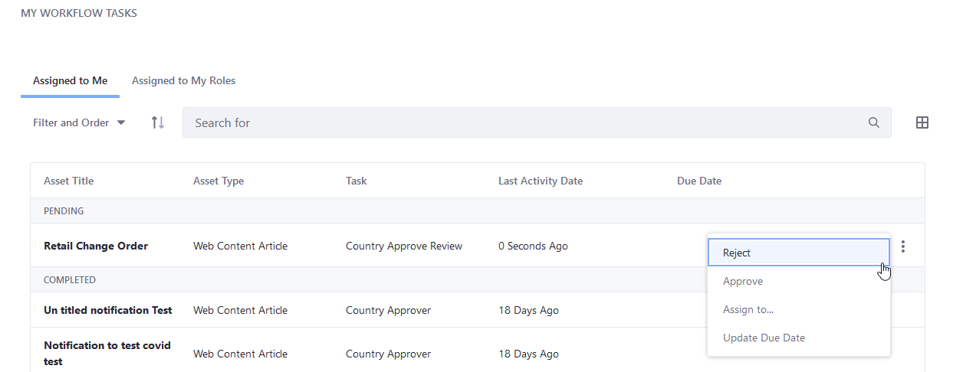
Workflow Example
After reviewing the content, the approver has the options to reject, approve, or assign the task to someone else.
In this example, the approver rejects the update.

Slide 49
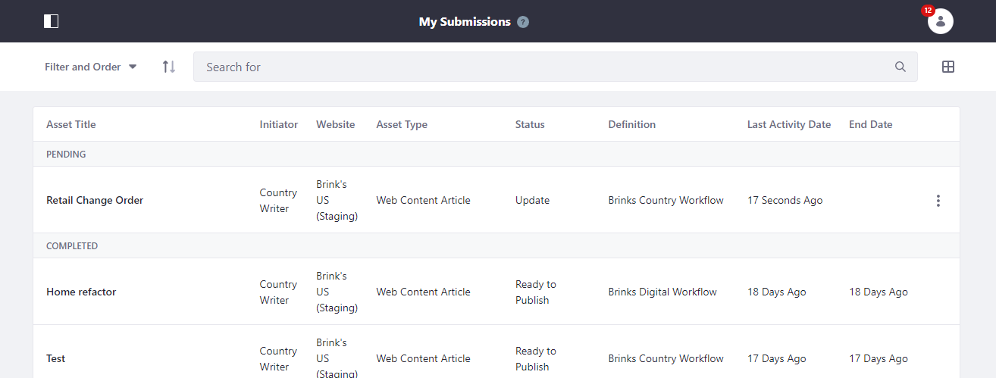
Workflow Example
After the approver rejects the content, the status changes in Country Writer’s submission page.
Country Writer also receives a notification through the site and email about the status update.

Slide 50
Workflow Example
The rejected task is also added to My Workflow Tasks for the user to make the update on it.

Slide 51
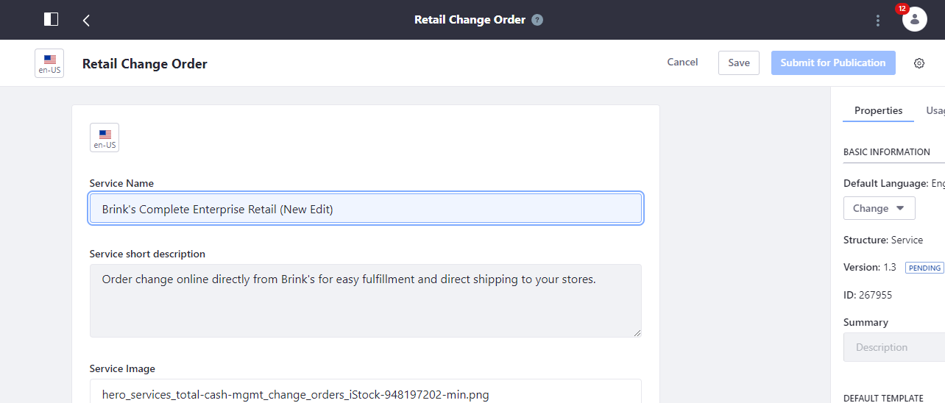
Workflow Example
Country Writer makes a new edit and clicks Save.
Note that Submit for Publication button is inactive because this is a resubmit.

Slide 52
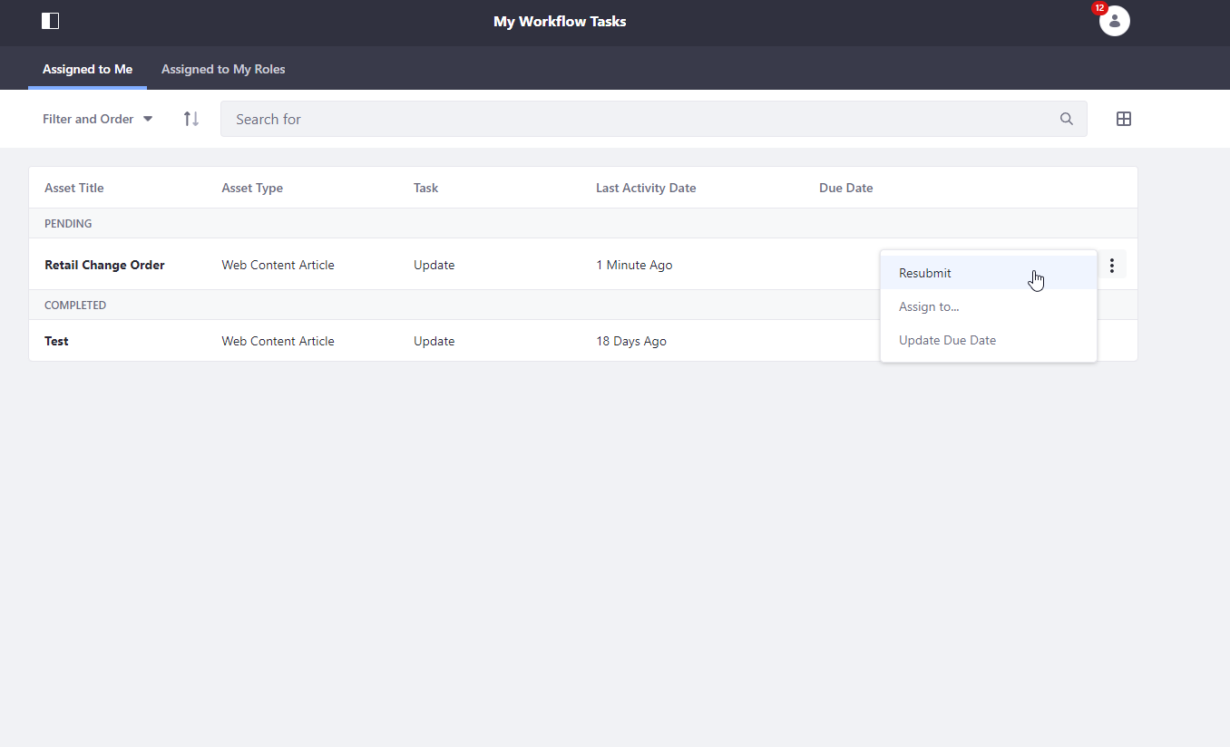
Workflow Example
After making new edit, go to My Workflow Tasks to resubmit the edit.

Slide 53
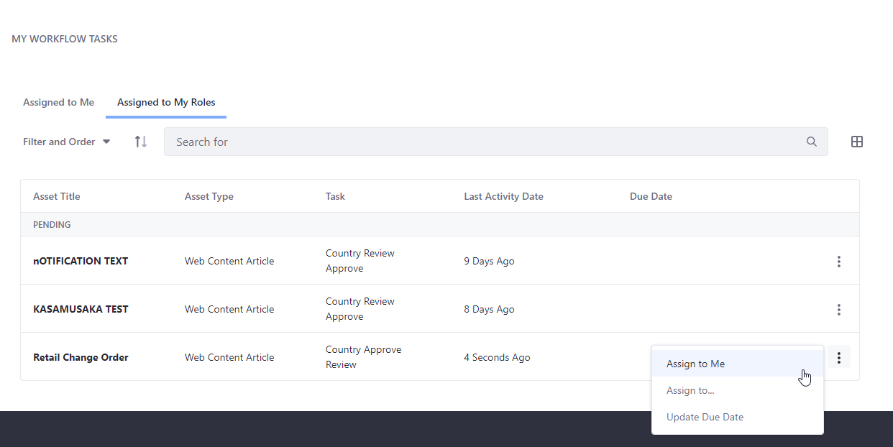
Workflow Example
After Country Writer resubmits the content, Country Approver reassigns the task to self.

Slide 54
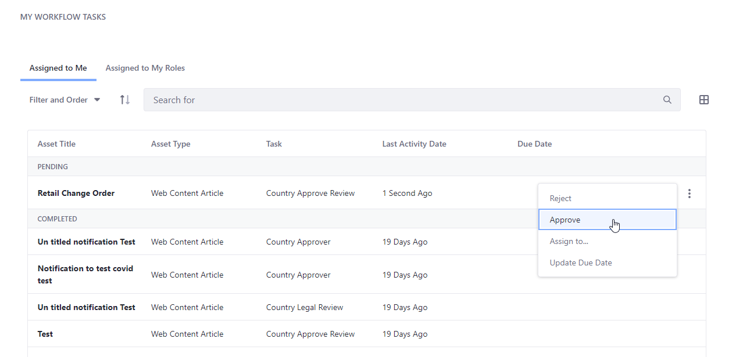
Workflow Example
Country Approves the edited content after reviewing it.

Slide 55
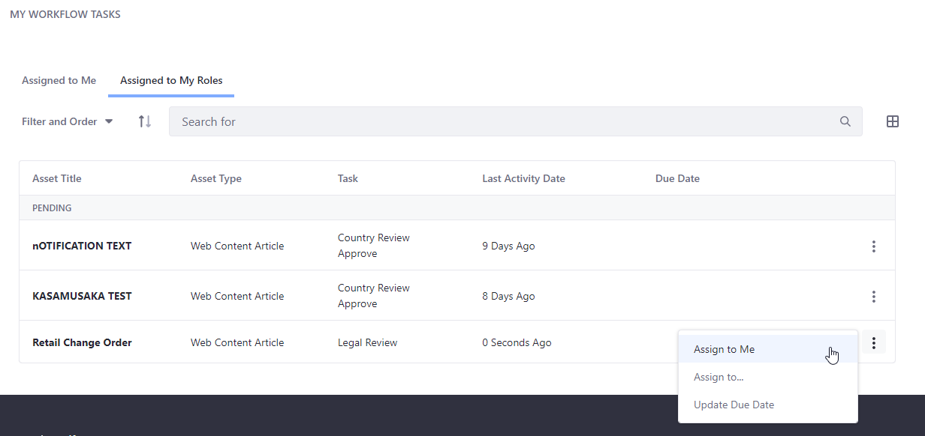
Workflow Example
Country Approver now must perform Legal Review.

Slide 56
Workflow Example
Country Writer can also track the status through My Submissions page.

Slide 57
Workflow Example
Country Approver approves the content after a legal review.
Make sure to leave the legal basis of approval in the comment during the review.

Slide 58
Workflow Example
If the Country Approver rejects the content after the legal review, the process starts over, and Country Writer will have to resubmit the content after editing it.

Slide 59
Workflow Example
After Country Approver approves the content, the status is updated in Country Writer’s My Submission page.
Note that the Submit for Publication button is active again, so different content editors can edit the content again.
The content is now published to Staging and ready to be published to Live.

Slide 60
Site Maintenance Tutorial

Slide 61
Web Contents
With the current Brink’s guidelines, countries can edit any existing web contents except for the Corporate contents (About page).
Countries can also create the following four contents:
Job Opportunity contents
Insight contents
Blog Posts
Case Studies
Events
Notification contents
Financial Statements contents
PDF Tabs
Year Tabs

Slide 62
Editing existing web content
Before editing of creating a content, if switch to Staging.
In the Live version of the site, contents cannot be edited to enforce the workflow of each content.

Slide 63
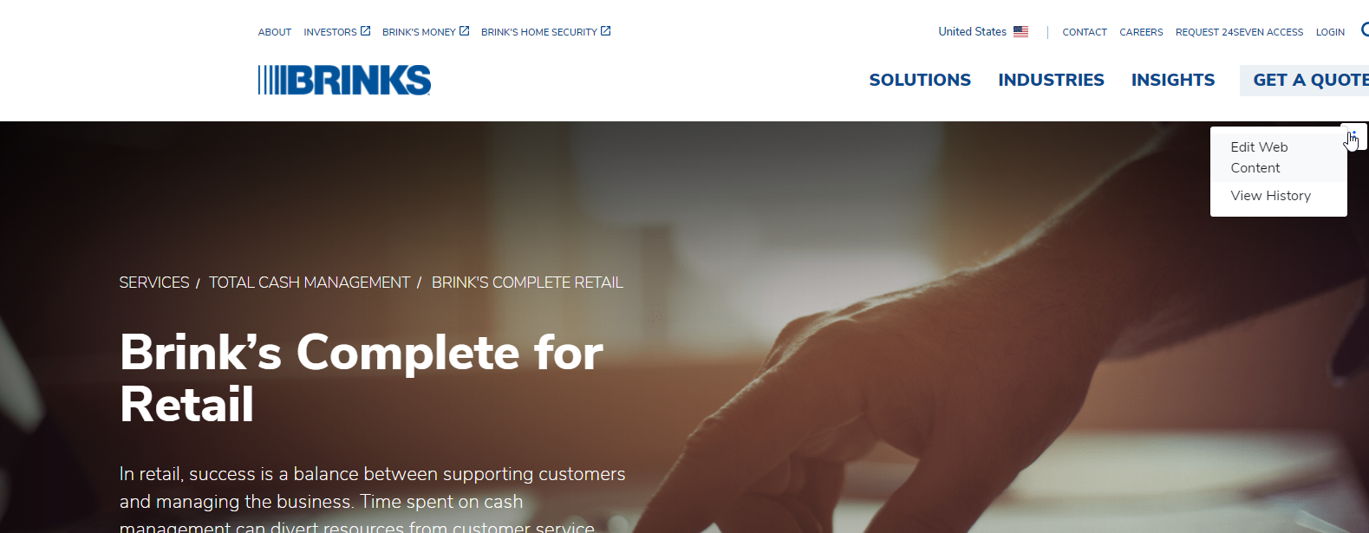
Editing existing web content
The edit button can be found in the three-dotted menu on the top right corner of the content.

Slide 64
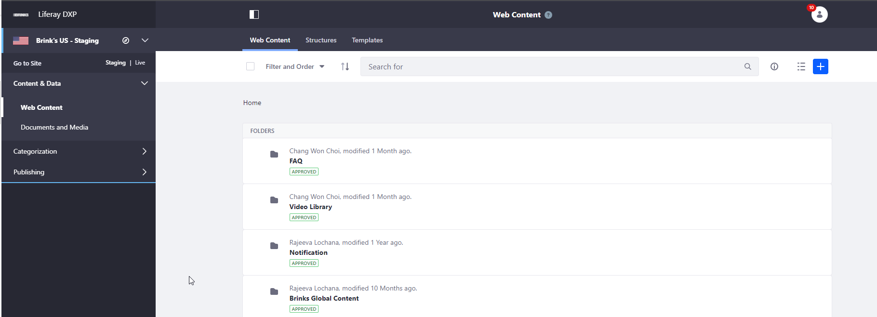
Editing existing web content
Web Contents can also be accessed under Content & Data menu in the side menu panel.
Simply click the content to edit it.

Slide 65
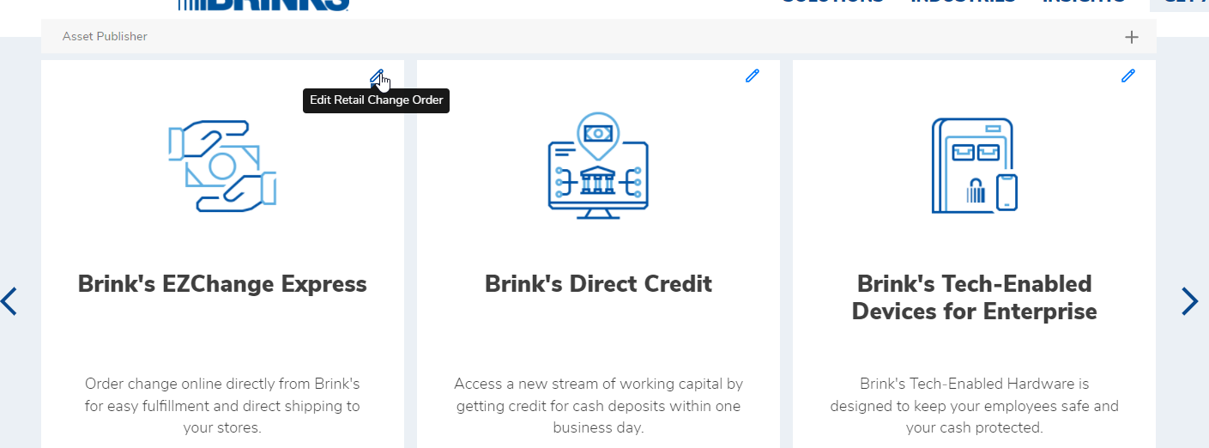
Editing existing web content
Some contents are displayed through asset publisher. The edit button for these contents are on the top right corner of each content card.

Slide 66
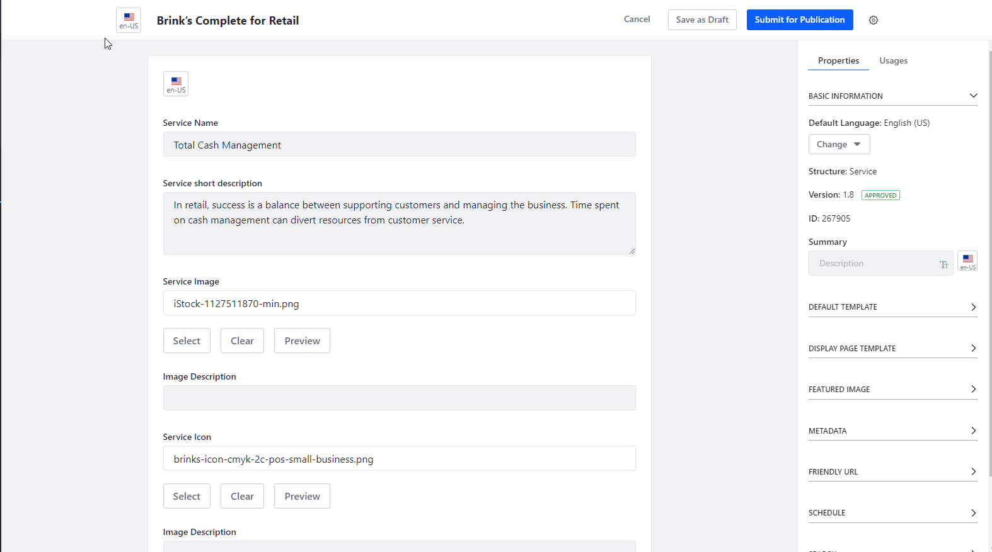
Editing existing web content
In the edit page, if the site uses multiple languages, the content language can be switched through the language button.

Slide 67
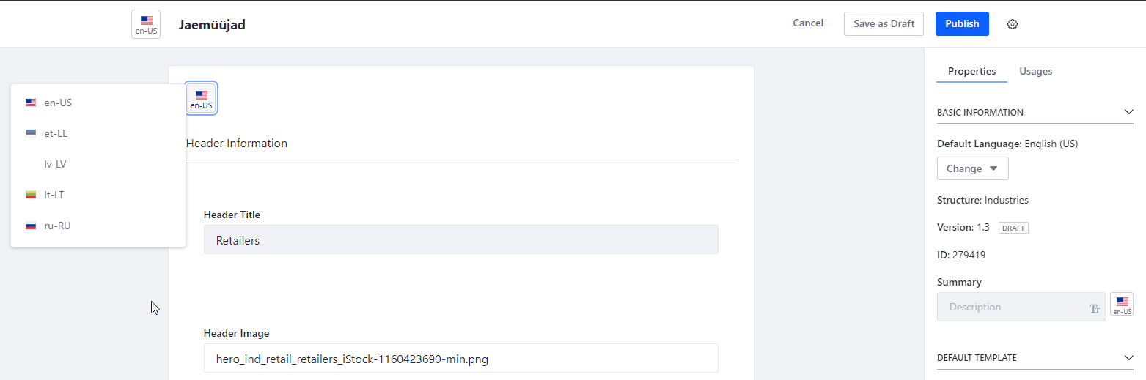
Editing existing web content
When the language option list is visible, select the language of the content to be modified.

Slide 68
Editing existing web content
The image of the content can be modified through Select, Clear and Preview button.
Select is used to select different image for the content.
Clear is used to remove the image from the content.
Preview is used to preview the image before publishing the content.

Slide 69
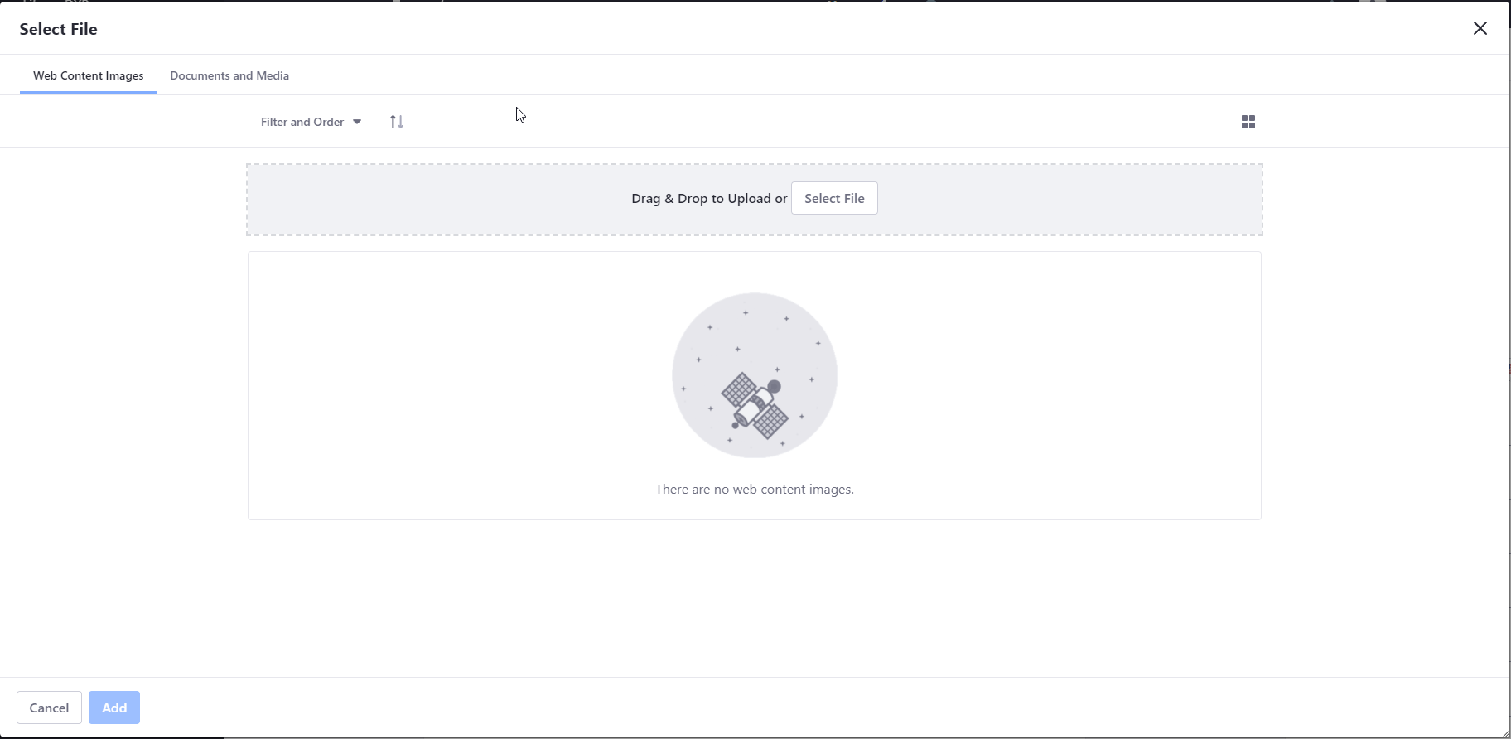
Editing existing web content
One option to select a new image for the content is to upload a new image.

Slide 70
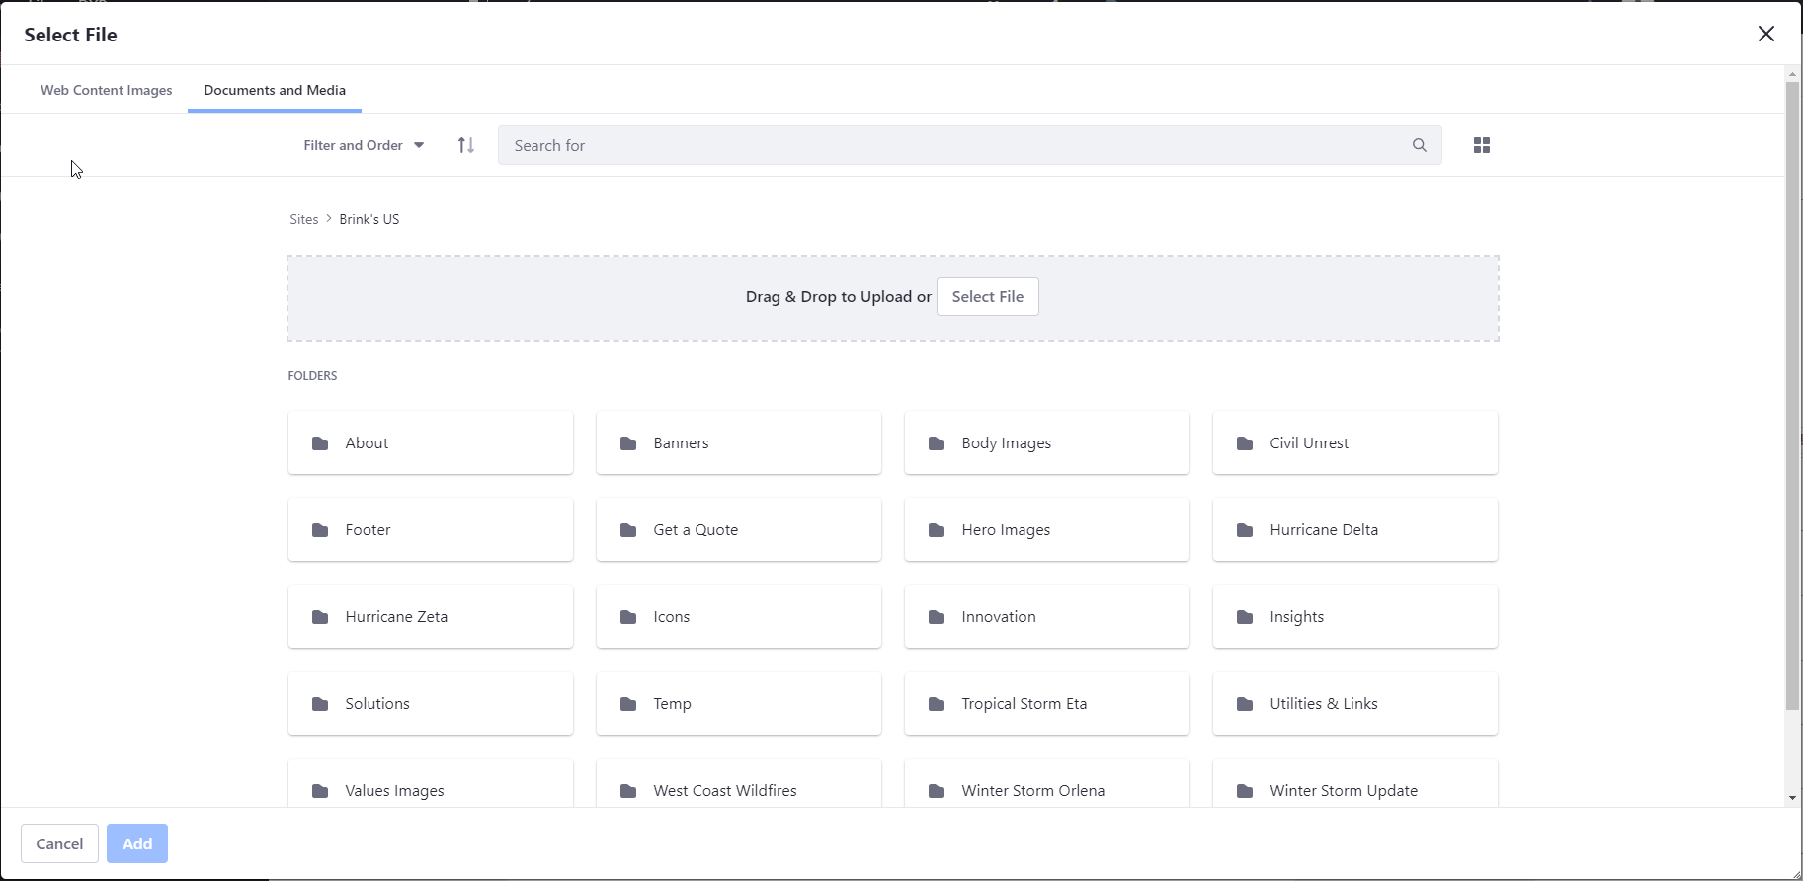
Editing existing web content
Another way to select a new image is using the existing images in Documents and Media.
A new image can also be uploaded directly to Documents and Media during content editing or creation.

Slide 71
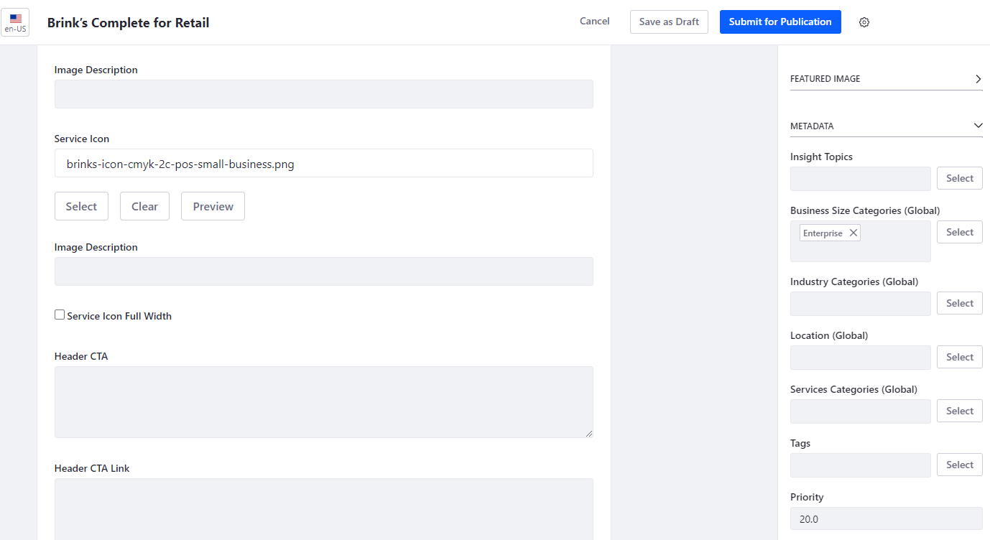
Editing existing web content
Metadata menu is used to attach categories or tags to the content.
Categories that doesn’t exist within country is indicated by the text “(Global)” added next to them.
Priority can be used to determine the order of the content within asset publisher.

Slide 72
Editing existing web content
Do not use Save as Draft button when editing the content because it results in an unexpected behavior.
To submit the change, click Submit for Publication button.

Slide 73
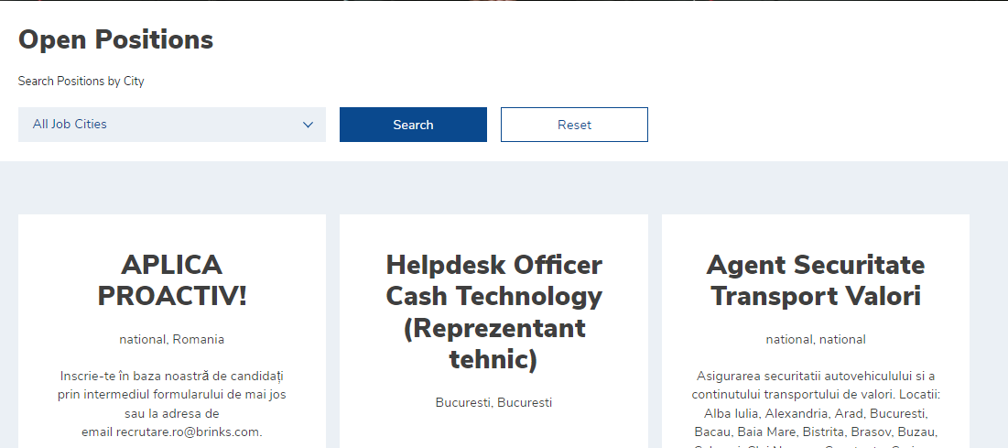
Job Opportunities
Some countries use Job Opportunities content for their Careers page.

Slide 74
Creating Job Opportunities
Job Opportunities folder can be found under Careers folder.
Careers folder can be found in Web Content menu under Content & Data in the side panel.

Slide 75
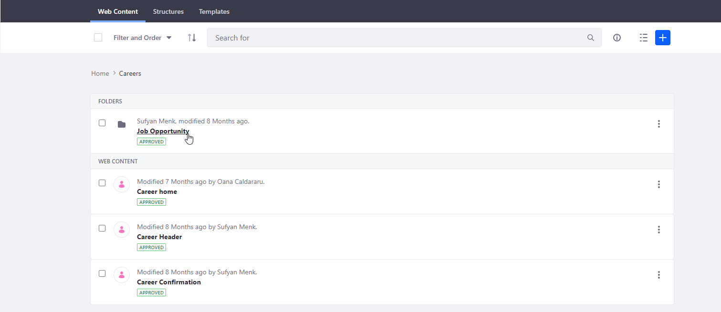
Creating Job Opportunities
Within Careers folder, click Job Opportunity folder to edit or create Job Opportunities contents.

Slide 76
Creating Job Opportunities
Click the plus button to add new Job Opportunity.

Slide 77
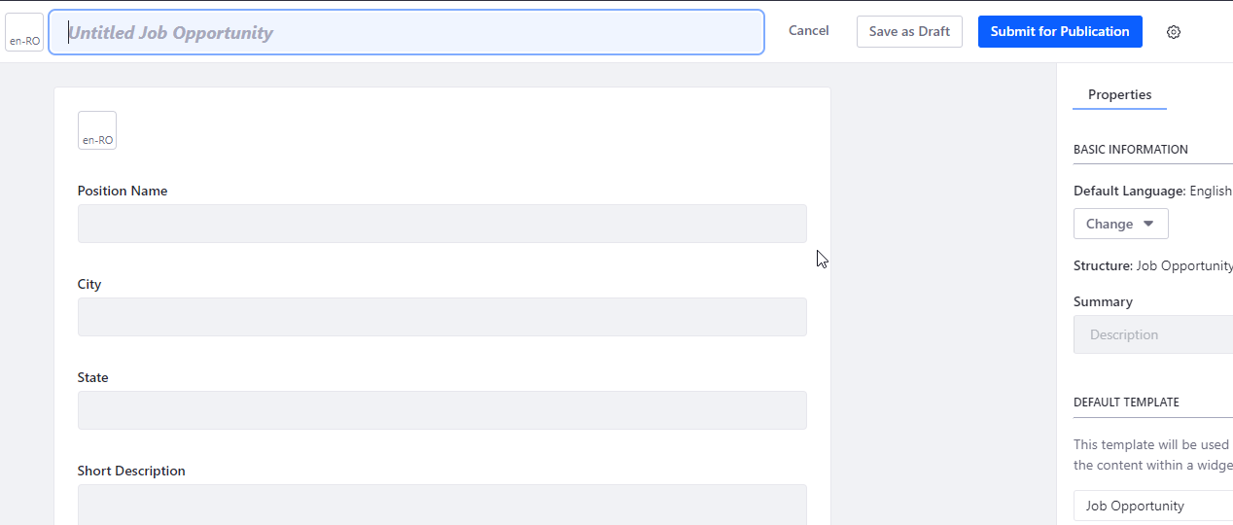
Creating Job Opportunities
City field in Job Opportunity is used to categorize the Job Opportunity contents based on city.

Slide 78
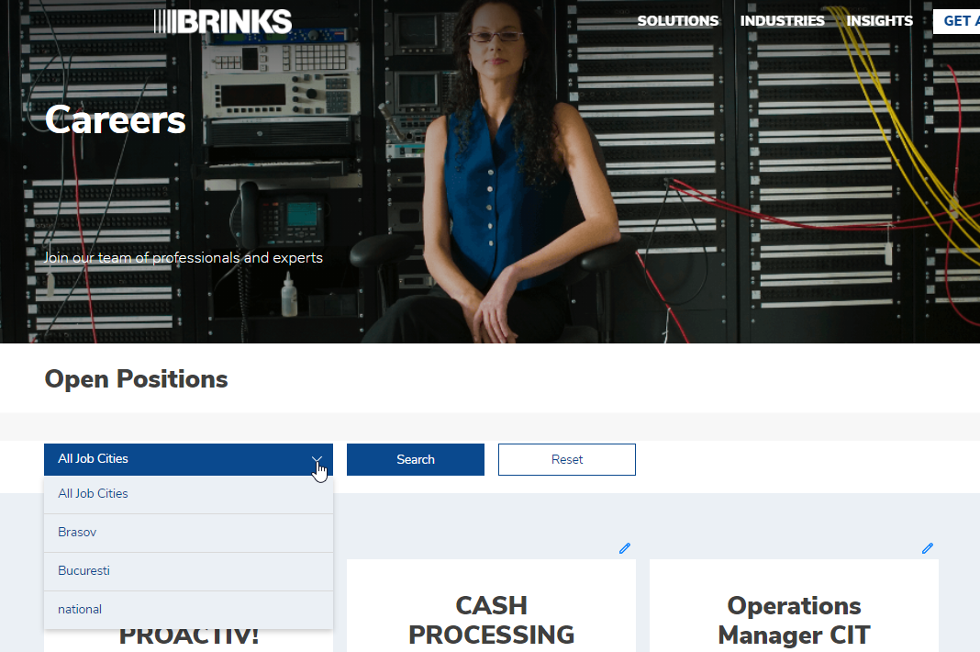
Creating Job Opportunities
Careers categorization menu is populated using the city fields of different Job Opportunity contents.

Slide 79
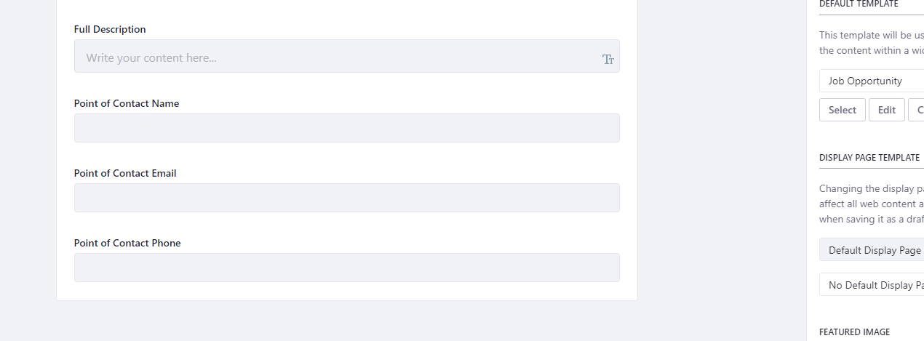
Creating Job Opportunities
Point of Contact Email is the email that all the applications or the submissions related to this Job Opportunity will be sent to.

Slide 80
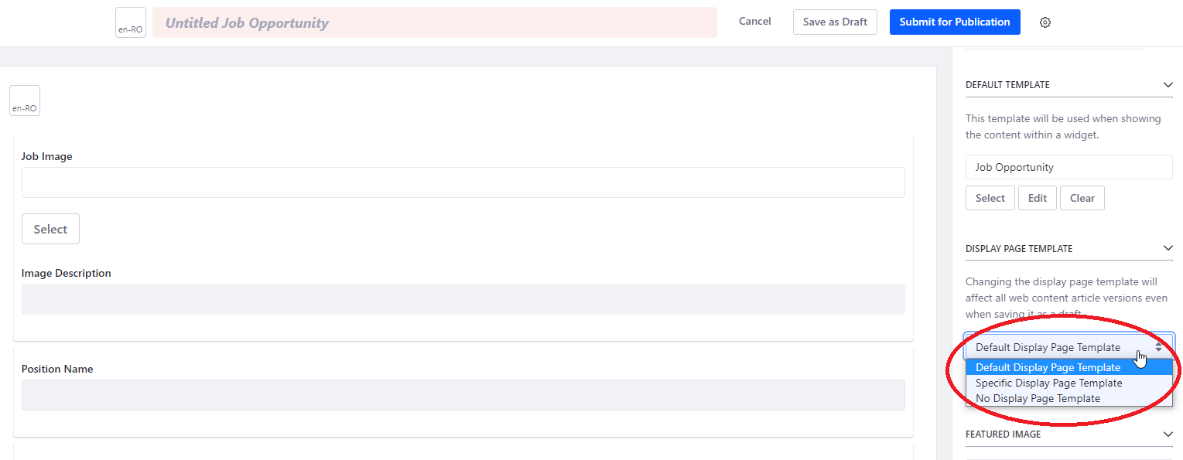
Creating Job Opportunities
For contents under Job Opportunities, Specific Display Page Template must be set.
Display Page Template allows a single page to display multiple contents one at a time

Slide 81
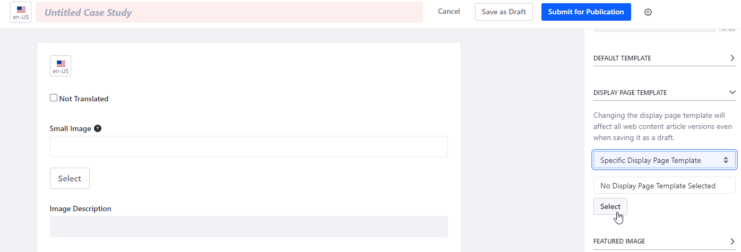
Creating Job Opportunities
After selecting Specific Display Page Template, click Select.

Slide 82
Creating Job Opportunities
In the Select Page popup, click Public Pages.

Slide 83
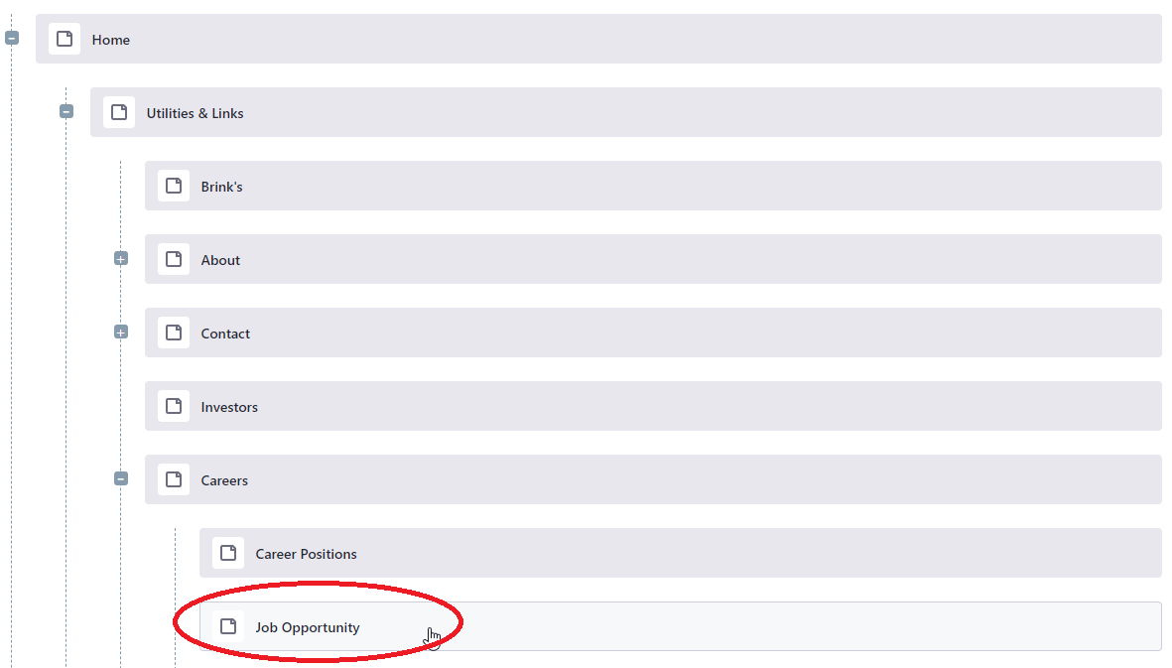
Creating Job Opportunities
Select the corresponding page under Insights.

Slide 84
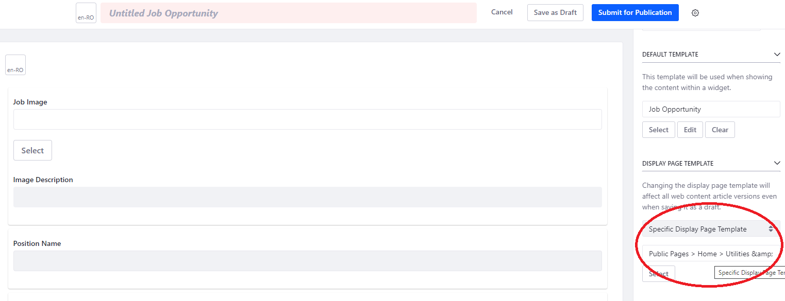
Creating Job Opportunities
Specific Display Page Template is successfully chosen for the content.

Slide 85
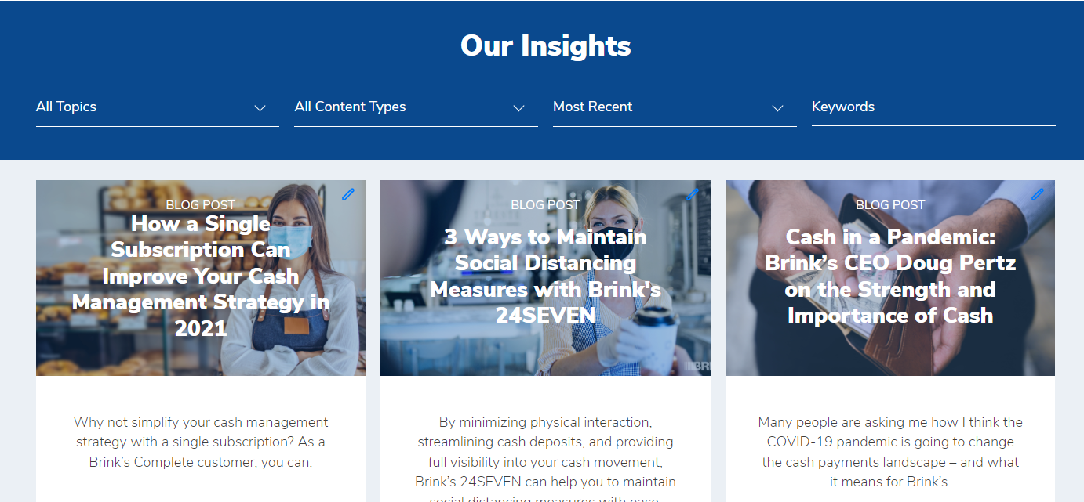
Insights
There are three types of Insights contents: Blog Posts, Case Studies, and Events.
The contents can be filtered by topics, content types and date.

Slide 86
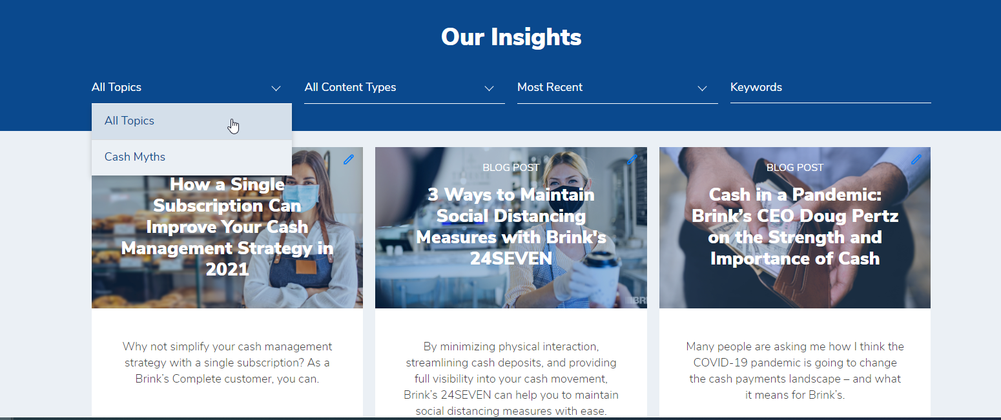
Creating Insights
Insights Topics can be used to filter the Insights contents through the dropdown menu.

Slide 87
Creating Insights
Insights content type can also be used to filter the Insights contents through the dropdown menu.

Slide 88
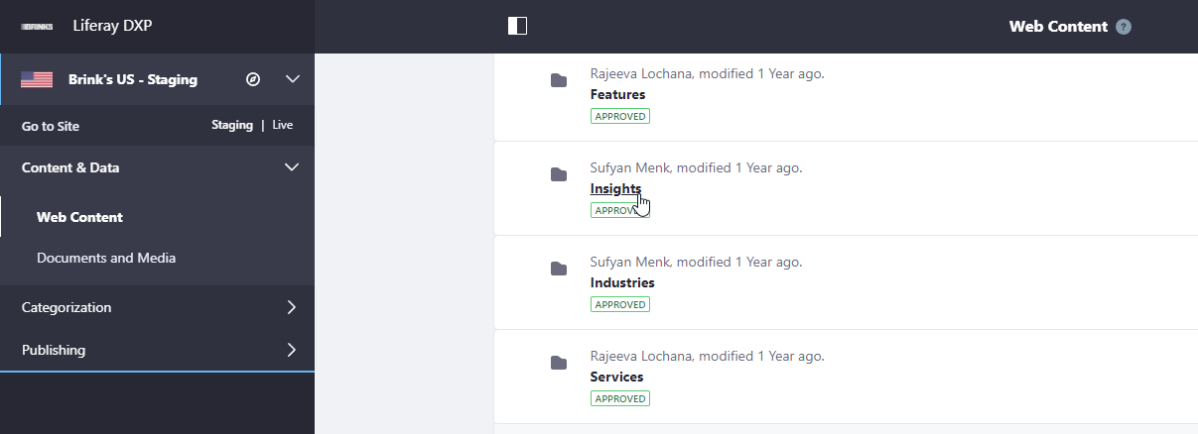
Creating Insights
Insights folder can be found in Web Content menu under Content & Data in the side panel.

Slide 89
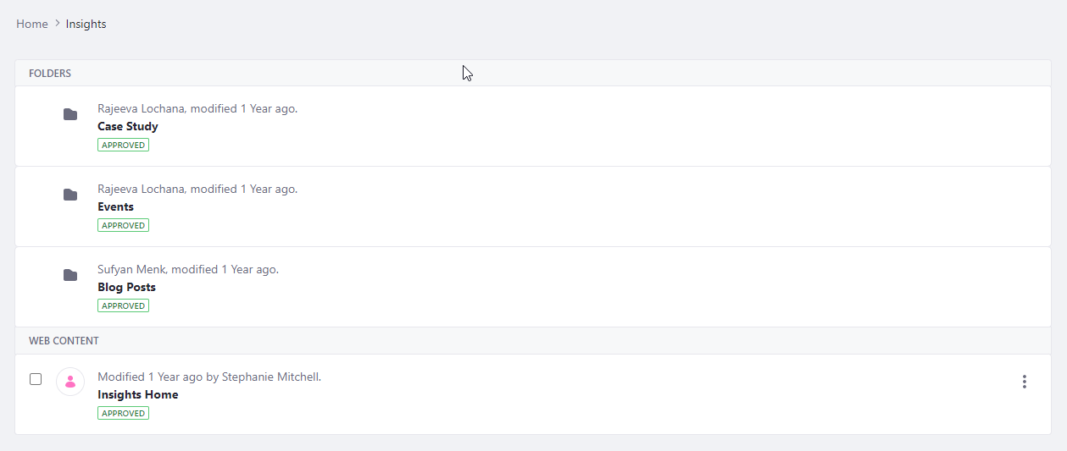
Creating Insights
Each type of Insights content have their dedicated folder.
To create or edit the content, enter the corresponding folder for the content type.

Slide 90
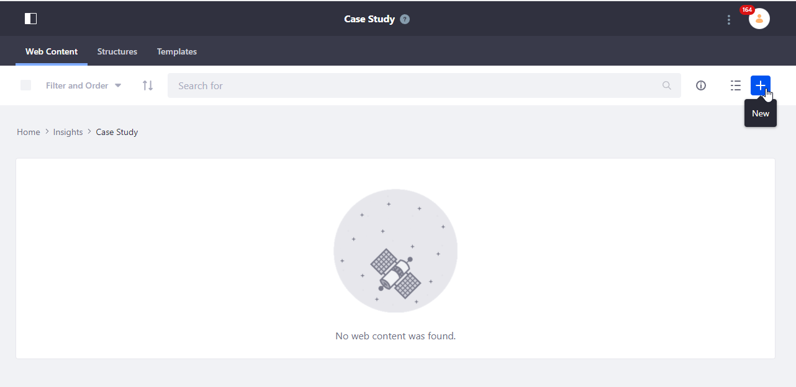
Creating Insights
Click the plus icon to create a new content.

Slide 91
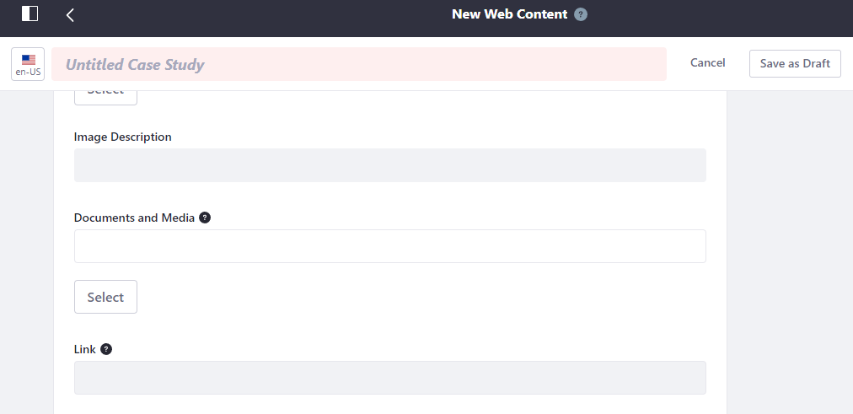
Creating Insights
Documents and Media is used attach a file to an Insights content, so that clicking it will open the file.

Slide 92
Creating Insights
To attach a document through Documents and Media, simply select document that in Documents and Media after clicking Select.

Slide 93
Creating Insights
Link is used to lead to another site or open a file using a URL. The URL from Documents and Media can also be used here.
Paste the URL in the field for Link.

Slide 94
Creating Insights
For contents under Insights, Specific Display Page Template must be set.
Display Page Template allows a single page to display multiple contents one at a time

Slide 95
Creating Insights
After selecting Specific Display Page Template, click Select.

Slide 96
Creating Insights
In the Select Page popup, click Public Pages.

Slide 97
Creating Insights
Select the corresponding page under Insights.

Slide 98
Creating Insights
Specific Display Page Template is successfully chosen for the content.

Slide 99
Creating Insights
For contents under Insights, Insight Topics can be set to allow filtering in the Insights page.

Slide 100
Creating Insights
One or more topics can be selected as Insights Topics.

Slide 101
Creating Insights
After the selection, the topic selected can be seen.

Slide 102
Notifications
Notifications are stacked on top of the page.
Alert notifications are shown in red, and regular notifications are shown in blue.

Slide 103
Creating Notifications
Notification folder can be found in Web Content menu under Content & Data in the side panel.

Slide 104
Creating Notifications
Click the plus button to create a new Notification content.

Slide 105
Creating Notifications
There are two types of Notification. Regular notifications are displayed in blue. Alert notifications are displayed in red.

Slide 106
Creating Notifications
Visibility Type is used to select whether to display the notifications in Corporate pages.

Slide 107
Creating Notifications
Notifications can be used to lead to another site or open a file through a URL. The URL from Documents and Media can also be used here.
Simply paste the URL of the site or the file in this field.

Slide 108
Financial Statements
Financial Statements page allows the country to store each year’s financial statements in an organized way.
Financial Statements are composed of Year tabs and PDF tabs contents.

Slide 109
Financial Statements
Year Tab contents display a card for each year.
By clicking a CTA button on each card, the users can navigate to financial statements of each year.

Slide 110
Financial Statements
PDF Contents displays multiple financial contents in an organized way.
The users can navigate to different PDF by clicking the tab above the PDF display screen.

Slide 111
Creating PDF Tabs
Upload the documents under “Financial Statements” folder in “Documents and Media” menu.
If the folder does not exist, create the folder and upload the documents to the folder.

Slide 112
Creating PDF Tabs
Once the documents are uploaded, publish the site.

Slide 113
Creating PDF Tabs
After publishing the site, switch to Live version of the site and go back to “Financial Statements” folder in “Documents and Media” menu.
Click on the documents and click the information icon and get the link for each PDF document.

Slide 114
Creating PDF Tabs
Go back to the Staging version of the site and navigate to “PDF Contents” folder under “Financial Statements” folder in “Web Content” menu.
If the folder does not exist, create the folder.

Slide 115
Creating PDF Tabs
Click the blue plus icon and click “PDF Tabs” to add new PDF contents for a certain year.

Slide 116
Creating PDF Tabs
Fill in the title of the content (e.g 2021 PDF Tab Content), Tab Title (e.g Brink's Aviation Security Services S.A - 2021), and the PDF Link of the document for that tab.
Click the blue plus icon to add more documents for that year.

Slide 117
Creating PDF Tabs
Select “Specific Display Page Template” for Display Page Template

Slide 118
Creating PDF Tabs
Click the “Select” button and navigate to the “Public Pages” tab on the screen that pops up.
Search “pdf” and click “PDF Display” template. Click “Done” to apply the change.
Publish the content.

Slide 119
Creating PDF Tabs
After the content is fully published, navigate back to “PDF Contents” folder under “Financial Statements” folder in “Web Content” menu.
Click on the published content to view the editing screen. Navigate to Friendly URL section of the content and get the full URL to use when creating Year Tab contents.

Slide 120
Creating Year Tabs
Navigate to “Financial Statements” folder in “Web Content” menu.
Click Plus Icon and search for Year Tabs Type.

Slide 121
Creating Year Tabs
Fill in the title of the content (e.g Financial Statements Collection), Document Year (e.g 2021), and the link of the PDF Tab contents created retrieved previously (e.g /-/2021-greece-pdf-tab-content).
Each PDF Tab content links should be placed for the corresponding year.
Click the blue plus icon to add more years.

Slide 122
Creating Year Tabs
Year Icon, Year Body and Year Button Text will be displayed in the card as shown above.
These fields are not mandatory.
Year Button Text will display “Visit” if empty.

Slide 123
Publishing Site
To publish the site, click Publish to Live.
Note that Country Writer CANNOT publish the site.

Slide 124
Publishing Site
Click Publish to Live in the pop-up screen.

