Slide 1
Presentation Title
This material is for Review and Approval - [Committee] [Board] approval will be requested at this meeting
Choose one of the three options below:
Presentation Title
This material is for Discussion Only
Presentation Title
This material is for Consideration – [Committee] [Board] approval will be requested at a subsequent meeting [insert date if known]
DATE

Slide 2
About This PPT
Use the layouts provided and follow these guidelines to maintain consistency across presentations
Please build your Board Strategy Meeting presentation using the format and slide layouts found in this deck. We’ve also included some examples and commonly-used slides for your use and reference.
Guidelines
Use the slide layout that works best for your content (see slide 4 for how to select a slide layout).
Do not move individual slide elements around. Elements can be edited for content or removed entirely if they are not needed, but you should avoid relocated them if possible.
Use only the colors provided in the current PowerPoint theme for graphs and charts.
For tables, use the format on slide 8.
Maintain proper margins; crop or shrink images to fit within the page – do not cover the footer with images.
Use Arial font throughout.
  Header font should be 24pt dark blue (#0A498E), regular weight, not bold (ex: above).
  Subhead should be 18pt dark gray (#3F403F), regular weight, not bold (ex: above).
  Paragraph subheads or chart headers should be 18pt dark gray (#3F403F), bold (ex: “Guidelines” above).
  Body copy should be no smaller than 12pt and no larger than 18pt dark gray (#3F403F), and should be consistent throughout the deck.

Slide 3
Colors: Primary & Secondary Color Palettes
Primary Color Palette
We have adopted a strict color palette using the colors below. This gives the brand a unique look and feel that enables Brink’s to be distinguished instantly.
Secondary Color Palette
An extended set of accent colors may be used for certain design applications, such as graphics and presentations.
These colors are never to be used as tints or shades. Only use the colors shown below in the exact mixes (Pantone, CMYK or RGB) depending on medium.
Secondary colors should be used sparingly, and only in minimal amounts.
*Note: Coral should not be used in copy or design related to financial matters as shades of red tend to have negative connotations in finance.
Primary Blue
Pantone: 286
CMYK: 100, 75, 0, 0
RGB: 10, 74, 142 HEX #: 0A4A8E
Sky Blue
Pantone: 291
CMYK: 38, 8, 8, 1
RGB: 151, 202, 235 HEX #: 97CAEB
Green
Pantone: 7739
CMYK: 81, 15, 100, 2
RGB: 44, 153, 66 HEX #: 2C9942
Dark Green
Pantone: 7733
CMYK: 92, 31, 89, 22
RGB: 0, 110, 67 HEX #: 006E43
Coral
Pantone: 1925
CMYK: 3, 100, 62, 0
RGB: 231, 0, 76 HEX #: E7004C
Plum
Pantone: 222
CMYK: 45, 96, 47, 35
RGB: 111, 29, 70 HEX #: 6f1d46
Bright Blue
Pantone: 310
CMYK: 54, 0, 11, 0
RGB: 100, 207, 227 HEX #: 64CFE3
Gold
Pantone: 123
CMYK: 0, 23, 91, 0
RGB: 255, 197, 40 HEX #: FFC528
Orange
Pantone: 1505
CMYK: 0, 71, 100, 0
RGB: 255, 107, 0 HEX #: FF6B00
Burnt Orange
Pantone: 174
CMYK: 27, 87, 100,
23
RGB: 153, 57, 33
HEX #: 993921

Slide 4
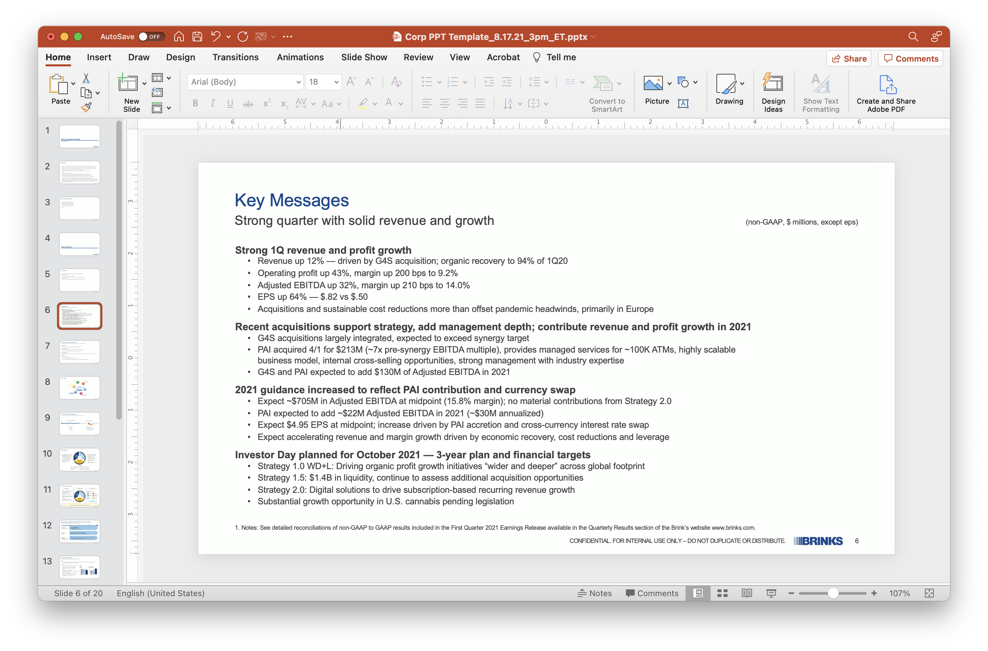
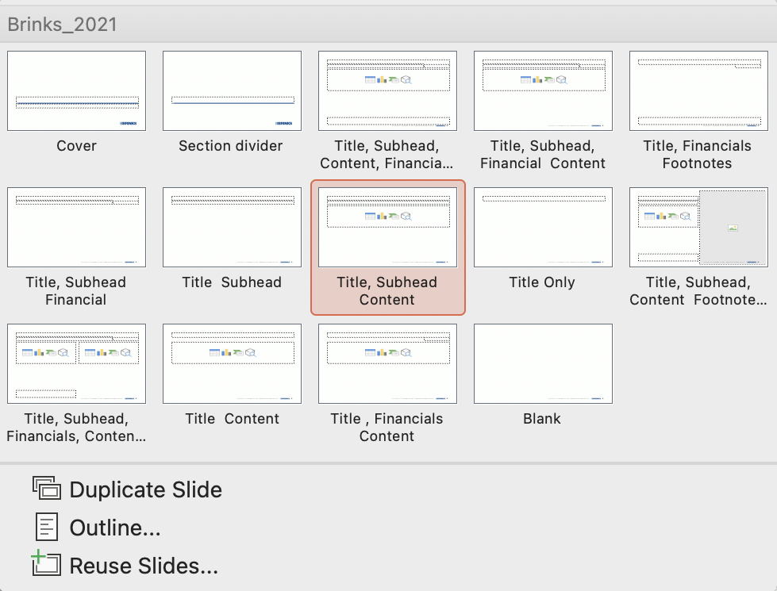
Selecting Slide Layouts
To add a new slide to your presentation and/or access the slide layouts:
Go to the “Home” tab, select the drop down arrow next to “New Slide” to view the various options of slide formats.
Select a layout from the available options.

Slide 5
Cover Page

Slide 6
This is a section divider

Slide 7
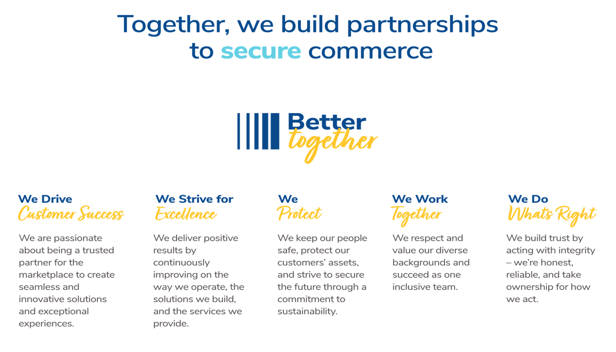
Our Purpose & Values

Slide 8
Sample Table
Actions
S/N | Action | Owner | Status
1 | CPI Team and Model Setup | GM | Closed
2 | CPI Project and Initiatives across all Levels | CPI & HODs | Closed
3 | Global Team Best Practice Sharing | Global & Region CPI | Closed
4 | Global Center of Excellence (COE) Best Practice Sharing | CPI & HODs | Closed
5 | CPI Awards and Recognition System (LEAN Day) | GM & HODs | Closed

Slide 9
Cash Levels Stronger Post-COVID
Brink’s Cash Levels
First Quarter 2021
First quarter 2021
17%
Yoy % increase
  Brink’s U.S. Cash Processed
  +4%
  Value of Cash²
1990-2020
~6%
30-yr CAGR
2018
2019
2020
2021
  +18%
  Withdrawal Transactions⁴
First quarter 2021
12%
YoY % Increase
2002-2020
~9%
30-yr CAGR
U.S. and euro cash at record levels⁵
2018
2019
2020
2021
U.S. currency in circulation through 3/31/21. Source: St. Louis Federal Reserve (FRED). Weekly (QoQ) / Monthly (Historical) Average Currency in Circulation (Billions of Dollars, Weekly, Not Seasonally Adjusted)
Represents year-over-year increase in value of cash processed in U.S.
Euro currency in circulation through March 2021. Source: ECB. Monthly Currency in Circulation (Billions, Monthly, Not Seasonally Adjusted)
Represents year-over-year increase in number of withdrawal transactions on “same terminal” basis
Refers to USD currency-in-circulation levels from 1917 to present; Euro levels from 2002 to present

Slide 10
First-Quarter Results by Segment
($ Millions)
North America¹
Revenue (7%) | Op Profit (+141%)
Constant currency (8%) | +141%
Latin America
Revenue (10%) | Op Profit (3%)
Constant currency (+2%) | +12%
Europe
Revenue (+70%) | Op Profit (+405%)
Constant currency (+56%) | +371%
Rest of the World
Revenue (+66%) | Op Profit (+124%)
Constant currency (+59%) | +115%
Organic (8%) +141%
Acq — —
FX +1% —
Organic — +12%
Acq +2% +1%
FX (12%) (15%)
Organic (20%) +14%
Acq +76% +357%
FX +13% +33%
Organic (4%) +79%
Acq +63% +36%
FX +7% +9%
20.2%
Margin
21.8%
Margin
10.2%
Margin
17.2%
Margin
3.9%
Margin
4.9%
Margin
12.8%
Margin
2
In the first quarter of 2021, we changed the method for calculating the allowance for doubtful accounts of the North America segment’s U.S. business. This change in method resulted in a $12.3 million operating profit increase in the segment, which was offset by a $12.3 million increase to Corporate expense, resulting in no impact to consolidated operating profit for the quarter. Historically, all Brink’s business units followed an internal Company policy for determining an allowance for doubtful accounts and the allowances were then reconciled to the required U.S. GAAP estimated consolidated allowance, with any differences reported as part of Corporate expense. Other than for the U.S. business, the reconciling differences were not significant. We changed the U.S. calculation of the allowance in order to more closely align it with the U.S. GAAP consolidated calculation and to minimize reconciling differences, resulting in the offsetting $12.3 million adjustments to align the methods.
1Q20 Op Profit Margin of 1.7%
Note: Constant currency represents 2021 results at 2020 exchange rates.

Slide 11
2021 Free Cash Flow Target
(Non-GAAP, $ millions)
Adjusted
EBITDA
Growth of ~65% excluding deferred payments
D&A / Other
33-41% of EBITDA
 | Adjusted EBITDA
 | Working Capital and Cash Restructuring: Lower restructuring expected in 2021 post-Covid-19 and G4S acquisition
 | $35 Deferred Payments to be made: primarily payroll taxes in US and France
 | Cash Taxes: Higher due to timing of refunds
 | Cash Interest: Higher due to acquisitions, partially offset by cross-currency interest rate swap
 | Cash Capital Expenditures: Higher due to temporary reductions in 2020
 | Free Cash Flow before Dividends
Op Profit
1
1
VS. 2020 | $94-$184 | ( $3 ) | ( $18 ) | ( $27 ) | ( $67 ) | ($21)-$69 | $59-$149
Notes: Amounts may not add due to rounding. See detailed reconciliations of non-GAAP to GAAP results included in the First Quarter 2021 Earnings Release available in the Quarterly Results section of the Brink’s website www.brinks.com.
Includes cash proceeds from sale of property, equipment and investments.

Slide 12
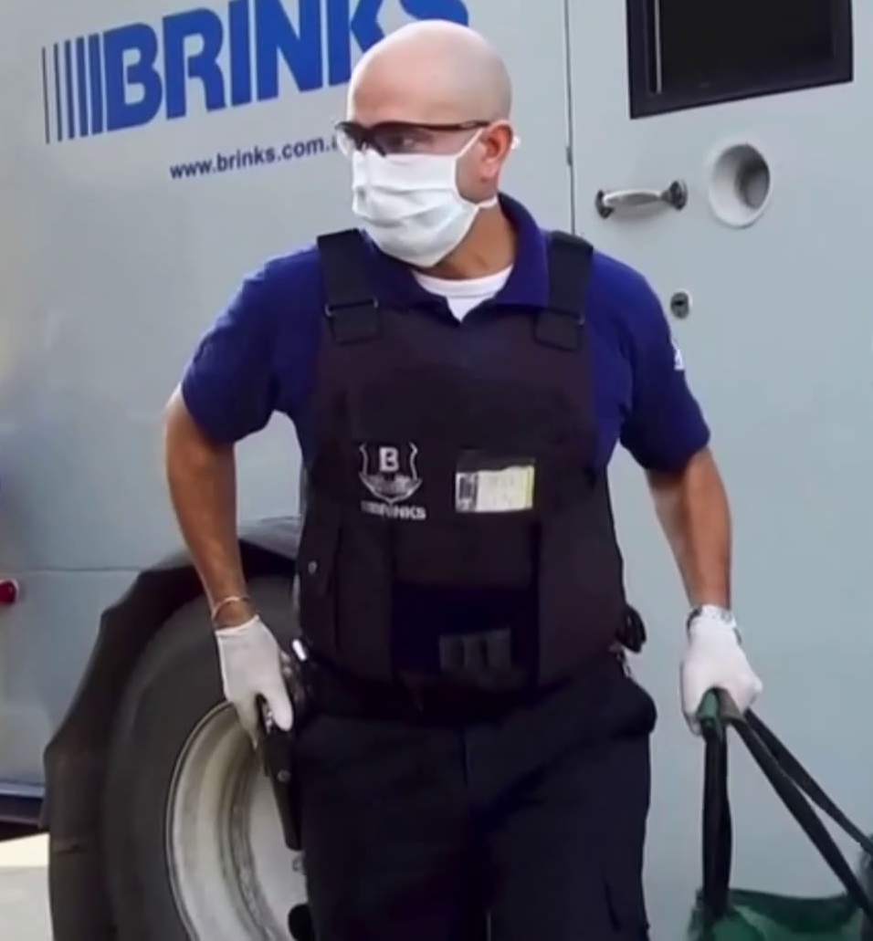
Our People & Customers
Health & Safety
  Working with public health authorities to respond to affected employees with contact tracing and aggressive branch cleaning to mitigate further spreading.
  Implementing best practices and training for hygiene, sanitization, and social distancing.
  Distributing personal protective equipment, including masks and gloves, and sanitation supplies to frontline employees.
  Implementing all employee health screening including daily temperature checks for employees.
Brink’s is providing essential services to customers around the world.
CONFIDENTIAL. FOR INTERNAL USE ONLY – DO NOT DUPLICATE OR DISTRIBUTE.
12

Slide 13
Strong Financial Health – Ample Liquidity
($ Millions, except where noted)
Increased liquidity in 2020
  Incremental $590 million Term Loan A closed on
  April 1, 2020
  Incremental $400 million Senior Notes closed on June 22, 2020
No Maturities until 2024
  Credit Facility matures February 2024
  $600 million 4.625% Senior Notes mature October 2027
  $400 million 5.5% Senior Notes mature July 2025
Interest Rates
  Variable interest LIBOR plus 2.00%
  $400M USD/EUR interest rate swap saves 151 bps
Debt Covenants Amended
  Net secured debt leverage ratio of 1.8x vs 4.25x max
No legacy liability contributions expected until 2029
Moody’s Ba2 (Stable); S&P BB (Stable)
Cash
~$1.6 B
Liquidity
~$1.45 B
Liquidity
~$1.4 B
Liquidity
Revolver
$1 B
Term Loan A
Senior Notes
Fin. Leases & Other
¹
Pro-forma liquidity at year-end 2021, considering our 2021 Free Cash Flow Target and the impact of the PAI acquisition.
Utilized Revolver Available Revolver
U.S. and euro cash at record levels

Slide 15



Slide 16
This is for a large quote or callout.

Slide 17


Slide 18




SVG Elements
Add these elements to slides that may need more visual interest.

