Slide 1
Brink’s Strategy Meeting Layout
August 18, 2021

Slide 2
About This PPT
Use the layouts provided and follow these guidelines to maintain consistency across presentations
Please build your Board Strategy Meeting presentation using the format and slide layouts found in this deck. We’ve also included some examples and commonly-used slides for your use and reference.
Guidelines
Use the slide layout that works best for your content (see slide 3 for how to select a slide layout).
Do not move individual slide elements around. Elements can be edited for content or removed entirely if they are not needed, but you should avoid relocated them if possible.
Use only the colors provided in the current PowerPoint theme for graphs and charts.
For tables, use the format on slide 12.
Maintain proper margins; crop or shrink images to fit within the page – do not cover the footer with images.
Use Arial font throughout.
  Header font should be 24pt dark blue (#0A498E), regular weight, not bold (ex: above).
  Subhead should be 18pt dark gray (#3F403F), regular weight, not bold (ex: slide 6).
  Paragraph subheads or chart headers should be 18pt dark gray (#3F403F), bold (ex: slide 7).
  Body copy should be no smaller than 12pt and no larger than 18pt dark gray (#3F403F), and should be consistent throughout the deck.

Slide 3
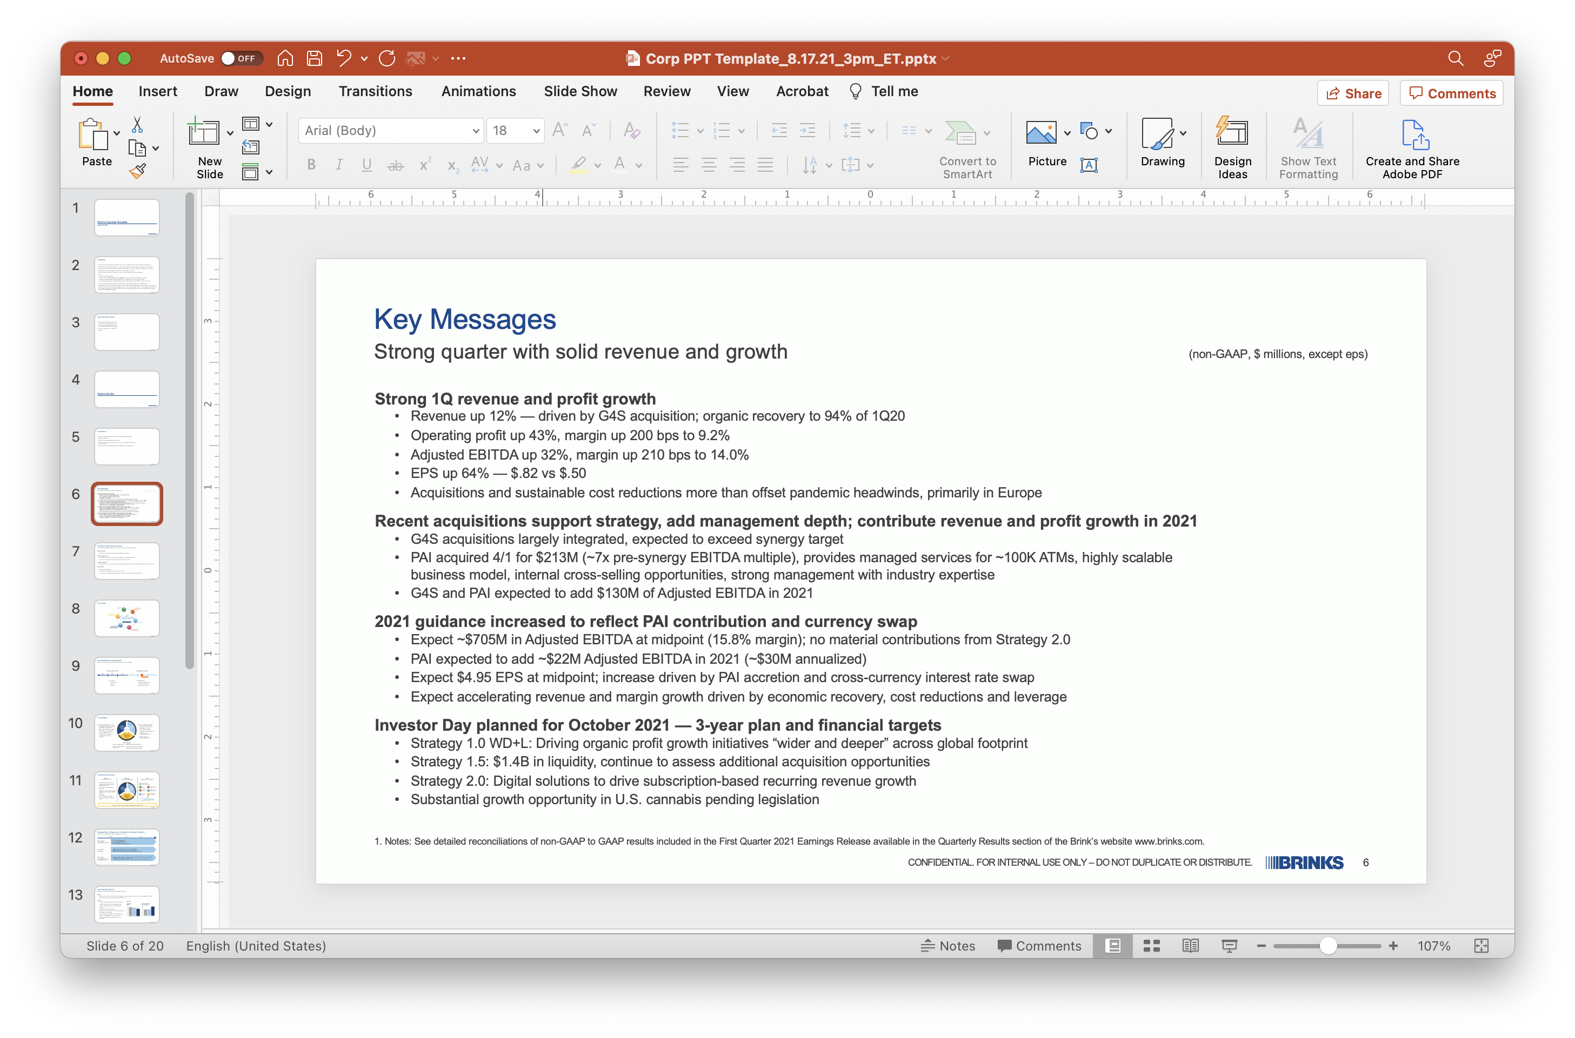
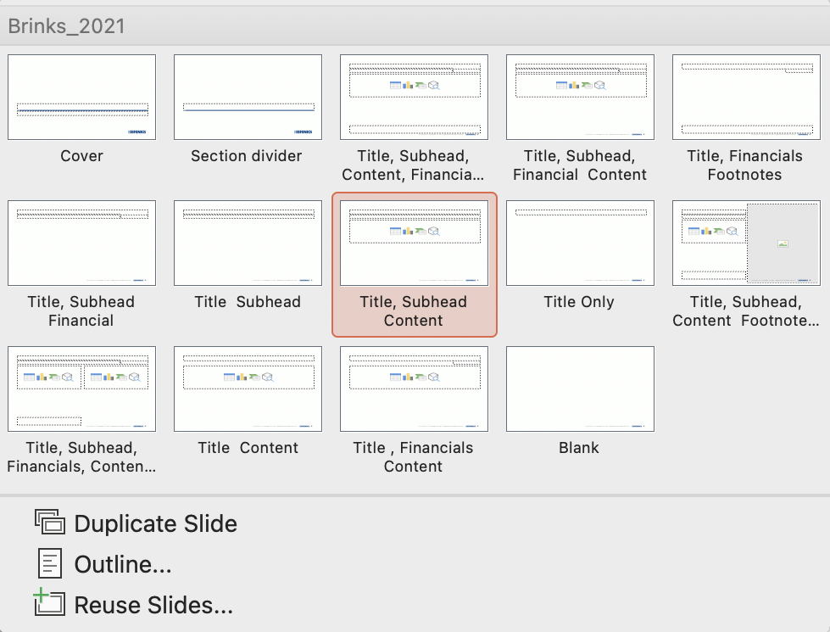
Selecting Slide Layouts
To add a new slide to your presentation and/or access the slide layouts:
Go to the “Home” tab, select the drop down arrow next to “New Slide” to view the various options of slide formats.
Select a layout from the available options.

Slide 4
Section Divider

Slide 5
Our Mission
Keep the use of cash as easy, secure and affordable as other
payment methods.
Offer total cash management solutions.
Provide consumers safe, private and convenient payment options in
the digital age.
Protect, store and transport high-value assets in a changing world.

Slide 6
HR Voice of the Customer Survey
81 leaders completed the survey (~70% country and 30% corporate)
Methodology
Quantitative; included open-ended qualitative questions
Survey Objectives
Understand perceptions of progress against our global HR vision
Inform our plans and actions to further support our vision
Topics Included
Customer service, business understanding and support, value delivery, alignment with Brinks values
Next Steps
Analyze the findings
Consider how the findings affect our priorities
Communicate findings and how we will respond to global HR community, BLT

Slide 7
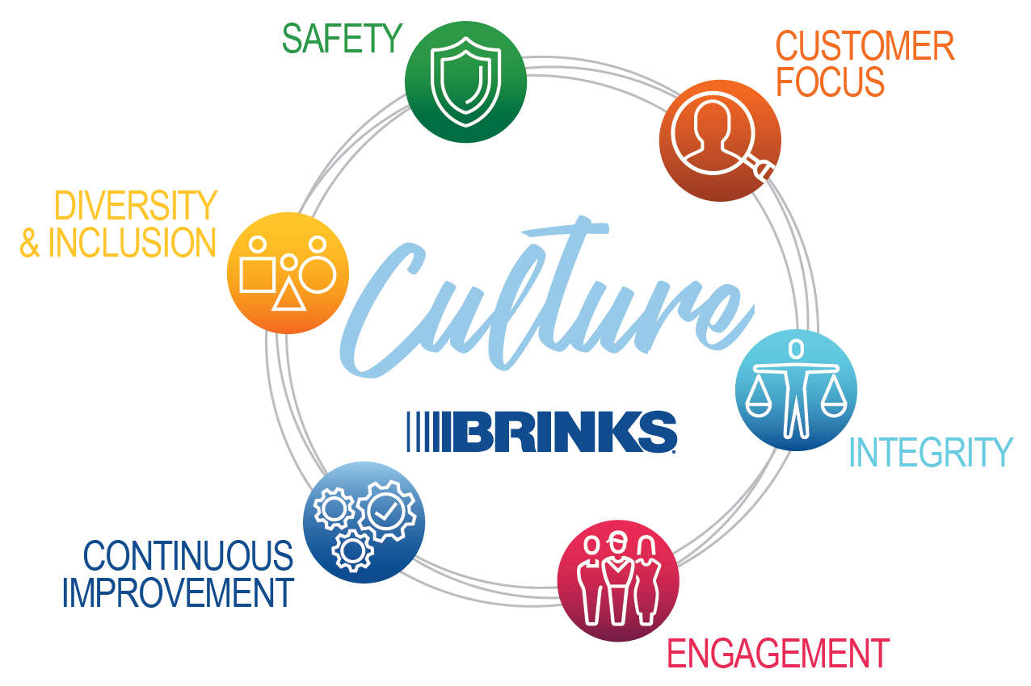
Our Values

Slide 8
Our Strategic Planning Approach
We build three-year plans to guide the execution of our strategy
Strategic Plan 1 (SP1)
Strategic Plan 2 (SP2)
2017
2018
2019
2020
2021
2022
WE ARE HERE
Foundation
Performance
Culture
Mission
Transformation
Tech-enabled solutions
Customer experience
High-value services

Slide 9


Our Strategy
Introduce differentiated services
Leverage uniform, best-in-class
global technology base for logistics and operating systems
Offer end-to-end cash supply chain managed services
Launch customer portal and
value-added, fee-based
services
Introduce
Differentiated
Services
(IDS)
Accelerate
Profitable
Growth
(APG)
Accelerate profitable growth
Grow high-value services
Grow account share
with large FI customers
Increase focus on smaller FIs
Penetrate large,
unvended retail market
Explore core and
adjacent acquisitions
Close the Gap — Operational Excellence
(CTG)
Close the gap
Operational excellence
Lead industry in safety
and security
Exceed customer expectations
Increase operational productivity
Achieve industry-leading margins

Slide 10






How We Drive Success
Mission
What we will achieve
Keep the use of cash as easy, secure and affordable as other payment methods.
Offer total cash management solutions.
Provide consumers safe, private and convenient payment options in the
digital age.
Protect, store and transport
high-value assets in a changing world.
Strategy
How we’ll be successful
Values
The way we work together
A winning culture
based on these values:
Introduce
Differentiated
Services
(IDS)
Accelerate
Profitable
Growth
(APG)
Safety
Engagement
Customer
focus
Continuous Improvement
Integrity
Diversity & Inclusion
Close the Gap — Operational Excellence
(CTG)
We will win for our employees, customers and investors.

Slide 11
Strategic Plan 2: A New Layer of Growth on a Strong Foundation
Strategy 2.0 adds digital cash management solutions
2020
2021
2022
2023
Strategy 2.0 Digital Cash Management
Strategy 1.5 Acquisitions
Strategy 1.0 Wider Deeper + Leverage Core Organic Growth
2.1 – Digital Cash Management
2.2 – Enterprise Cash Automation
2.3 – ATM Managed Services
2.4 – Integrating Cash with Digital Payments
$2.2B invested in 15 acquisitions, including G4S and PAI
G4S largely integrated, expect to exceed synergy targets
$1.4B in liquidity, assessing new opportunities to support core & 2.0¹
Leverage – sustained cost reductions + rev growth expected to add 150 bps margin by 2022
WD Target $70M cost reductions 2021 – 2022
  Implementing efficiency initiatives over expanded platform with dedicated Lean experts
Pro-forma liquidity at year-end 2021, considering our 2021 Free Cash Flow Target and the impact of the PAI acquisition.

Slide 12
Sample Table
Actions
S/N | Action | Owner | Status
1 | CPI Team and Model Setup | GM | Closed
2 | CPI Project and Initiatives across all Levels | CPI & HODs | Closed
3 | Global Team Best Practice Sharing | Global & Region CPI | Closed
4 | Global Center of Excellence (COE) Best Practice Sharing | CPI & HODs | Closed
5 | CPI Awards and Recognition System (LEAN Day) | GM & HODs | Closed

Slide 13
Timeline | Strategy 1.0 WD, Leverage and Lean
Develop leverage assumptions
Oct. 26
Begin submitting WD+L+Lean results in monthly reporting and MBRs
Early January
Complete WD+L Initiative Plans
Dec. 28
Complete Operational Excellence Assessments and Lean Roadmap
Jan. 30
Countries
Select countries: MBR trial for WD+L & Lean initiative reporting
Dec. 18
OCT
NOV
DEC
JAN
FEB
Corporate
Finalize WD+L tracking/
reporting templates
By Nov. 30
Deploy Phase 2 WD playbooks
Jan. 15
Deploy Lean training for Bronze certification
Feb. 28
Deploy Phase 1 WD playbooks + comms toolkits
Dec. 15

Slide 14
Cash Levels Stronger Post-COVID
Brink’s Cash Levels
First Quarter 2021
First quarter 2021
17%
Yoy % increase
  Brink’s U.S. Cash Processed
  +4%
  Value of Cash²
1990-2020
~6%
30-yr CAGR
2018
2019
2020
2021
  +18%
  Withdrawal Transactions⁴
First quarter 2021
12%
YoY % Increase
2002-2020
~9%
30-yr CAGR
U.S. and euro cash at record levels⁵
2018
2019
2020
2021
U.S. currency in circulation through 3/31/21. Source: St. Louis Federal Reserve (FRED). Weekly (QoQ) / Monthly (Historical) Average Currency in Circulation (Billions of Dollars, Weekly, Not Seasonally Adjusted)
Represents year-over-year increase in value of cash processed in U.S.
Euro currency in circulation through March 2021. Source: ECB. Monthly Currency in Circulation (Billions, Monthly, Not Seasonally Adjusted)
Represents year-over-year increase in number of withdrawal transactions on “same terminal” basis
Refers to USD currency-in-circulation levels from 1917 to present; Euro levels from 2002 to present

Slide 15
First-Quarter Results by Segment
($ Millions)
North America¹
Revenue (7%) | Op Profit (+141%)
Constant currency (8%) | +141%
Latin America
Revenue (10%) | Op Profit (3%)
Constant currency (+2%) | +12%
Europe
Revenue (+70%) | Op Profit (+405%)
Constant currency (+56%) | +371%
Rest of the World
Revenue (+66%) | Op Profit (+124%)
Constant currency (+59%) | +115%
Organic (8%) +141%
Acq — —
FX +1% —
Organic — +12%
Acq +2% +1%
FX (12%) (15%)
Organic (20%) +14%
Acq +76% +357%
FX +13% +33%
Organic (4%) +79%
Acq +63% +36%
FX +7% +9%
20.2%
Margin
21.8%
Margin
10.2%
Margin
17.2%
Margin
3.9%
Margin
4.9%
Margin
12.8%
Margin
2
In the first quarter of 2021, we changed the method for calculating the allowance for doubtful accounts of the North America segment’s U.S. business. This change in method resulted in a $12.3 million operating profit increase in the segment, which was offset by a $12.3 million increase to Corporate expense, resulting in no impact to consolidated operating profit for the quarter. Historically, all Brink’s business units followed an internal Company policy for determining an allowance for doubtful accounts and the allowances were then reconciled to the required U.S. GAAP estimated consolidated allowance, with any differences reported as part of Corporate expense. Other than for the U.S. business, the reconciling differences were not significant. We changed the U.S. calculation of the allowance in order to more closely align it with the U.S. GAAP consolidated calculation and to minimize reconciling differences, resulting in the offsetting $12.3 million adjustments to align the methods.
1Q20 Op Profit Margin of 1.7%
Note: Constant currency represents 2021 results at 2020 exchange rates.

Slide 16
2021 Free Cash Flow Target
(Non-GAAP, $ millions)
Adjusted
EBITDA
Growth of ~65% excluding deferred payments
D&A / Other
33-41% of EBITDA
 | Adjusted EBITDA
 | Working Capital and Cash Restructuring: Lower restructuring expected in 2021 post-Covid-19 and G4S acquisition
 | $35 Deferred Payments to be made: primarily payroll taxes in US and France
 | Cash Taxes: Higher due to timing of refunds
 | Cash Interest: Higher due to acquisitions, partially offset by cross-currency interest rate swap
 | Cash Capital Expenditures: Higher due to temporary reductions in 2020
 | Free Cash Flow before Dividends
Op Profit
1
1
VS. 2020 | $94-$184 | ( $3 ) | ( $18 ) | ( $27 ) | ( $67 ) | ($21)-$69 | $59-$149
Notes: Amounts may not add due to rounding. See detailed reconciliations of non-GAAP to GAAP results included in the First Quarter 2021 Earnings Release available in the Quarterly Results section of the Brink’s website www.brinks.com.
Includes cash proceeds from sale of property, equipment and investments.

Slide 17
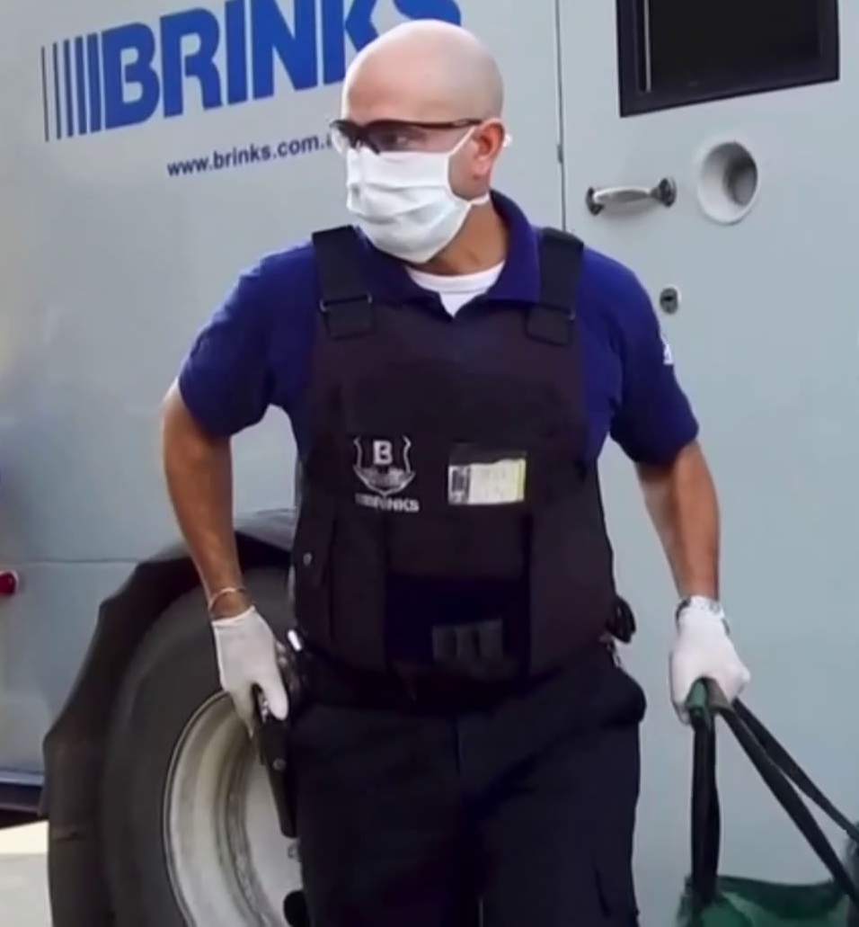
Our People & Customers
Health & Safety
  Working with public health authorities to respond to affected employees with contact tracing and aggressive branch cleaning to mitigate further spreading.
  Implementing best practices and training for hygiene, sanitization, and social distancing.
  Distributing personal protective equipment, including masks and gloves, and sanitation supplies to frontline employees.
  Implementing all employee health screening including daily temperature checks for employees.
Brink’s is providing essential services to customers around the world.
CONFIDENTIAL. FOR INTERNAL USE ONLY – DO NOT DUPLICATE OR DISTRIBUTE.
17

Slide 18
Strong Financial Health – Ample Liquidity
($ Millions, except where noted)
Increased liquidity in 2020
  Incremental $590 million Term Loan A closed on
  April 1, 2020
  Incremental $400 million Senior Notes closed on June 22, 2020
No Maturities until 2024
  Credit Facility matures February 2024
  $600 million 4.625% Senior Notes mature October 2027
  $400 million 5.5% Senior Notes mature July 2025
Interest Rates
  Variable interest LIBOR plus 2.00%
  $400M USD/EUR interest rate swap saves 151 bps
Debt Covenants Amended
  Net secured debt leverage ratio of 1.8x vs 4.25x max
No legacy liability contributions expected until 2029
Moody’s Ba2 (Stable); S&P BB (Stable)
Cash
~$1.6 B
Liquidity
~$1.45 B
Liquidity
~$1.4 B
Liquidity
Revolver
$1 B
Term Loan A
Senior Notes
Fin. Leases & Other
¹
Pro-forma liquidity at year-end 2021, considering our 2021 Free Cash Flow Target and the impact of the PAI acquisition.
Utilized Revolver Available Revolver
U.S. and euro cash at record levels

