Slide 1
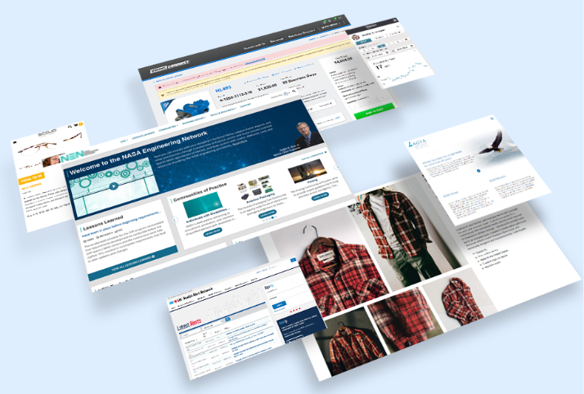
Resource Library Tutorial

Slide 2
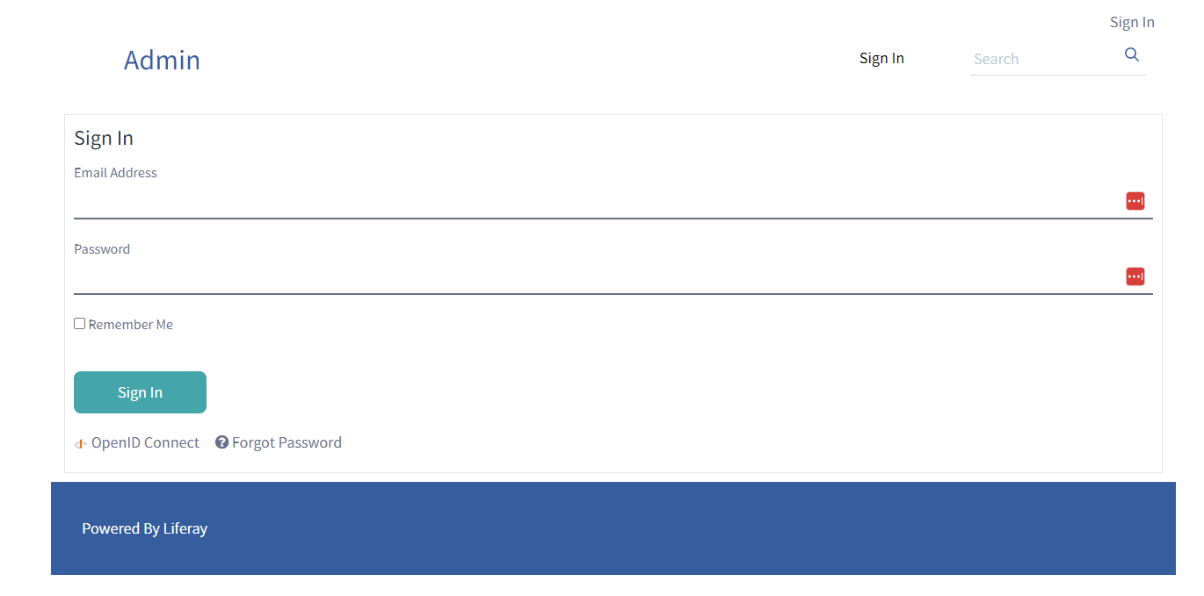
Login Page
https://customerportal-uat.brinksinc.com/en/web/admin (UAT)
https://customerportal.brinksinc.com/en/web/admin (PROD)

Slide 3
Navigate to Resource Library
Click Compass button
Select Resource Library Option

Slide 4
Login Page
https://customerportal-uat.brinksinc.com/en/web/admin (UAT)
https://customerportal.brinksinc.com/en/web/admin (PROD)

Slide 5
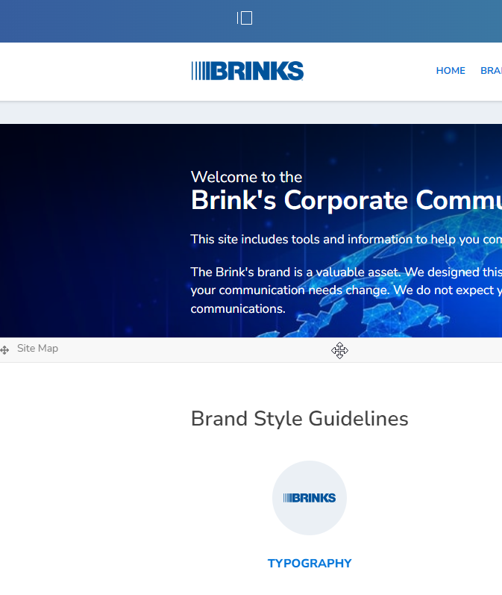
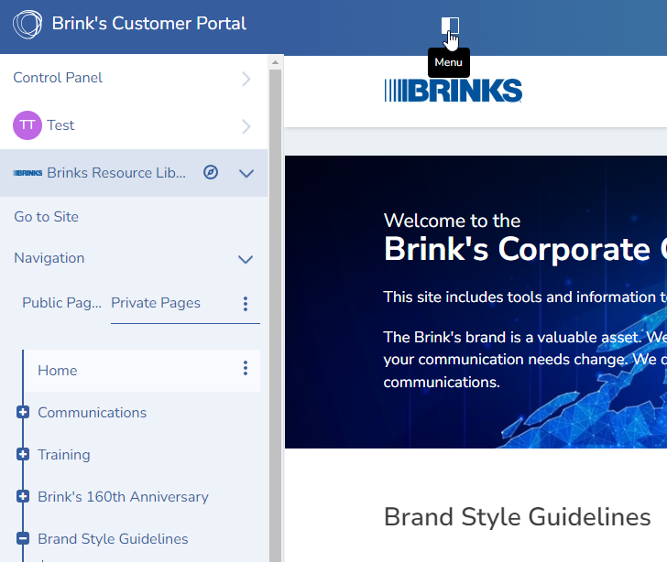
Side Panel Menu
Click Menu button to toggle the side menu

Slide 6
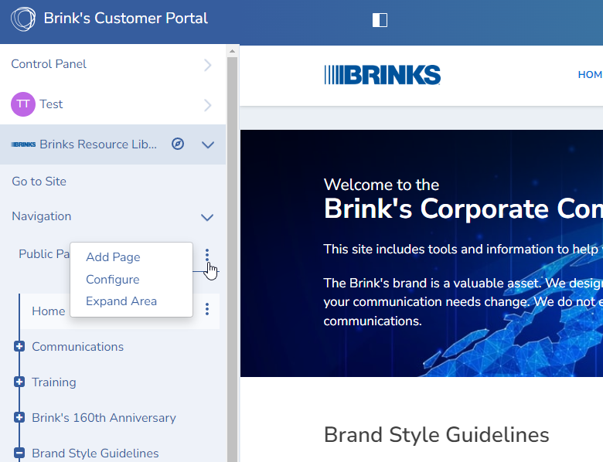
Creating a Page
Click a three dotted menu button and click Add Page

Slide 7
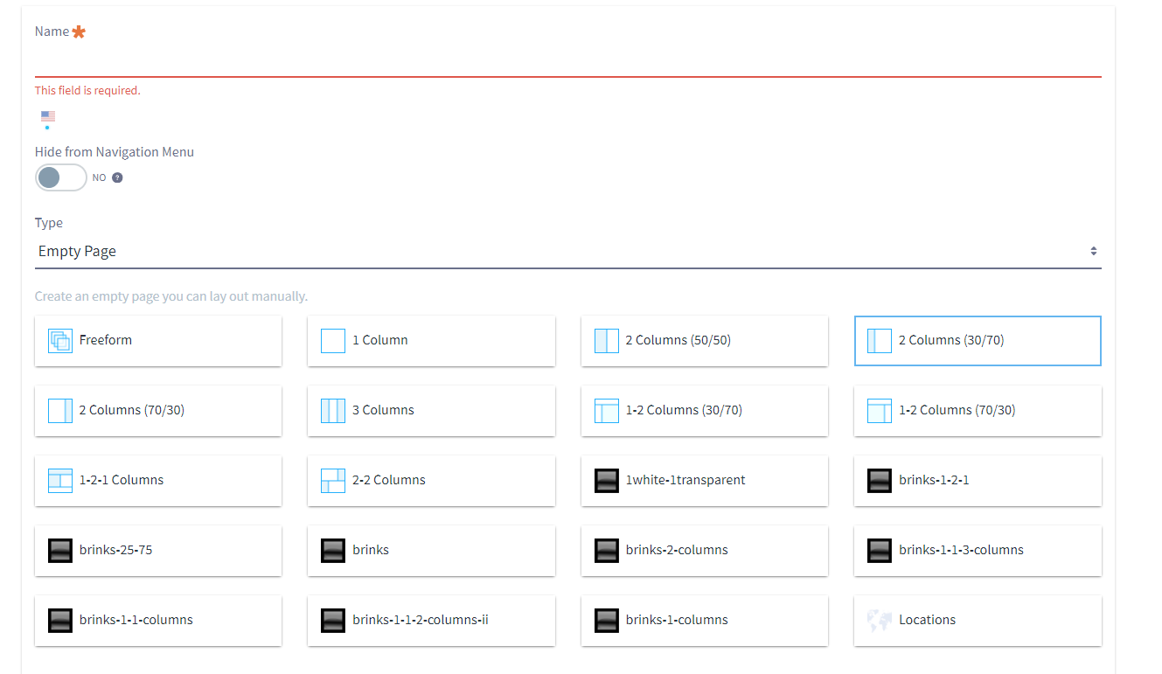
Creating a Page
Type a name of the page and choose a layout. It is best to try out each layout and see what they look like.

Slide 8
Creating a Page
Hide from Navigation will prevent the page from showing up on the home page.

Slide 9
Page Structure
Childe pages under a page will show up in the home page as above.
In this example, if we want Typography to show up in different section like Brand Assets, we can simply drag and drop the page under Brand Assets in the side menu.

Slide 10
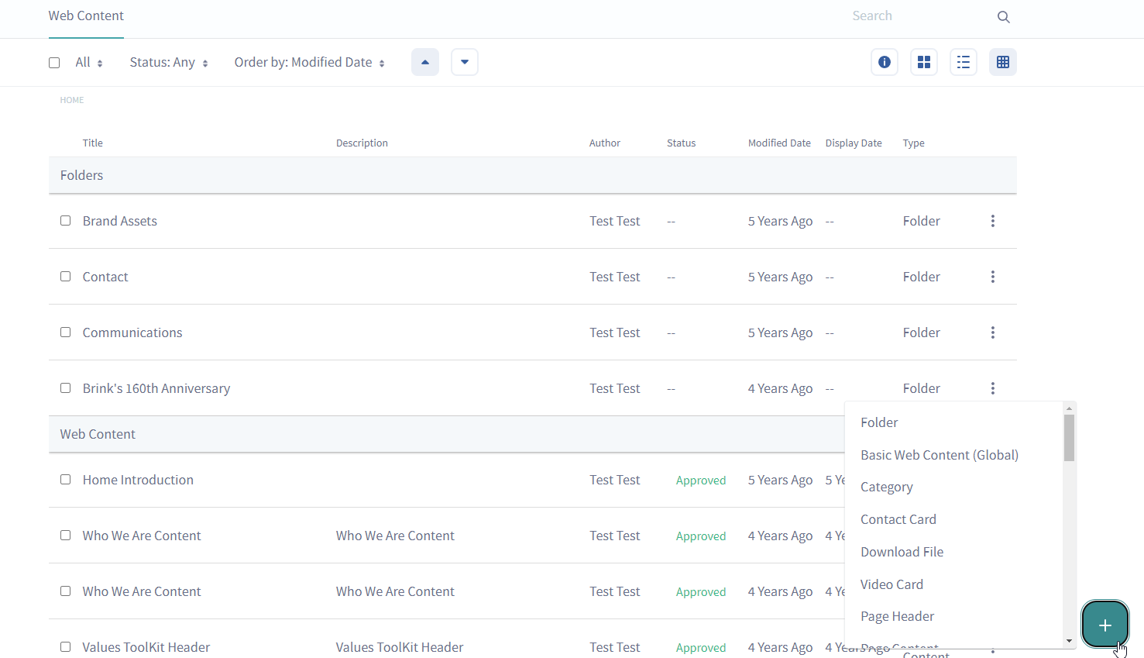
Web Content
Texts that get displayed on the page.
There are several different types of web content.

Slide 11
Web Content
Categories and Tags can be added to Web Content, which is useful when filtering the contents within Asset Publisher.

Slide 12
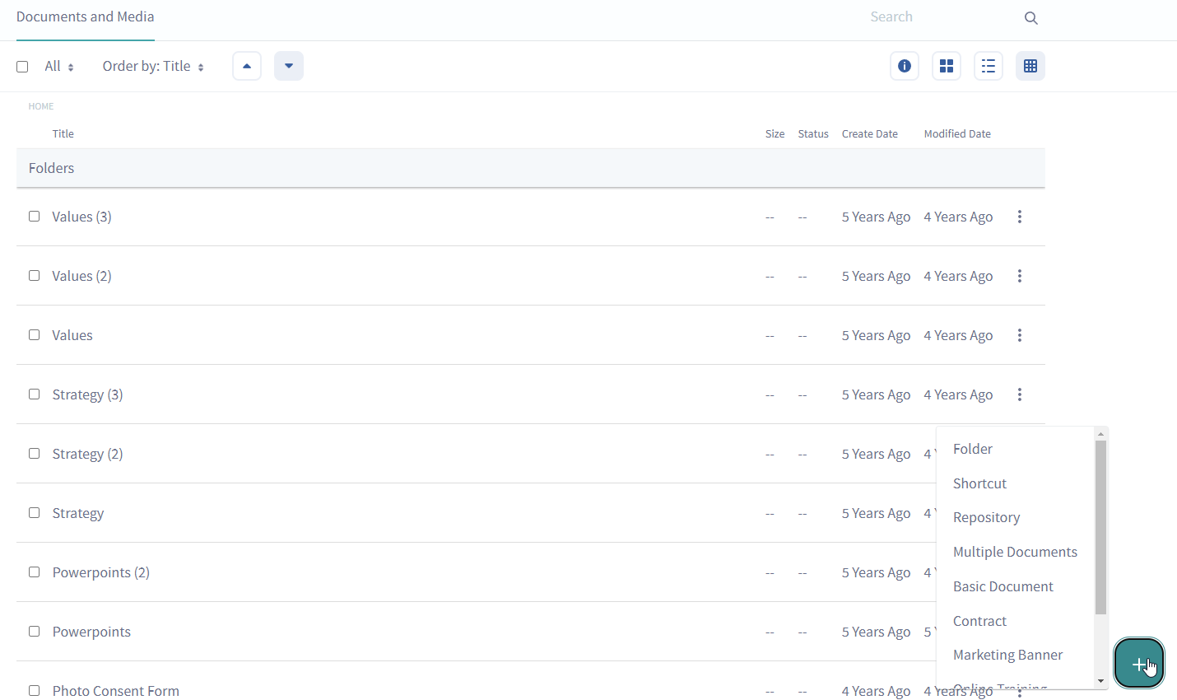
Documents and Media
Place to store files and icons.
Can create folders to organize them.

Slide 13
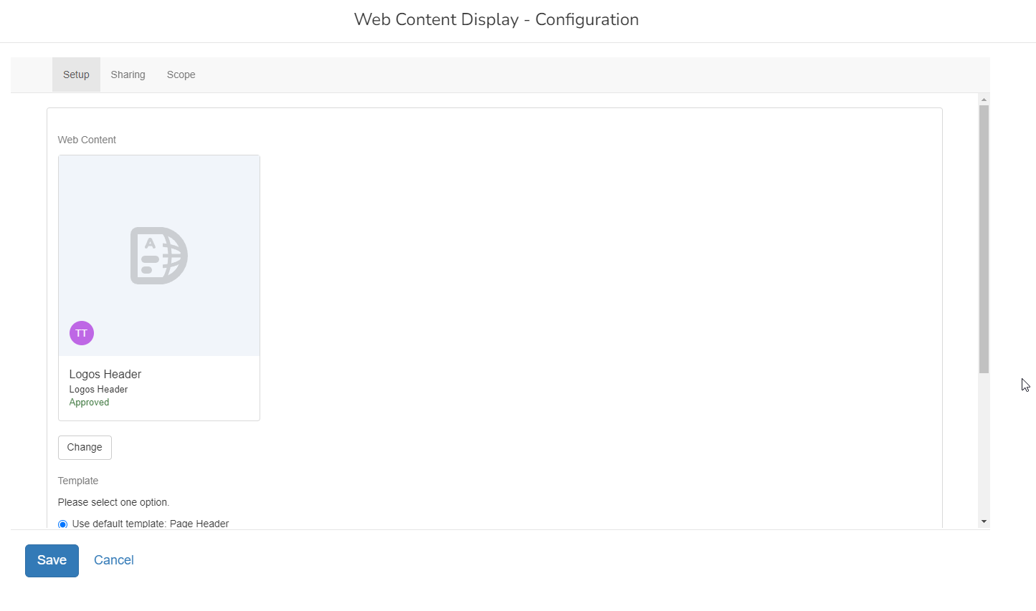
Web Content Display
Place holder for Web contents to get displayed.

Slide 14
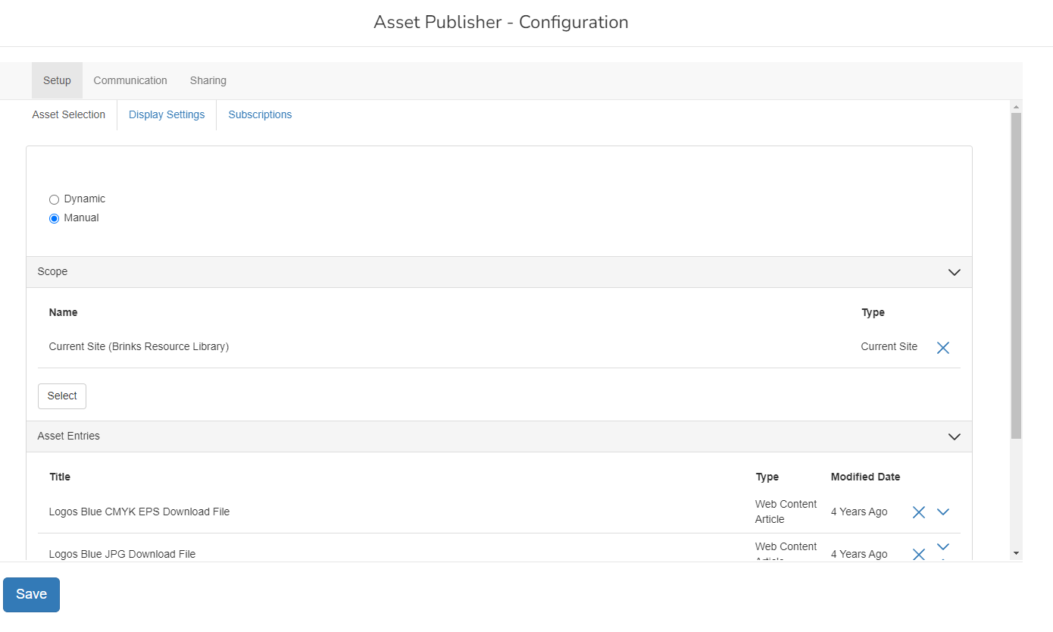
Asset Publisher
Automated way to display multiple web contents.
Multiple templates are available through Display Settings.

Slide 15
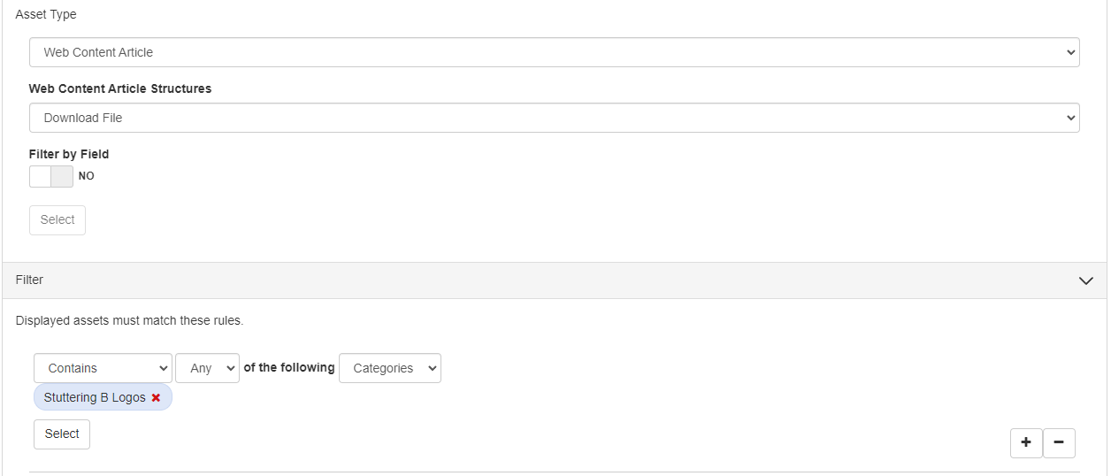
Asset Publisher
When Dynamic mode is chosen, we can filter out the contents to display based on the content type, categories and tags.

Slide 16
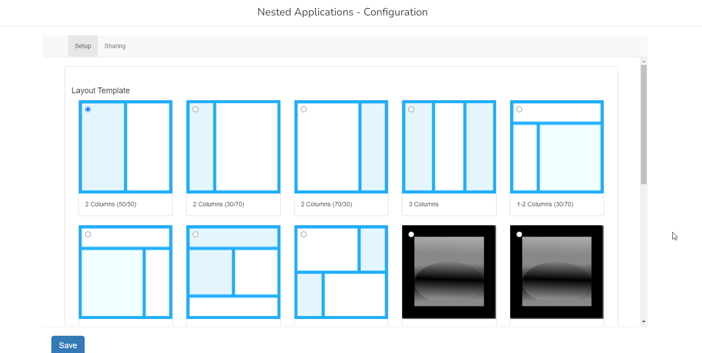
Nested Applications
Provide a way to display multiple web contents, asset publishers, etc.

Slide 17
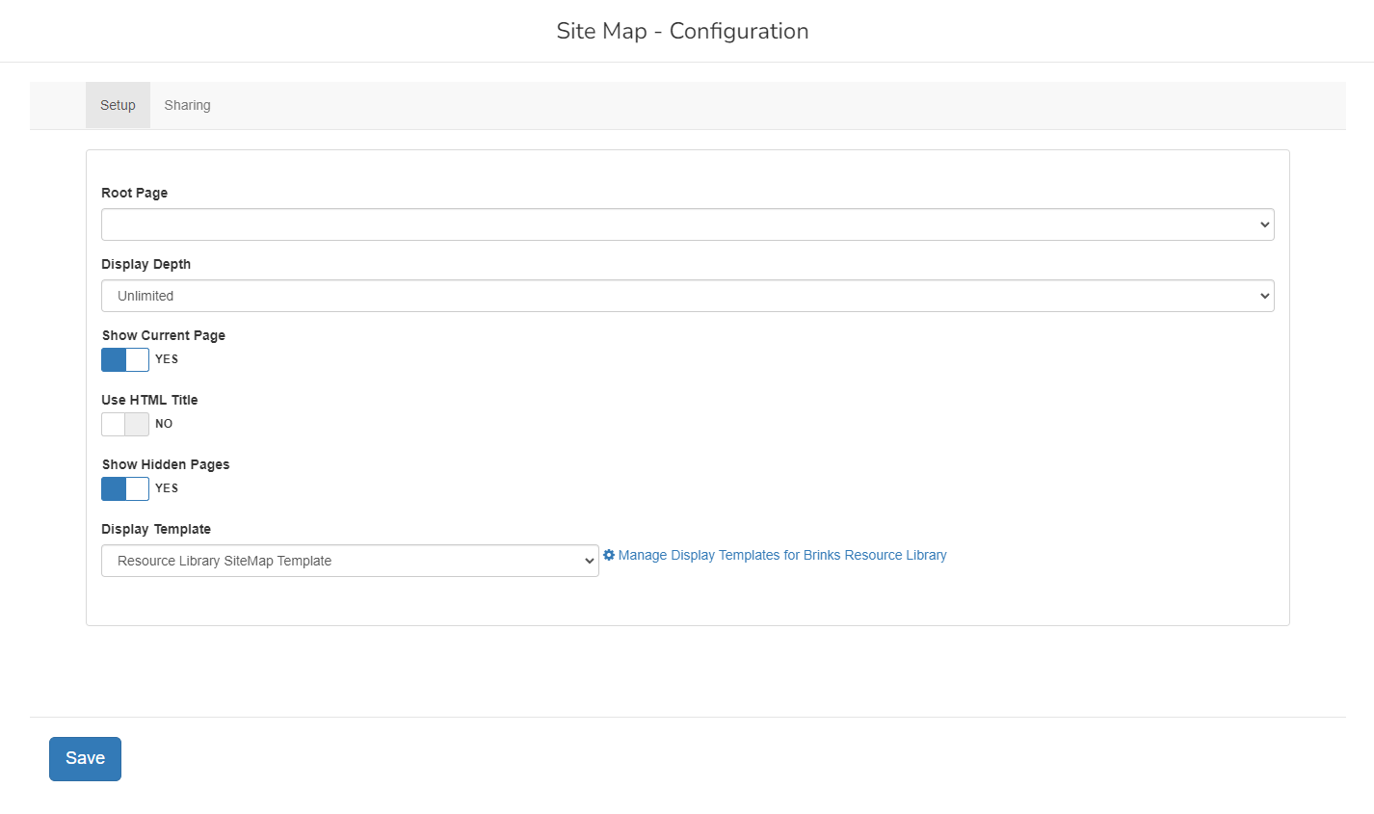
Site Map
Displays all child pages.
Multiple templates are available.

