Slide 1
Lease Accounting Centers and Local Teams
Collaboration for solid controls and financial results
Lease Procedures Training 2024
June 14, 2024 and June 17/18, 2024

Slide 2
Our Goals Today
Review the Brink’s basics about leases – many new finance and accounting people at Brink’s and continuous improvement brings new information
Roll out the 2024 Update to the lease standard work titled “Lease Procedures, Timing and SOX”
Make sure you know where to find the standard work procedures and forms
Overview the quarterly “pace and timing” for leases
Collaborate to improve quarterly precision – touch base about our improvements and solicit input

Slide 3
What has changed since last year
Lease Calendar has been available for the full year on Global Accounting Policies and Procedures, in multiple layout formats.
Recording AP Clearing as expense instead of liability helps with forecasting lease expense by using Lease Accelerator reports and attaining recording into expense accounts used for disclosing in 10K as more Local teams move to this strategy.
Your lease accountant’s and LAC team leader’s contact information is available on Global Accounting Policies and Procedures.
Master Lease Tracker has moved in the calendar from 2nd month 4th week to end of month 1 and in Q4, the request is to have it by 1 week after 12/31 GL Close in January, same time as A schedules.
Exposure of quarter end accrual for leases that completed but didn’t make it into LA by posting finance leases to Local FCC books instead of to corporate, bringing more visibility to collaboration needs between Local teams and LAC to streamline processing and reduce accruals that require reconciliation and analytic explanation. Lease cut-off and accrual process is called “Leases Not Loaded”.
A broader range of assets are being leased, requiring Local teams to collaborate between asset owners who are doing the leasing and local accounting who manage the GL accounts—accounts must be opened from the Master COA to the local ledger for new asset categories.
Exhibits are being re-written to be more ESL (English as a second language) friendly and separates what is needed from local teams and information LAC can glean from contracts. Always pull down newly at the beginning of each quarter.
Asset impairments for leased assets are to be reported with the Reassessment Considerations Mid-Quarter.

Slide 4
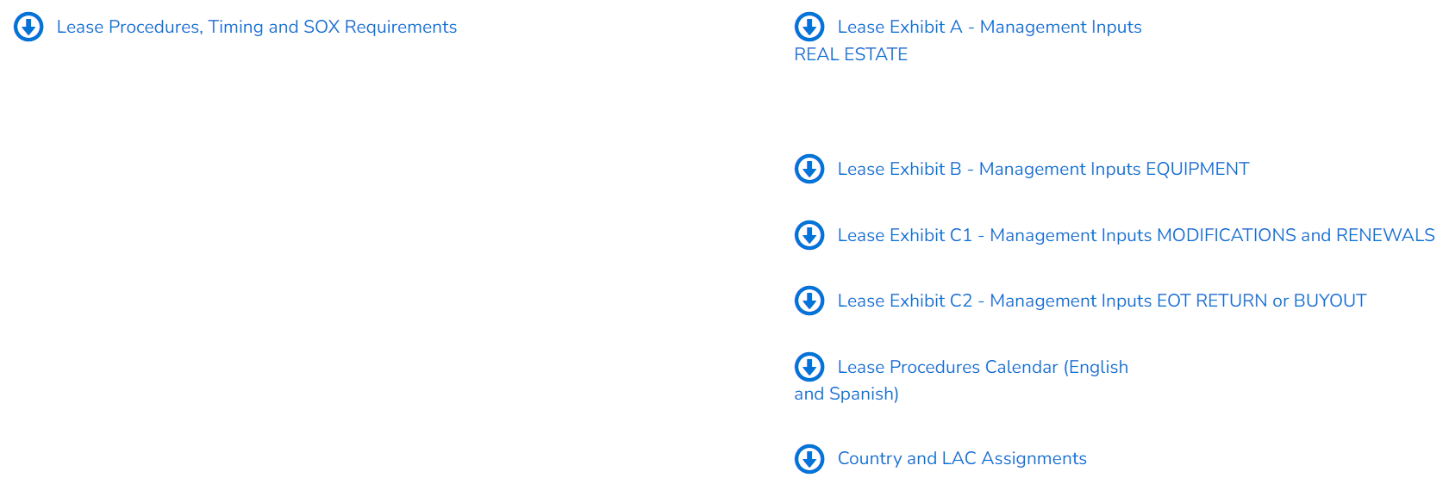
Where to find the Standard Work documents
https://brinksresourcelibrary.brinks.com/en/global-accounting-policies-procedures?__woopraid=XZ6LxxWFIMOH

Slide 5
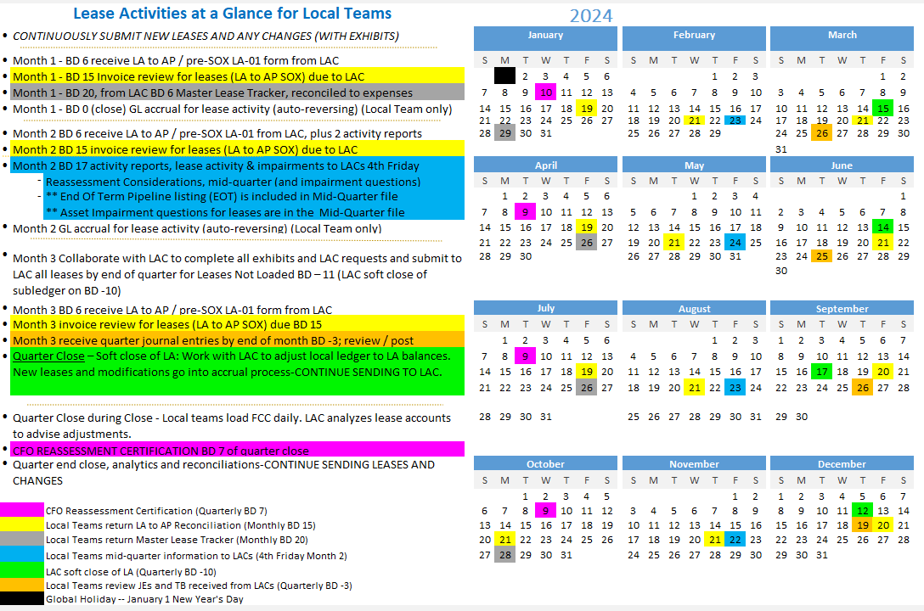

Slide 6
Who or what is a Lease Accounting Center?
Lease Accounting Centers are a BCO Accounting Center of Excellence with four locations speaking 4 languages (acronym is LAC and pronounced like a word)
BCO Lease Accounting Leadership leads the LACs for the assurance of SOX controls and accurate financial calculations for lease accounting and the very complex requirements.
Does the LAC do lease administration?
No, the LACs perform accounting, not administration. Lease administration at Brink’s is currently de-centralized and performed in various ways either by entity or by region. Basically, where the asset resides and is managed is where the lease is administered.
LACs DO perform US GAAP compliant lease accounting (GAAP=public company compliant Generally Accepted Accounting Principles)
IFRS accounting is available if needed
for all Brink’s countries/entities with more than $1M-$2M USD in lease agreements (in-scope)
In-scope entities provide accounting for leases that
are > 1year AND <$30K in total payments
have terms of 1 year and less, and
are deemed to be out of scope or immaterial by the LAC.
LACs maintain the accounting subledger for both assets and liabilities related to the lease and reconcile to both FCC and to local ledgers (in Blackline) for all “material” long term leases. Subledger is Lease Accelerator and is referred to as LA. LA letters can mean either Lease Accelerator or Lease Accounting – they are both kind of the same.
partner with countries/entities (LAC customers) to assure compliance with the Brink’s Lease Policy.

Slide 7
Lease Accounting Center teams and customers
Lease accounting is performed by four global Lease Accounting Centers (LACs). Kathryn Ingerly, CPA, Senior Manager – Global Lease Accounting, is the process owner for lease accounting, managing the 4 LACs and reporting to Joe Zevnik.
Lease Accounting Center | Team Leaders | Represented Countries/Entities
US – Dallas English | Jairo Florez 5 staff | BCO Corporate United Kingdom US Brink’s Incorporated Canada Brink’s Capital Canada Capital BGS US Brink’s International All US-based entities Payment Alliance Intl.
Brazil Portuguese & Asia | Taironi Costa 2 staff | Brazil ePago Brazil Macau Japan Hong Kong Consolidated Singapore Testlink UK Ireland Ireland ATM Note Machine India Malaysia Indonesia
Shared Service Center Spanish & Other | Camilo Briceno 6 staff | Argentina ePago Colombia Panama Chile ePago International SEM Panama Colombia Mexico SSC Colombia Dominican Rep Israel Greece Russia Germany GS Switzerland Czech Republic Romania Dubai Kuwait Philipines Portugal
France French | Helene de Vendegies 2 staff | France Madagascar Luxembourg Temis Morocco Reunion Mauritius Netherlands Belgium

Slide 8
Vision and Strategy for Lease Accounting Centers
Vision
Global collaboration for consistent, accurate and available Lease Financial Results.
Global Lease Accounting – same data strategies, same rules, procedures and methods for Brink’s everywhere (BBS methods)
Strategy
Complete Quarterly Procedures Timely with Accurate Outcomes and NO SOX CONTROL DEFICIENCIES
Work with Local Operations and Accounting to be predictable and accurate
Improve Lease Procedures
Learn and use tools to be more efficient
Create and support a complete lease accounting environment for all leases
Support continuous improvement to provide all lease accounting from LACs

Slide 9
A few basics about Brink’s leases…
Categories of Leases
Capitalized Operating Leases
Finance Leases (previously called “capital” leases)
Short Term Leases
Immaterial Leases (longer than 1 year, but less than $30,000 USD in life of the lease payments)
Types of assets that are accounted for – EVERY fixed asset category can have all categories of leases.
There are or will be GL accounts in Finance Leases and in Capitalized Operating leases for every asset class in the Fixed Asset Policy.
If it can be bought, it can also be leased – the asset accounting is the same except it needs to also reconcile to the liability and follow US GAAP for expense disclosures in the annual SEC 10K report.
Lease assets require more collaboration than purchased assets because the lessor has to be kept informed AND there are different rules in both accounting and in taxation for leased assets.

Slide 10
Lease Procedures, Timing and SOX (standard work document)
5 segments for more precise definition of responsibilities

Slide 11
Lease Policy Compliance Procedures
What is the trigger for information to be sent Always and Promptly to the LACs
New Leases or Changes to Leases
Exit a Lease Location or abandon a lease asset (communicate at Management Decision Date, at lessor notification date AND at “exit” or removal from operation)
Sale Leaseback transactions (need the sale invoice, agreement and entry as well as the leaseback agreement)
Contract Review for a) >$2M USD, b) an asset is part of a service offering, c) Brink’s does not own the asset
Improvements paid by the lessor
Construction at a leased location
What to send
Lease Exhibit, filled out with what you know and what you are trying to get accomplished with the supplier/lessor
Lease Exhibit A New Real Estate Lease
Lease Exhibit B New Equipment Lease (NEW TEMPLATE-please download newly)
Lease Exhibit C-1 Modification of Lease (any type of lease) (NEW TEMPLATE-please download newly)
Lease Exhibit C-2 Modification-Return or Buyout of Lease (any type of lease) (NEW TEMPLATE-please download newly)
Draft agreement and budget approval for lease (CER or LAR)
Final Signed Agreement by all parties (send last – do not hold the above to wait for this)

Slide 12
Procedures and Controls in Order of Performance
Complete and timely accounting entries depend on complete and timely lease information from the local teams.
What are the ongoing responsibilities of the Local Teams?
Send information before the final signatures (final signatures are definitely required, but not first)
Maintain the Master Lease Tracker for all leases and submit to LAC quarterly, fully updated (SOX test is Q2 bal in Q3)
Charge expenses to the right lease expense accounts for type of lease – type matters for disclosure – using LA entries
Work with LAC on implementing and properly using LA AP Clearing expense accounts:
LA does the coding for all leases in LA if Local Teams use AP Clearing for leases in LA
Short term and immaterial leases recorded correctly into these accounts allow more timely year end reporting
Complete the Lease Exhibits for Lease Term, components being leased and payment structure then review after all updates by LAC team to assure the basics are right – make sure what is documented is correct
Make sure both local lease owner/asset owner AND finance/accounting know about the lease—no surprises
Monthly payments analysis – every payment is validated and the components described to assure compliant recording
Complete ALL components of Reassessment Considerations Mid-quarter workbook
This is where Impairments should be reported; give LACs the information here to know about asset abandonments
Be aware of and responsive to End Of Term events
Renewals, changes in reasonable certainty for length of stay or use
Hold your LAC accountable to keep the schedule and return all items to your LAC according to the schedule

Slide 13
Procedures and Controls in Order of Performance
What are the ongoing responsibilities of the LACS?
Process Exhibits and new leases promptly so additional information needed can be timely communicated.
Solicit additional information as needed to complete the Lease Exhibits to assure complete understanding of lease then enter into subledger based on what is documented.
Return the Master Lease Tracker to local teams with requests/suggestions for better expense reporting.
Make sure FCC and MLT agree to Lease Accelerator quarterly, fully updated;
MLT is quarterly, with SOX control in Q3 (Q2 balances reported to LAC in month 1 of Q3);
Early completion of MLT in Q1 for Q4 balances supports quicker completion of 10K disclosures.
Provide guidance and responses for coding expenses to the right lease expense account(s) for the type of lease.
Adjust journal entries based on Local choice of how expenses are posted and work to cause aligned lease expense recording to improve forecasting and year-end disclosures.
Monthly payments analysis – Using info submitted by Local teams, enter variable cost and other expenses into LA
Complete entry of items reported in Reassessment Considerations, EOT and Impairments quarterly
Continue to track new lease activity and assure proper accounting cut-off with adjustment and OOP reporting
Share with local team what is on Leases Not Loaded for finance leases
Create journal entries, quarterly trial balance reports & reconciliations and accounting rollforward reports
Collaborate with Local Team to assure lease accounts reconcile to the local subledger

Slide 14
Procedures and Controls in Order of Performance
What are the Quarter End responsibilities?
After the 4th Friday of the 2nd month of each quarter and the submission of Reassessment Considerations Mid-Quarter workbook, if you have asset abandonments/impairments, schedule time with your LAC to review the current status and so you will understand the asset impairment that should occur.
If you are submitting a restructuring form for the quarter that includes something about one or more leases, it should be mentioned in the Reassessment Considerations Mid-Quarter.
Submit as much information as possible about your lease activities by the 4th Friday of the 2nd month of the quarter – mark your calendars.
Lease activity cut-off is BD -11 and the LACs need 3 weeks to process and finalize quarter information (soft close).
BC -11 means end of quarter less 11 business days and there are no more entries into Lease Accelerator for the quarter.
Lease journal entries can be to you by BD -3 when your lease activity is submitted fully by the 4th Friday of the 2nd month of each quarter.
Collaborate with LAC to understand and agree with ledger entries and Lease Portfolio Trial Balance-these are yours
Collaborate with LAC to assure good accounting cut-off and know the content of your Leases Not Loaded
Help LAC know when FCC is loaded so balances can be checked. Load FCC early so there will be time to fix issues
CFO CERTIFICATION OF MOST MATERIAL LEASES ON THE MANAGEMENT REPRESENTATION LETTER ON BD 7
LAC sends certification form on BD 2 to Lease Owners with copy to CFO; identify Local support to get this process done on time
Review analytics information provided, so you also know what happened with your leases
Keep submitting all new lease and modification information as soon as draft agreements are available so LAC is aware and continues to provide information about leases that may not have gotten loaded into the subledger. Please do not hold information and submit all at the same time – complete Lease Exhibit and send as it happens.
Blackline reconciliation approval after LAC preparation and review

Slide 15
SOX Controls for Leases (country / entity controls)
4 BCO required controls – 3 collaborate with LACs : These will be tested by both Brink’s SOX and by KPMG
Specified countries / entities to collaborate with LACs
LA-01 LA to AP; Template provided by LAC, completed and returned to LAC by BD 15.
Goal is to provide the differences between LA payment value and invoiced payment value, by lease.
LA-02 Master Lease Tracker annual reconciliation to Lease Expense in Q3 for Q2 YTD expense values, currently available documents and confirmed end date of current agreement.
A quarterly “non-key” control to list leases and check end dates exists for this to help keep this from being overly difficult at the annual time.
LA-03 Reassessment Certification of most material leases is prepared by lease owner in-country, sent to lease accountant for review and to CFO for certification.
Due to LACs on same day MRL is due to BCO – business day 7.
LA-04 Asset Retirement Obligation (ARO) each country/entity tracks and records all remediation obligations on all assets, including on leases.
3 LAC controls that correlate to country / entity controls
BCO-LA-25 Review country LA to AP and document necessary adjustments to lease subledger by BD 20.
BCO-LA-26 Review country Master Lease Tracker and assure complete listing is reconciled to total lease expenses – LA, short-term and immaterial – within less than $25k,
that all current agreements are stored and are the ones reflected in the lease accounting tool and that the end dates of the leases sent to the countries agree to lease accounting tool.
BCO-LA-02 Reassessment Certification of most material leases is reviewed on business day 7 by the LACs and Leases Not Loaded is updated for any changes since the Reassessment Considerations mid-quarter was received.
ARO is not collaborated with LACs, as it relates to leasehold improvements accounted for at the local level.

Slide 16
Lease Accounting Strategy #1
Complete Quarterly Procedures Timely
with Accurate Outcomes and
NO CONTROL DEFICIENCIES
Please know the calendar and be timely with all deliverables.
Timeliness compliance emails for all deliverables and entities will begin in Q3.
Escalation for lack of timely responses will start on day after due date.
Watch for escalation process to be published to you soon.

Slide 17
Lease Accounting Upcoming efficiencies
Continuous Improvement to create efficiencies and information
Smartsheet Workapps form for local teams to submit directly to centralized LAC workflow
Remove the inefficiency of email
Rollout planned for beginning of month 2 in Q3; some limited rollout prior
Smartsheet Workapps Report
See a listing of everything you have submitted
Working to report the status within the LAC workflow to you (future event)
Expansion of the AP Clearing as an expense account strategy
Lease Exhibit A re-write coming before end of year
Lease leaders will collaborate more closely for clarity on BCO Month-end Close calendar
Expanded Leases Not Loaded reporting to Local Teams to include operating leases

Slide 19
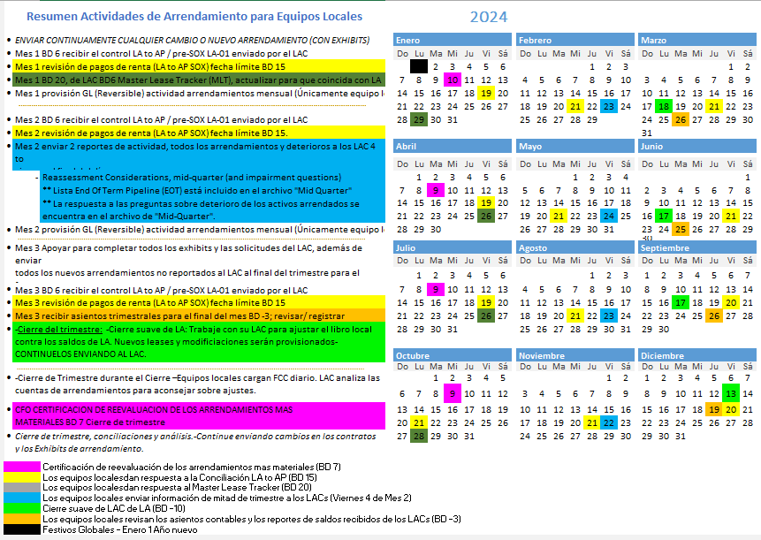

Slide 20
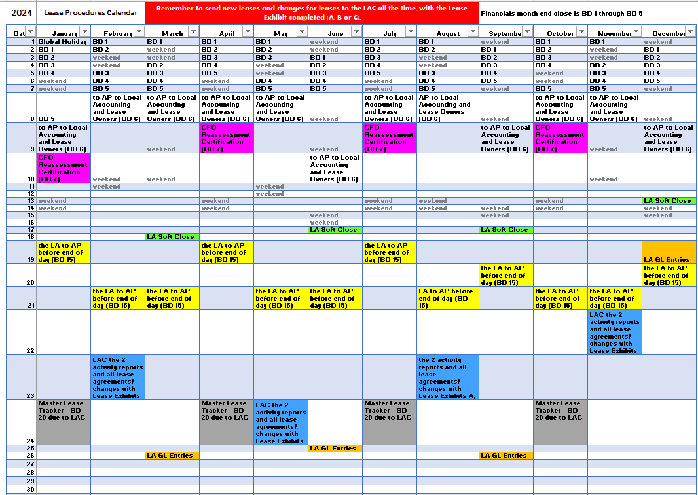

Slide 21
Continuous Improvement is Collaborative
Send us your thoughts about making this collaboration of information flow and financials for leases better
Send your best idea for smoother flow of information about leases to these 3 people:
Team Leader of your LAC
Lease Accountant assigned to your country/entity
Kathryn.Ingerly@brinks.com
Your suggestions will be reviewed as part of each LAC’s Weekly Work Session

