Slide 1
Instructions
Below are instructions about this presentation.
This presentation is about what to expect as a Lean Champion and helps establish a unified approach to rolling out Lean across the company.
If your country or team has already implemented Lean, you don’t need to change anything. However, please review this information and consider adding what’s helpful to what you are already doing.
As you go through the information, please update or customize – if needed – to reflect the details about the Lean rollout in your area.
On slide 11, Regional OpEx leaders should add any additional content / messaging that is appropriate for your countries.
We recommend that you keep your country’s HR team up-to-date about the details of the Lean rollout. Their collaboration will be key in ensuring successful Lean training and adoption.

Slide 2
Lean Champions
What to Expect
Notes:
Welcome comments:
Thank you for being here today.
Thank you for serving as a Lean Champion.
Lean is a critical part of our company strategy and you are playing a key role in ensuring its success.

Slide 3
Agenda
Overview
About Lean
Where we are with global rollout
Roles & Responsibilities
Lean roles
Champion responsibilities
What’s Next
Support & resources
Notes:
We want to make sure you are set up for success as a Lean Champion and that you have the support you need.
We wanted to get all the champions together and discuss what you can expect and to answer any questions.
So today we will … [go over the agenda]

Slide 4
About Lean – Overview
Lean is a management methodology we use to evaluate and improve processes and performance.
The Lean mindset, tools and practices help us continuously improve work processes, purposes and people.
Lean helps us maximize value and create capacity.
We are globalizing our Lean practices to accelerate our strategy and capture the value of growth initiatives.
Introduce Digital Solutions
(IDS)
Accelerate Profitable Growth
(APG)
Deliver Operational Excellence (DOE)
Lean is well established in our Latin American operations, and we are now globalizing and expanding it to other regions.
Notes:
First, we always want to take a moment to remind ourselves about what Lean is and why we are expanding it across Brink’s.
Operational Excellence is one of Brink’s three strategic objectives.
Lean – as a management methodology – is what we use to help us achieve Operational Excellence by evaluating and improving our processes and performance.
Lean mindset, tools and practices help us:
Continuously improve,
Maximize value,
Create capacity,
Accelerate our strategy, and
Grow
Lean is a proven methodology at Brink’s. We’ve had tremendous success with it in Latin America, and now we are expanding it to the rest of the world with your help.

Slide 5
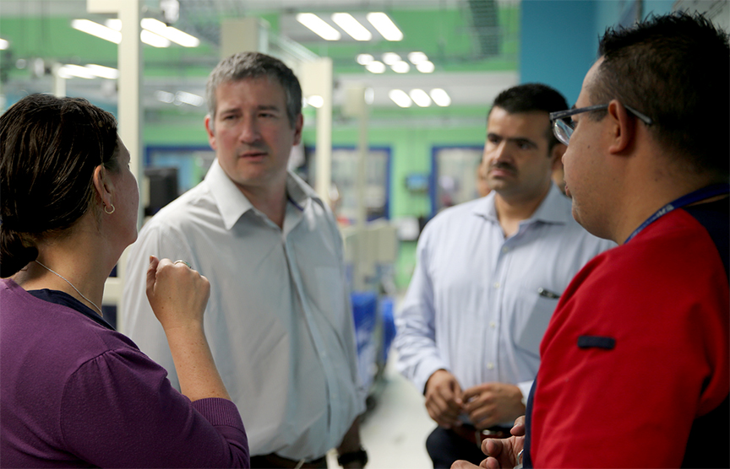
How Lean Helps Employees
With Lean training, Brink’s is investing in helping us learn and grow and teaching us skills we can use at work, at home and in our communities.
Lean is all about people.
Lean will help us:
unleash our power, creativity and potential
see ways to improve the work we do
figure out how to fix or remove the frustrations we encounter at work
Teammates in Mexico use Lean thinking and skills as they work together.
Notes:
While Lean does make a difference for the business of Brink’s, more than that, Lean is about and for our people.
Lean is designed to improve the way we do our jobs and our workplace culture.
Lean is a priority, which is why Brink’s is making this incredible investment in us, helping us learn and grow in ways that will benefit us at work, home and in our communities.
Lean is all about us. It’s about unleashing our power and potential. With Lean, we will be empowered to think and work differently. We will be able to see ways to improve the work we do.
And we will be able to figure out how to fix or remove the frustrations we encounter as we go about our work.

Slide 6
Where We Are with Global Rollout
2020
Developed plan, tools and resources for global rollout of Lean
ELT communicated plan to BLT
Developed and deployed communications for rollout
Operational Excellence Council worked with countries to understand rollout and expectations
Q1 2021
Continued work with countries to roll out Lean
Worked with countries to complete Operational Excellence assessment and develop Lean roadmaps
Determined tracking for results and impact
Developed global Lean training eModules for Bronze Level certification (Silver and Gold level training to come)
Translated training into multiple languages
Identified network of Lean Champions to help with implementation
Lean is not a temporary initiative; it is a part of how we do business.
Notes:
Now let’s take a look at where we are.
First, here are some highlights of what we’ve accomplished so far with Lean. [Go over list]
Remember that Lean is not a temporary initiative. The work we are doing today will continue throughout the year and into the years to come.

Slide 7
Where We’re Going
2021 – Q2-Q4
Develop and deploy Lean training for Silver level (expected Q3)
Track and hit targets related to Bronze level training (goal: 25% of all managers to be Bronze certified by end of 2021)
Continue momentum and implementation of Lean (ongoing)
Track and measure using Lean tools to gauge impact and results (ongoing)
Develop process for sharing success stories and best practices (expected Q2)
Develop and deploy additional Lean tools and resources as needed (ongoing)
Lean is not a temporary initiative; it is a part of how we do business.
Notes:
Now let’s look at where we are going with Lean for the next few months.
[go over list]
If plans or timelines change, we will keep you informed.
As a reminder, Lean is not temporary. Lean is the way we do business at Lean and the way we can help drive Operational Excellence.

Slide 8
Roles and Responsibilities
The following roles help drive the implementation and adoption of Lean.
Operational Excellence Council – Company-wide Rollout and Oversight
7 Lean experts representing every Brink’s region (led by Jamal Powell)
Develop and support Lean implementation
Work closely with finance, training and communications
Lean Champions – Local Implementation & Communications
Stay informed about Lean activities and expectations by working closely with your regional leader
Work with GM and HR to administer and communicate about Lean at local level
Lean Coaches – Local Guidance
Walk alongside employees as they learn and implement Lean
Work in coordination with regional leader and Lean Champion
Notes:
The following roles were created to help drive the implementation and adoption of Lean across the company.
[Go over roles]
These roles are considered best practices for Lean adoption and have worked well in Latin America where Lean methodology has been in place for the past few years.

Slide 9
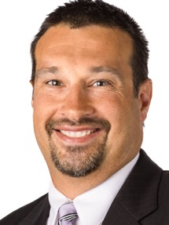
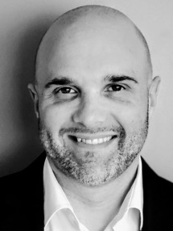
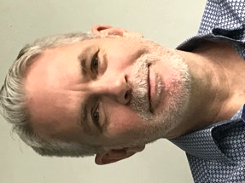
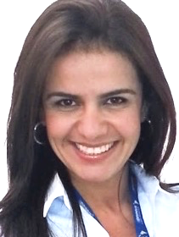
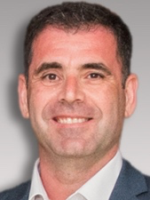
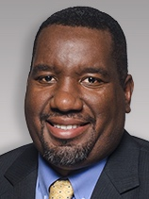
Operational Excellence Committee | Expert Support
James Hennessy
BGS
Jeff Klabunde
United States
John McClymont
Canada
Raluca Meledjiev
Asia Pacific and BGS
Priscila Palhares Mendes
Latin America
Michalis Papakis
Brink’s Europe, Middle East and Africa
Jamal Powell
VP Operational Excellence
Contact your regional experts for help with planning and execution of Lean initiatives
Notes:
As a reminder, these individuals make up the Operational Excellence Council.
They are a great resource for you.

Slide 10
Additional Support & Resources
Training is the main component in learning about Lean. However, other resources are available, including:
The Lean handbook, flash cards and other resources are on the Center of Excellence SharePoint site.
Lean videos are available featuring leaders talking about the importance of Lean in their regions.
Operational Excellence leaders and Lean coaches can answer questions, discuss concepts and provide support.
Optional Books & Resources
Everything I Know about Lean I learned in First Grade
Managing to Learn
5S for Operators
Videos (available in our SharePoint Knowledge Library)
Notes:
The best way to learn about Lean is through training. We encourage you to take the training and inspire others to do the same.
In addition to that …
[Go through list]

Slide 11
What’s Next
Stay connected: Set a meeting with your regional leader (if you haven’t already) to determine next steps and how to coordinate Lean efforts in your country.
Encourage training: Push out & support training. Take Bronze training, if you haven’t already. Encourage country leaders & management teams to get trained.
Gather success stories: Collect success stories as training and Lean is implemented in your region. Share with your regional leader.
Increase awareness: Use Lean communications toolkit to increase Lean awareness, understanding and enthusiasm. Keep HR updated.
Provide feedback: Take the forthcoming survey designed to inform future initiatives and resources to support the Lean rollout.
Notes:
As we close, these are the next steps you can take.
[Go over list]
Again, we really appreciate your help in making Lean successful and helping to transform Brink’s.

Slide 12
Q&A
Notes:
Thank you for your time today. Now for any questions.

