Slide 1
Lean Champions
Role & Responsibilities
Notes:
RALUCA
Welcome comments:
Thank you for being here today with Jamal Powell and me.
Thank you for serving as a Lean Champion.
Lean is a critical part of our company strategy, and you are playing a key role in ensuring its success.

Slide 2
About our Discussion
Objectives
Get to know each other and create a network of Champions across our region
Build a greater understanding of a Champion’s role and responsibilities
Notes:
RALUCA
We want to make sure you are set up for success as a Lean Champion and that you have the support you need.
We wanted to get all the champions for our region together, so we can get to know each other, and discuss what you can expect and to answer any questions.

Slide 3
5 Questions to Get to Know Each Other
What is your name?
What country do you work in?
How long have you worked at Brink’s or G4S?
Why are you excited about Lean?
What do you enjoy doing when you aren’t working?
Notes:
RALUCA
It’s important that we get to know each other better and understand that we are not working alone. We have each other as support. We can share ideas, ask questions and be an encouragement to each other.
So let’s start by getting to know everyone a little more.
I’ll start by answering these 5 questions. And then I’ll call on each of you to answer them as well.
Thanks for doing that. It’s great to get to know each of you more. Now, I’ll ask Jamal to talk with us about Lean.

Slide 4


About Lean – Overview
Lean is a management methodology we use to evaluate and improve processes and performance.
  The Lean mindset, tools and practices help us continuously improve work processes, purposes and people.
  Lean helps us maximize value and create capacity.
We are globalizing our Lean practices to accelerate our strategy and capture the value of growth initiatives.
Introduce
Digital
Solutions
(IDS)
Accelerate
Profitable
Growth
(APG)
Deliver
Operational Excellence
(DOE)
Lean is well established in our Latin American operations,
and we are now globalizing and expanding it to other regions.
Notes:
JAMAL
First, we always want to take a moment to remind ourselves about what Lean is and why we are expanding it across Brink’s.
Operational Excellence is one of Brink’s three strategic objectives.
Lean – as a management methodology – is what we use to help us achieve Operational Excellence by evaluating and improving our processes and performance.
Lean mindset, tools and practices help us:
Continuously improve,
Maximize value,
Create capacity,
Accelerate our strategy, and
Grow
Lean is a proven methodology at Brink’s. We’ve had tremendous success with it in Latin America, and now we are expanding it to the rest of the world with your help.

Slide 5
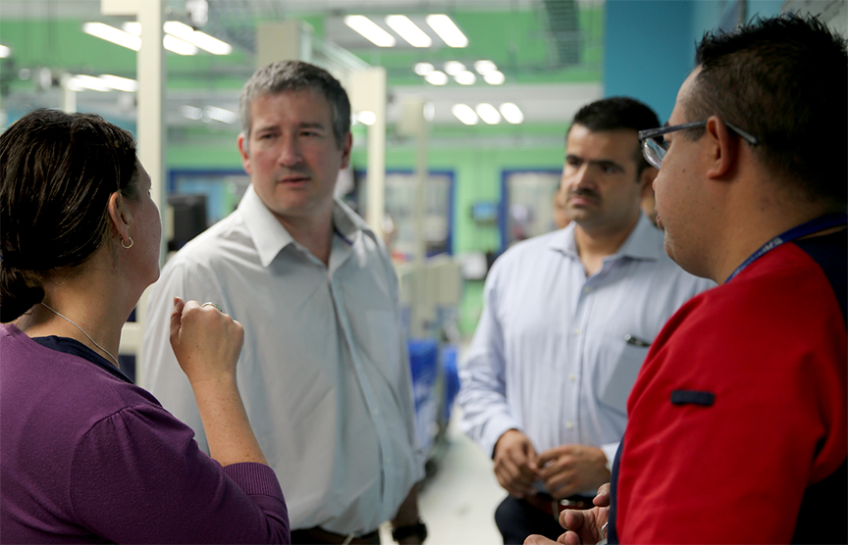
About Lean – All About People
With Lean training, Brink’s is investing in helping us learn and grow and
teaching us skills we can use at work, at home and in our communities.
Lean is all about people.
Lean will help us:
  unleash our power, creativity and potential
  see ways to improve the work we do
  figure out how to fix or remove the frustrations
  we encounter at work
Teammates in Mexico use Lean thinking and skills as they work together.
Notes:
JAMAL
While Lean does make a difference for the business of Brink’s, more than that, Lean is about and for our people.
Lean is designed to improve the way we do our jobs and our workplace culture.
Lean is a priority, which is why Brink’s is making this incredible investment in us, helping us learn and grow in ways that will benefit us at work, home and in our communities.
Lean is all about us. It’s about unleashing our power and potential. With Lean, we will be empowered to think and work differently. We will be able to see ways to improve the work we do.
And we will be able to figure out how to fix or remove the frustrations we encounter as we go about our work.

Slide 6
Reporting Example | Lean Priorities Monthly Dashboard
Initiative | 2021 Plan | YTD May Target | YTD May Actual | Status | Comments
Lean Savings (LC) | 8.536 | 1.879 | 2243
A3s | 522 | 172 | 63
Kaizen Events | 18 | 4 | 6
Lean Days | 204 | 46 | 24
Model Branches | 26 | 24 | 25
Job Instructions | 24 | 6 | 12
VSMs | 12 | 4 | 3
Total People Trained | 75 | 15 | 20
Bronze Certification | 20 | 10 | 13
Silver Certification | 45 | 5 | 0
Gold Certification | 80 | 0 | 0
Awards | 48 | 12 | 12
Will meet or exceed by target date
Initiative significantly changed
Will not meet or exceed
Notes:
JAMAL
As Lean is implemented, we will be asking for key data points to be reported monthly.
These data points need to be as accurate and clear as possible, as the reports will be sent to Doug Pertz and the Brink’s Board of Directors.
The Operational Excellence Council is working closely with country leaders to understand how to capture these metrics and how to complete all the necessary reporting.
As a Lean Champion, it’s important for you to know what will be reported and why.

Slide 7
Team for Lean
The following roles help drive the implementation and adoption of Lean.
Operational Excellence Council – Company-wide Rollout and Oversight
7 Lean experts representing every Brink’s region (led by Jamal Powell)
Develop and support Lean implementation
Work closely with finance, training and communications
Lean Champions – Local Implementation & Communications
Stay informed about Lean activities and expectations by working closely with your regional leader
Work with GM and HR to administer and communicate about Lean at local level
Lean Coaches – Local Guidance
Walk alongside employees as they learn and implement Lean
Work in coordination with regional leader and Lean Champion
Notes:
JAMAL
The following roles were created to help drive the implementation and adoption of Lean across the company.
[Go over roles]
These roles are considered best practices for Lean adoption and have worked well in Latin America where Lean methodology has been in place for the past few years.

Slide 8
3 Lean Champion Assignments
Facilitate the development of a Lean roadmap to plan and track the implementation for your country.
Help define targets and determine a cadence for review (ideally weekly).
Build a 6- to 12-month plan, be specific, and identify what to do in the next 1 to 3 months.
Define roles and responsibilities for everyone who is part of the review, and make it visual (set up a place where you can display the information and gather as a team to discuss progress).
Help define the right KPIs to track and improve.
Include them as part of the cadence for review.
Use them to see what kind of impact your actions are having.
Refer to your country’s Operational Excellence assessment for a baseline.
Make sure the Lean Bronze certification candidates can put what they are learning into action.
Facilitate (if you can) a hands-on workshops with the available materials.
Notes:
RALUCA
As a Lean Champion, we ask that you complete these three assignments.
[Go over #1 on the list]
Creating a Lean roadmap will help manage all the changes and will avoid placing the entire Lean “effort” on you only. We need the entire management team engaged and driving action.
[Go over #2 on the list]
A lot of work has already been done on KPIs for the Operational Excellence reviews.
Don’t forget that your country’s OpEx assessment helped to align the team around the current baseline and identified gaps. This is a tool to help you identify priorities for improvement. It also gives you an idea of what better can look like. Use it with the team to build your next 6- to 12-month plan.
[Go over #3 on the list]

Slide 9



Global Lean Program Overview
Lean Certification Level | Bronze | Silver | Gold
Expected Skills | Application of Lean principles and tools in daily work habits | Coaching others in the application of Lean tools and principles Facilitating Lean Days Focus on functional VSM improvements | Training others in the application of Lean tools and principles Facilitating kaizen events Focus on cross functional VSM improvements
Training Modules (eLearning & Application Workshops) | Building a Continuous Improvement Culture Problem Solving to Deliver Results 5S Workplace Value Stream Mapping Intro (VSM) Visual Management (VM) Training within Industry (TWI/JI) – Intro. Lean daily management – Huddle Total Productive Maintenance (TPM) | A3-Coaching Facilitation skills - Lean day Value Stream Mapping (VSM), (OBC), tack time Application – More technical training How to calculate cycle time, balance workloads, introduce tools Training within Industry (TWI) Creating of Job Methods/Job Relation Standardized Work (SW) | Lead a Kaizen event Scrum Innovation; Discovery Process, Strategy Deployment TWI master trainer
Knowledge Check | Pass all eLearning modules Complete all assignments | Pass all eLearning modules Complete all assignments | Pass all eLearning modules Complete all assignments
Deliverables | Complete an A3 Demonstrate the application of tools in the working area Demonstrate Gemba Walk | A3 Coaching x 2 Facilitate a Lean Day (work on 1 problem) and lead a VSM (current+future) + A3 | Facilitate Lean Workshop Facilitate a Kaizen Event (week long, review process and solve bigger problems) Lead a Cross functional VSM +A3 Lean Case Study
Duration | 5 months (between training, deliverables, A3 development and closing) | 6 months | 6 months
Reading Material/Books* | Everything I know about Lean I learned in first grade Lean Handbook and Flash Cards Managing to Learn 5S for Operators Videos | Learning to see Continuous flow Kaizen for the shop floor Humble Inquiry Videos | Getting the right things done Creating a Lean Culture Implementing TWI Toyota Kata The Art of Doing Twice the Work in Half the Time
Annual Recertification | Reach 10 points Complete e-learning (prerequisite) A3=3 points 5S=2 points Gemba Walk =2 points VSM event=3 points | Reach 20 points Complete e-learning (prerequisite) A3 = 3 points VSM = 3 points Coach A3= 6 points Lead Lean day= 8 points | Reach 30 points A3=3 points VSM = 3 points Coach A3= 6 points Deliver training (by slot)= 8 points Lead kaizen Event=10 points
Notes:
RALUCA
To talk in a little more detail about the 3 Lean Champion assignments, I want to briefly go over the Lean certification path and show how you can help your team implement the tools.
[Talk through the slide]

Slide 10
Online Training Launch & Supporting Materials – Bronze Level
Training Modules | Supporting Materials | Practice (Deliverable)
Creating a Continuous Improvement Culture | CI Culture & Problem Solving Workshop | Gemba (Process) Walk
Problem Solving (A3) |  | A3
5S Workplace Organization | 5S Workshop | Red Tag (Sort) Event
 |  | Cleaning Day
Visual Management | Visual Management & Huddle Workshop | Visual (Production Control) Board
Huddle |  | Practice Huddles
Training within Industry – Job Instruction | TWI & Job Instruction Workshop | Develop Job Instruction Card
 |  | Job Instruction Coaching
Value Stream Mapping | Value Stream Mapping Workshop | Participate in a VSM Event
Total Productive Maintenance | TPM Workshop | TPM Implementation
Notes:
RALUCA
Here is some more detail around the specifics of the training and supporting materials.
[Talk through the slide]

Slide 11
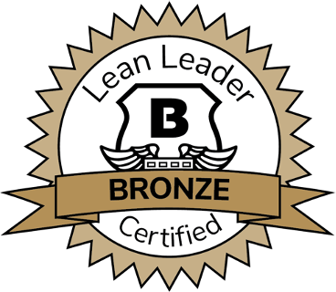
Overview of Bronze Training
Everyone is expected to participate in Lean training, starting with the Bronze level.
The training is divided into two parts: See It, Do It.
  See It: Employees are introduced to Lean tools and skills through an online
  learning system.
  Do It: Employees attend a workshop where we practice what we’ve learned.
  Once completed, employees will partner with their Lean coach to implement
  Lean tools in their workplace.
The training is self-paced but must be done within a reasonable timeframe.
Each participant has an assigned a coach or partner to walk through the training together.
Employees earn points for completing each task. It takes 10 points to complete the Bronze level.
From beginning to end, reaching the Bronze level should take about five months.
Silver and Gold levels available after completion of Bronze.
Notes:
RALUCA
It’s critical that all of us are trained, starting with the Bronze level.
You are expected to complete the training, and we ask that you help encourage others to take it.
The training is divided into two parts: See It, Do It.
In See It, we participate in eLearning modules.
In Do It, we attend a workshop where we will practice what we’ve learned. Once you have completed these 2 learning actions, you will partner with your Lean coach to implement Lean tools into your workplace.
As we go through the training at our own pace, we will earn points and work with a coach. We must earn 10 points to achieve the Bronze level, which should take about five months.
Online training will be deployed through the country’s LMS or available through the Global Training LMS.

Slide 12
Checklist of Ongoing Responsibilities
 | Stay connected: Set a meeting with your regional leader (if you haven’t already) to determine next steps and how to coordinate Lean efforts in your country.
 | Encourage training: Push out & support training. Take Bronze training, if you haven’t already. Encourage country leaders & management teams to get trained.
 | Gather success stories: Collect success stories as training and Lean is implemented in your region. Share with your regional leader.
 | Increase awareness: Use Lean communications toolkit to increase Lean awareness, understanding and enthusiasm. Keep HR updated.
 | Provide feedback: Take the forthcoming survey designed to inform future initiatives and resources to support the Lean rollout.
Notes:
RALUCA
In addition to the 3 Champion assignments, there are a few ongoing responsibilities for Champions.
As a Lean Champion, you can refer to this checklist for your ongoing responsibilities and expectations.
[Go over list]
We really appreciate your help in making Lean successful and helping to transform Brink’s.

Slide 13
Lean Success Stories
Notes:
RALUCA
We are already seeing the positive results of Lean implementation.
While training is essential, there are ways to start Lean quickly and easily – even while training is happening.
Here are some examples from countries that are already seeing great results.

Slide 14
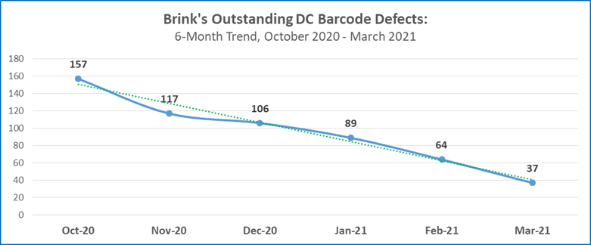
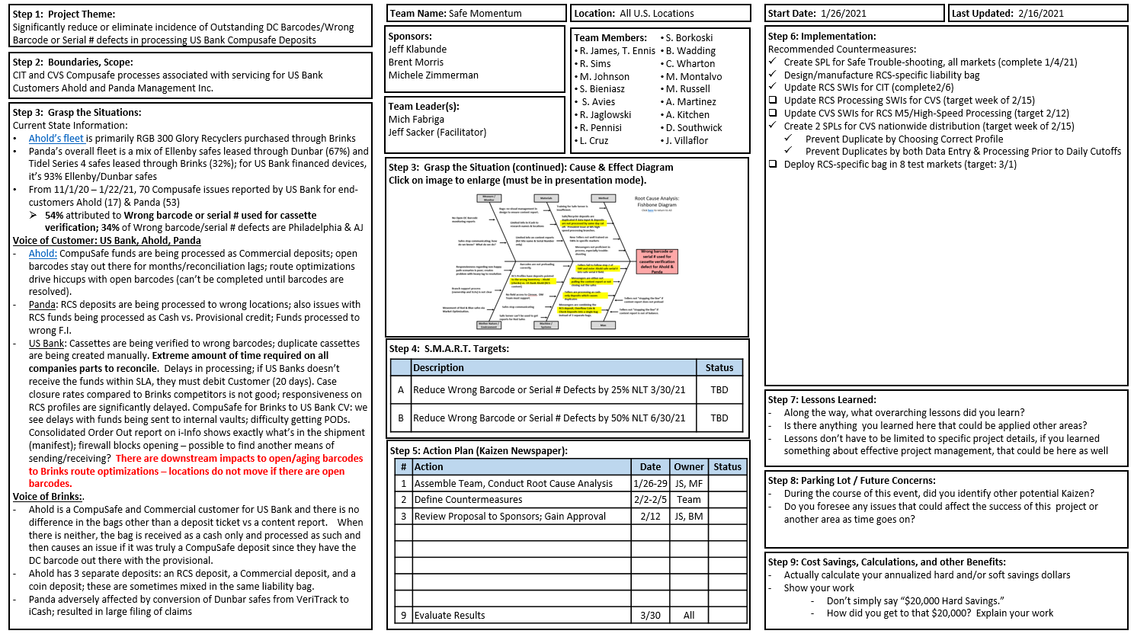
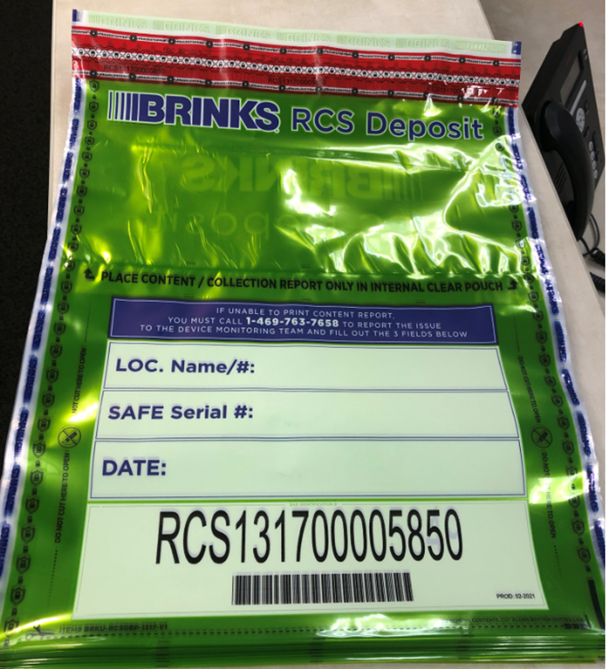
Lean Success | United States
Goals
Reduce the number of duplicate credits resulting from RCS content report not printing
Actions
Conducted A3 Kaizen event
Visual management color coding of RCS deposit bag
2 pocket bag design for visual confirmation that content report is present
Printed phone number to call for assistance if content report does not print
Added necessary fields to populate in event content report does not print to aid in accurate teller processing
Results
Notes:
RALUCA / OR UNITED STATES REP
[Talk through the slide]

Slide 15
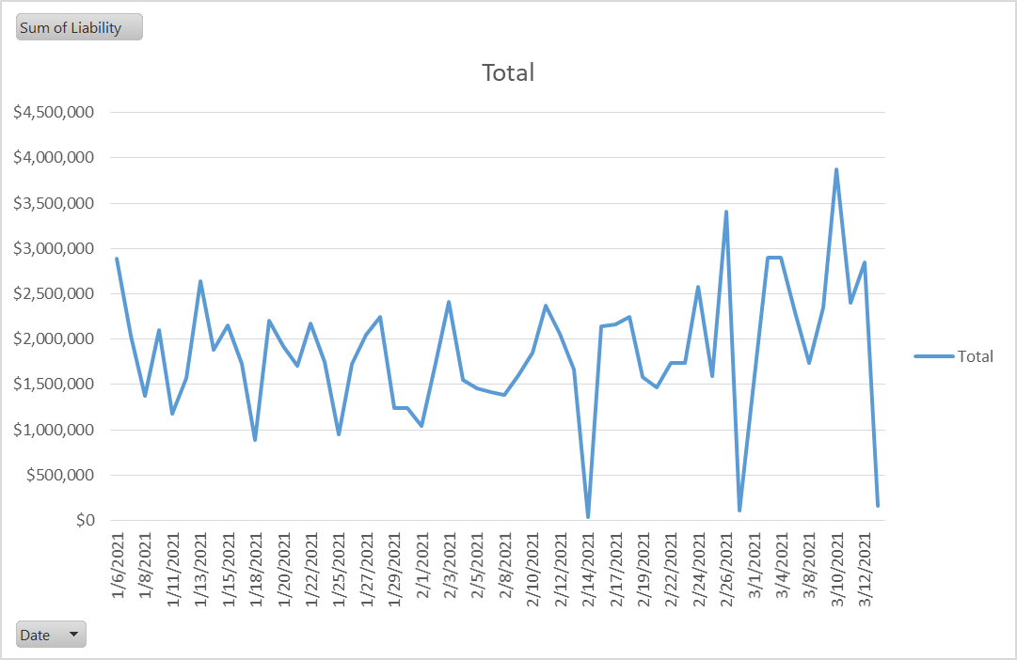
Lean Success | Canada
Goals
Align staffing required with exposed liability amounts at the Brink’s Canada Kingston facility
Actions
Monitored exposed liability amounts since start of January 2021
Measured required workload to sort and prepare incoming parcels for night run activity
Confirmed CSR requirements related to exposed liability and staff required by threshold
Restructured branch staff as a result of measured trends
Results
Able to adjust labor requirements between the hours of 14:30 – 17:30 each day
Savings of 15h / wk of straight labor savings
  Yearly cost reduction of $19.1k in operating expenses
Branch SG&A hours reduced
49%
Notes:
RALUCA / OR CANADA REP
[Talk through the slide]

Slide 16
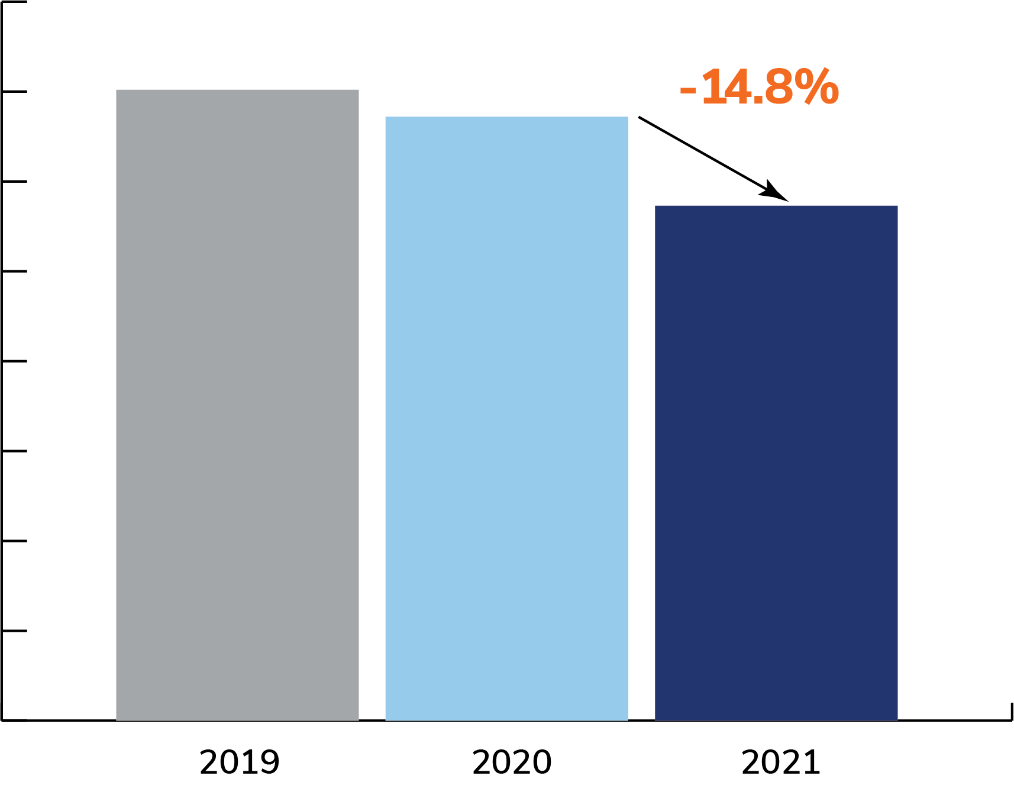
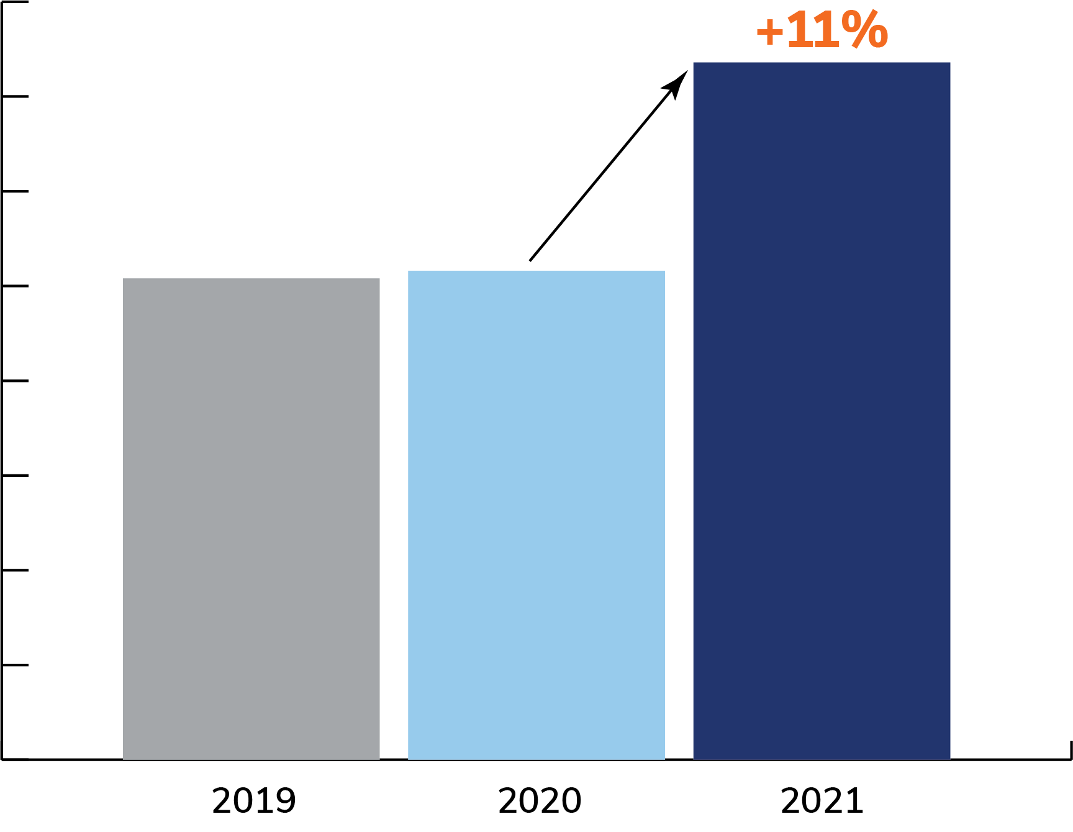
Lean Success | Mexico
Goals
Use Lean to reduce costs, as well as improve margin, productivity and employee capability when volumes declined significantly due to COVID-19
Actions
Taught employees how to use Lean tools to identify root causes & countermeasures
Used visual management to study work patterns to inform planning & staffing
Worked side-by-side with frontline employees, changing the mentality
Implemented bonus pay for productivity by team – not individual – to reinforce the importance of working together to solve problems
Results
Cost Per Bundle
Money Processing
Branch Margin
Notes:
RALUCA / OR MEXICO REP
[Talk through the slide]

Slide 17
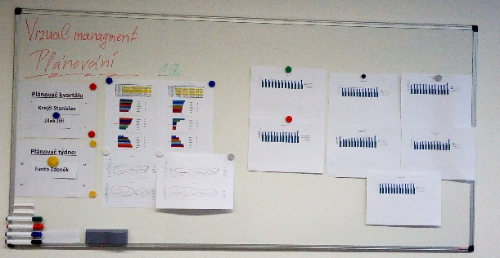
Lean Success | Czech Republic
Goals
Recover and Boost Performance in CIT/ATM Operations during the Pandemic (Jan-Mar 2021)
Actions
Introduce new set of KPIs (ST/Route, KM/ST, Hours/Route, ST/Hour, AM, PM, Premise Time)
Develop daily dashboard and establish performance targets by Branch
Make performance visible – visual management boards in the crews and in the Route Planning areas
Establish a governance system and measure route planning effectiveness daily
Route Planner Effectiveness
Results
CIT/ATM productivity increased by 9% in a 14 weeks period
What We Learned
Change starts with Leadership commitment
Setting clear expectations and measure performance daily creates accountability for results
Tools are just the vehicle to build new operating behaviors and culture
Notes:
RALUCA / OR CZECH REPUBLIC REP
[Talk through the slide]

Slide 18
Lean Success | Morocco
Goals
Decrease dispatch time between the pre-vault and the crew commander
Actions
Definition of the new process : check-out by sealed cart instead of bag by bag
Tested on 2 pilot branches
Validation of the new process with security
Implementation on the rest of the branches
Results
From 2020 to 2021
Dispatch time Bag by bag | Dispatch time Sealed cart
45 min/route | 10 min/route
Time wasted decreased by | Savings amount to
77% | 4 500$ /month
Notes:
RALUCA / OR MOROCCO REP
[Talk through the slide]

Slide 19
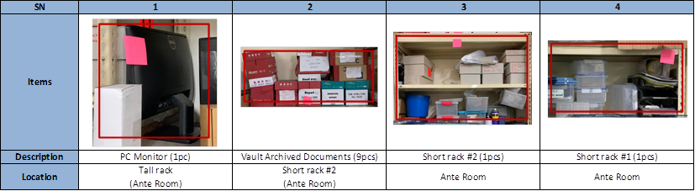
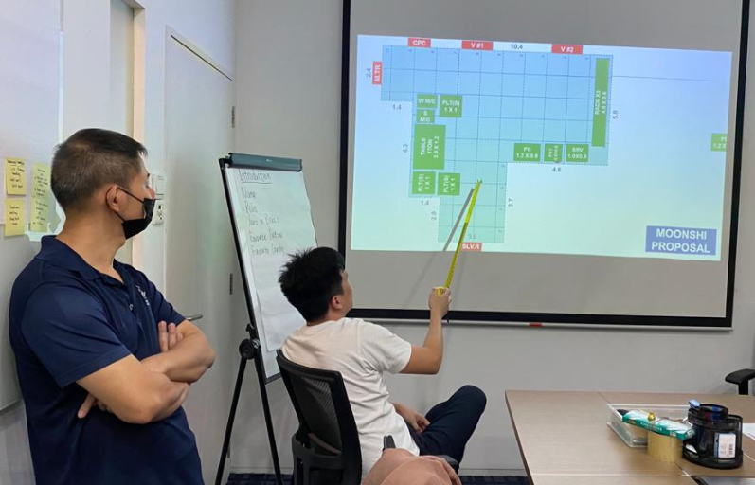
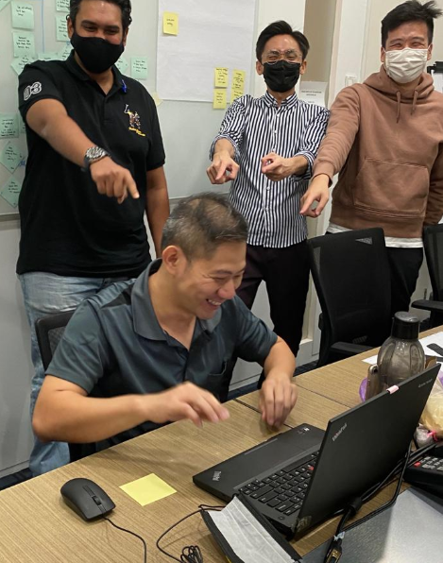
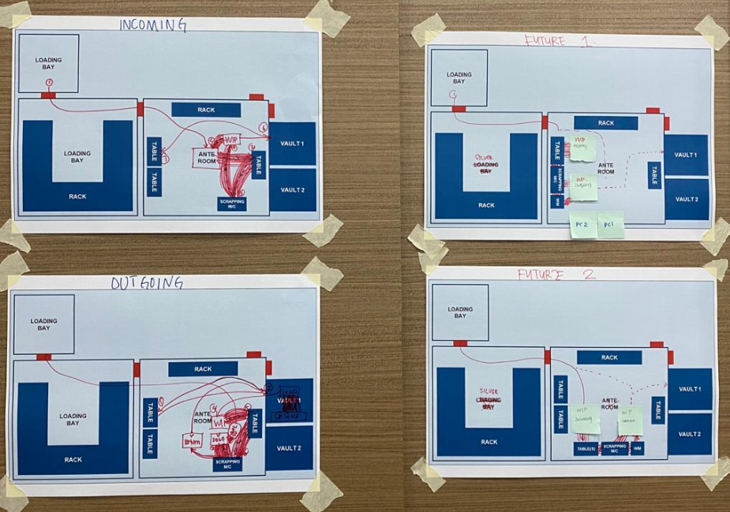
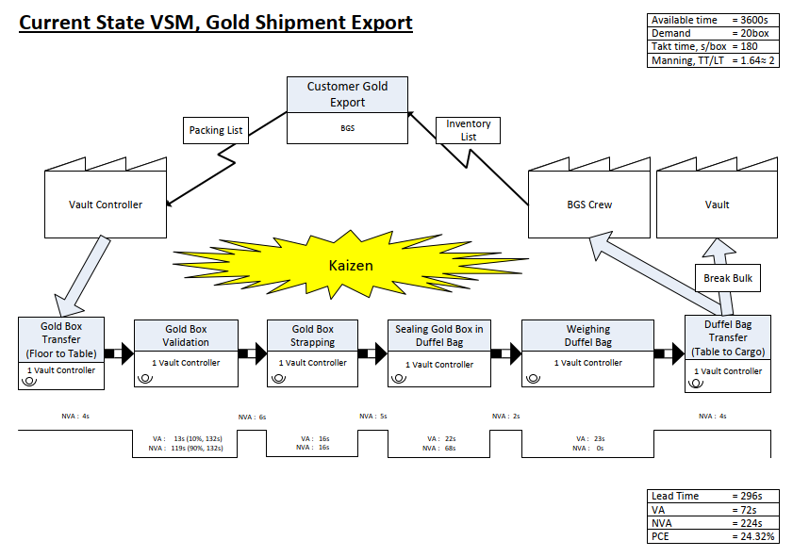
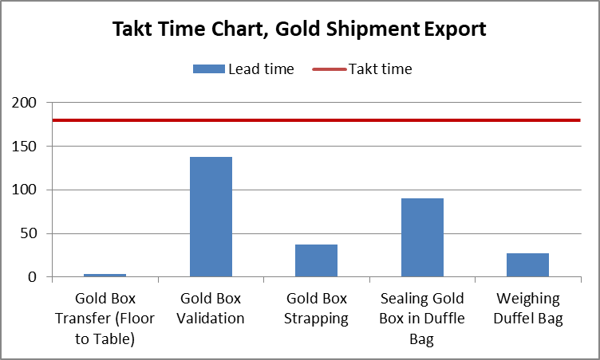
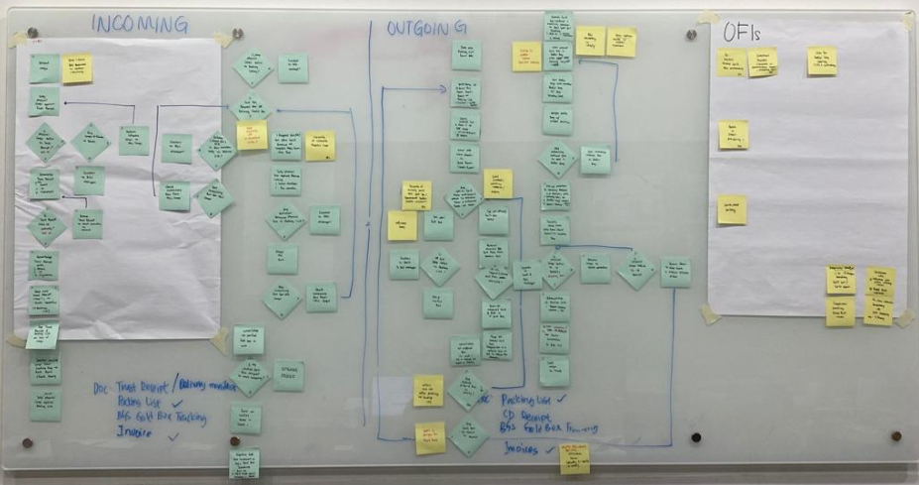
Lean Success | Singapore
GEMBA + Red Tagging (5S)
Brainstorming + Huddle
Spaghetti Diagram
VSM + Takt-Time Bar Chart
Process Map
Notes:
RALUCA / OR SINGAPORE REP
[Talk through the slide]

Slide 20
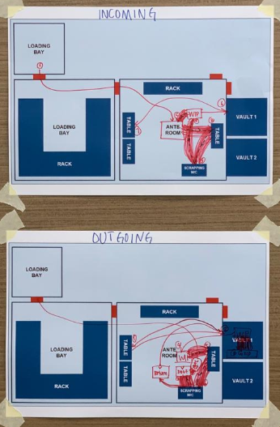
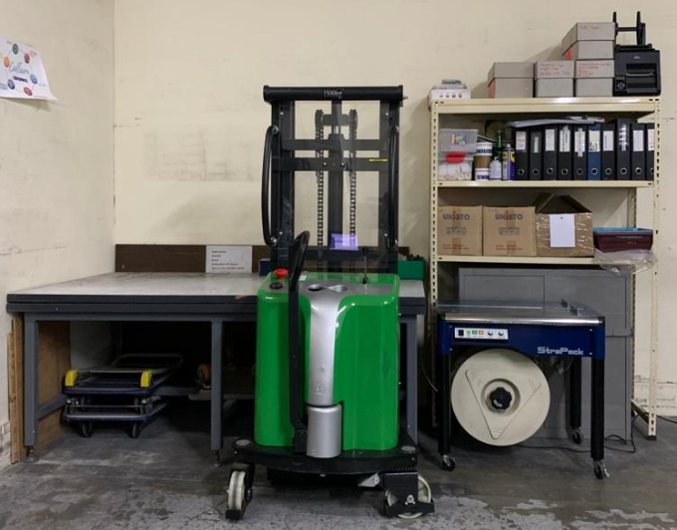
Lean Success | Singapore
Before Improvement (Apr 2021) | After Improvement (May 2021)
Long travelling distance between workstations Causing body fatigue and joint strain to Vault controller Congested workspace | Relocate workstations to minimize travelling distance Working ergonomic improved Workspace segregation for Pickpack and Gold shipment
Stacker
Processing
Table
Strapping m/c
Notes:
RALUCA / OR SINGAPORE REP
[Talk through the slide]

Slide 21
Q&A
Notes:
Thank you for your time today. Now for any questions.

