Slide 1
Lean Training Recognition Resources
Certificates, badges for email signatures and lapel pins

Slide 2
Instructions
To help celebrate employees’ completion of Bronze, Silver, Gold and Coach Lean training levels, we’ve created the following resources.
These are optional, but we do encourage their use. If you plan to use the certificates and badges, we ask that you don’t adjust the design and layout. We are working to create consistent Lean tools and resources for use throughout the company.
However, please do translate the certificates as needed. The badges will need to stay in English.
If you have any questions, contact Priscilla Pinon or Megann Marsalis.
CONFIDENTIAL. FOR INTERNAL USE ONLY – DO NOT DUPLICATE OR DISTRIBUTE.
2

Slide 3
Certificates

Slide 4


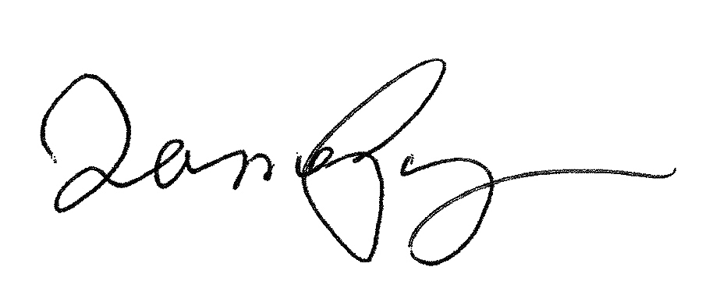
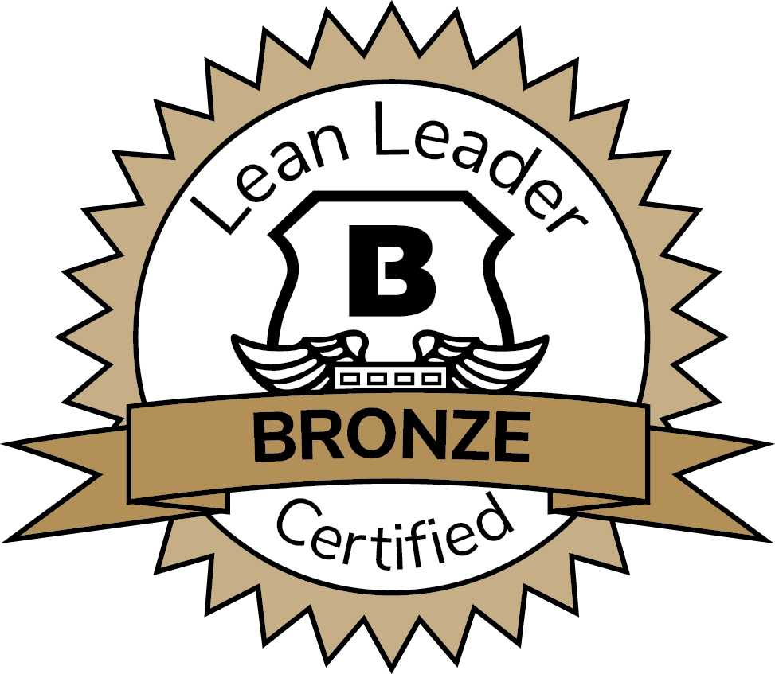
Lean Bronze Certified
In recognition of successfully completing, understanding and applying all concepts
and tools of the Lean Bronze level training, Brink’s officially certifies
<<Name>>
This certificate attests to your commitment to Lean and your contributions
in improving our workplace, growing our customer satisfaction,
and strengthening the operational excellence and transformation of Brink’s.
Jamal Powell
Vice President Operational Excellence
Date
<<Name>>, <<Title>>
Date

Slide 5

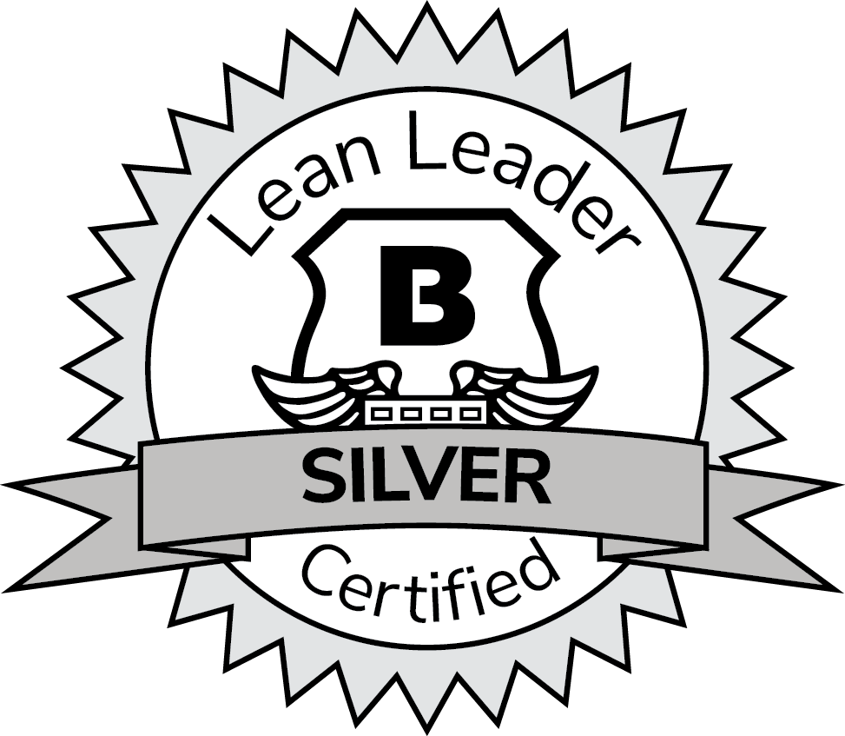
Lean Silver Certified
In recognition of successfully completing, understanding and applying all concepts
and tools of the Lean Silver level training, Brink’s officially certifies
<<Name>>
This certificate attests to your commitment to Lean and your contributions
in improving our workplace, growing our customer satisfaction,
and strengthening the operational excellence and transformation of Brink’s.
Jamal Powell
Vice President Operational Excellence
Date
<<Name>>, <<Title>>
Date

Slide 6

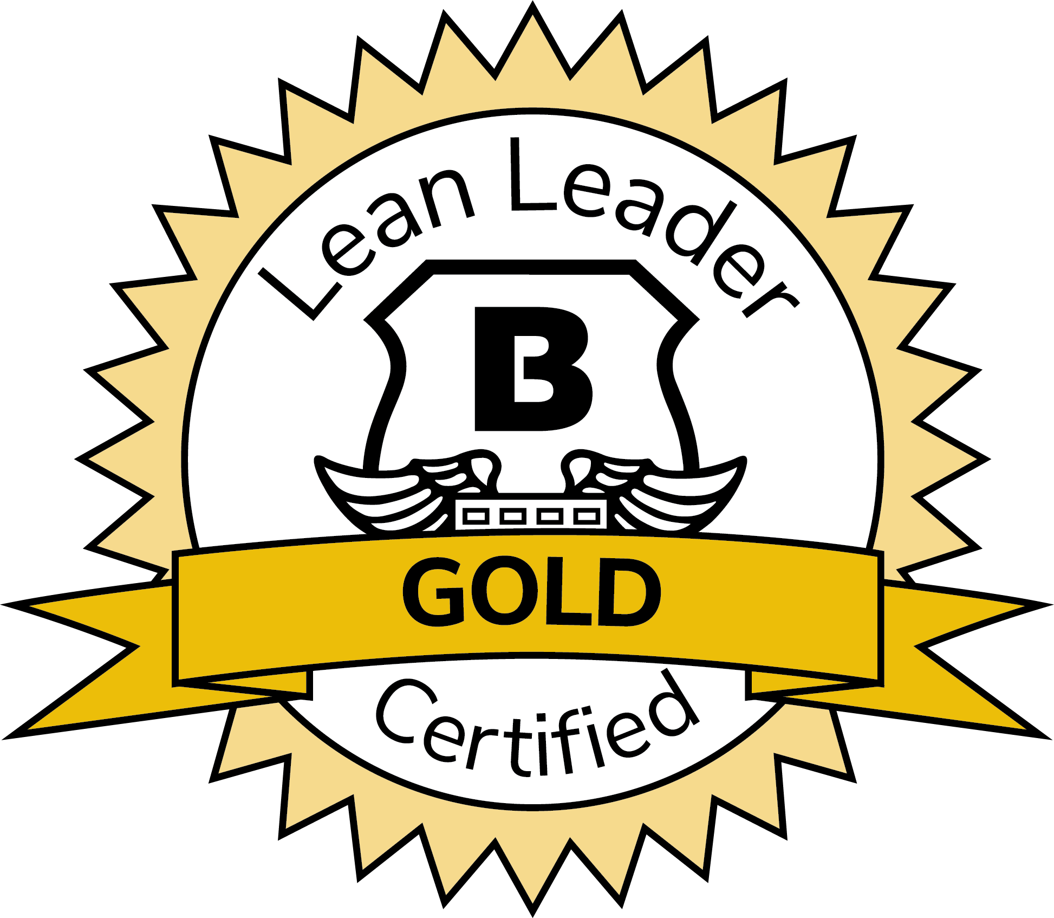
Lean Gold Certified
In recognition of successfully completing, understanding and applying all concepts
and tools of the Lean Gold level training, Brink’s officially certifies
<<Name>>
This certificate attests to your commitment to Lean and your contributions
in improving our workplace, growing our customer satisfaction,
and strengthening the operational excellence and transformation of Brink’s.
Jamal Powell
Vice President Operational Excellence
Date
<<Name>>, <<Title>>
Date

Slide 7

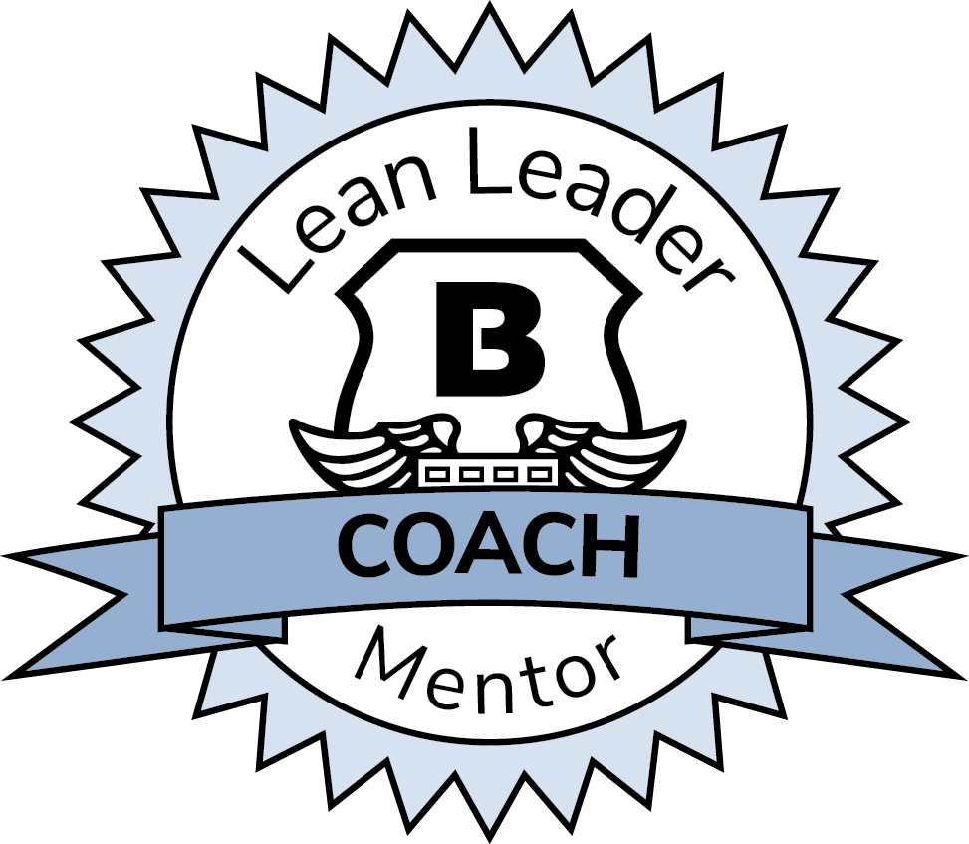
Lean Coach Certified
In recognition of successfully completing, understanding and applying all concepts
and tools of the three Lean training levels and serving as a coach to others,
Brink’s officially certifies
<<Name>>
This certificate attests to your commitment to Lean; to helping others learn and apply Lean;
and your contributions in improving our workplace, growing our customer satisfaction,
and strengthening the operational excellence and transformation of Brink’s.
Jamal Powell
Vice President Operational Excellence
Date
<<Name>>, <<Title>>
Date

Slide 8
Certification Badges

Slide 9
Badges
Copy and paste the badges for your use. If you need a higher resolution, please contact Dana Callahan or Megann Marsalis. Please do not translate the badges, as we are trying to maintain consistency across our Lean tools and resources.
CONFIDENTIAL. FOR INTERNAL USE ONLY – DO NOT DUPLICATE OR DISTRIBUTE.
9

Slide 10
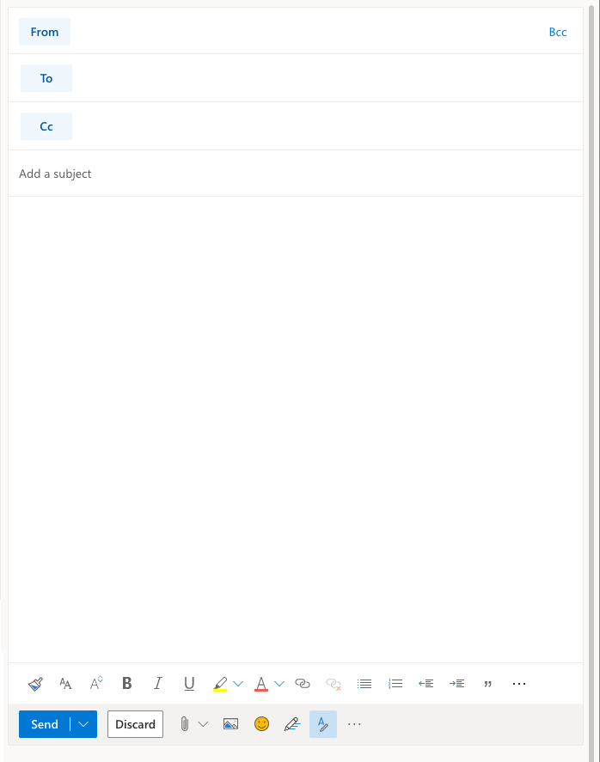
Email signature mockup
Employees can add their badge to the bottom of their email signature, as illustrated here. You can add written translation under your badge, since the badge needs to stay in English.
Name
Title
Company name
Department name
Telephone number
Fax number
Cell phone number
E-mail address
Company Web address
Name
Title
Company name
Department name
Telephone number
Fax number
Cell phone number
E-mail address
Company Web address
Badge Translation here
Badge Translation here
CONFIDENTIAL. FOR INTERNAL USE ONLY – DO NOT DUPLICATE OR DISTRIBUTE.
10

Slide 11
Lapel Pins

Slide 12
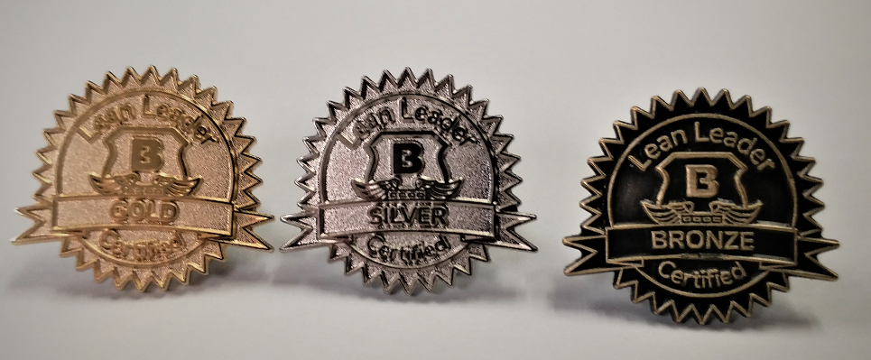
Instructions
For regions or countries interested in giving lapel pins to employees upon completion of Lean training, please know that as of September 2021 we are building a global process for ordering and distributing pins. Right now, this process is available in select areas.
We will update this document as soon as that process is final.
In the meantime, here is a picture of the pins. We are also creating a pin for Lean Coaches, which will be available soon.
CONFIDENTIAL. FOR INTERNAL USE ONLY – DO NOT DUPLICATE OR DISTRIBUTE.
12

