Slide 1
Honoring Our Heritage, Shaping Our Future
May 2024

Slide 3
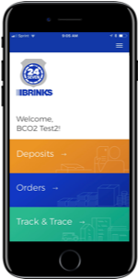
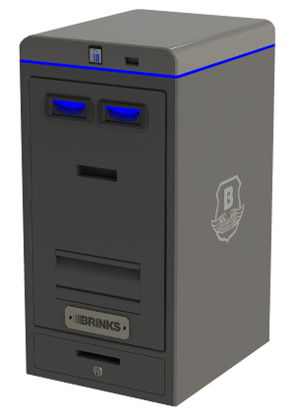
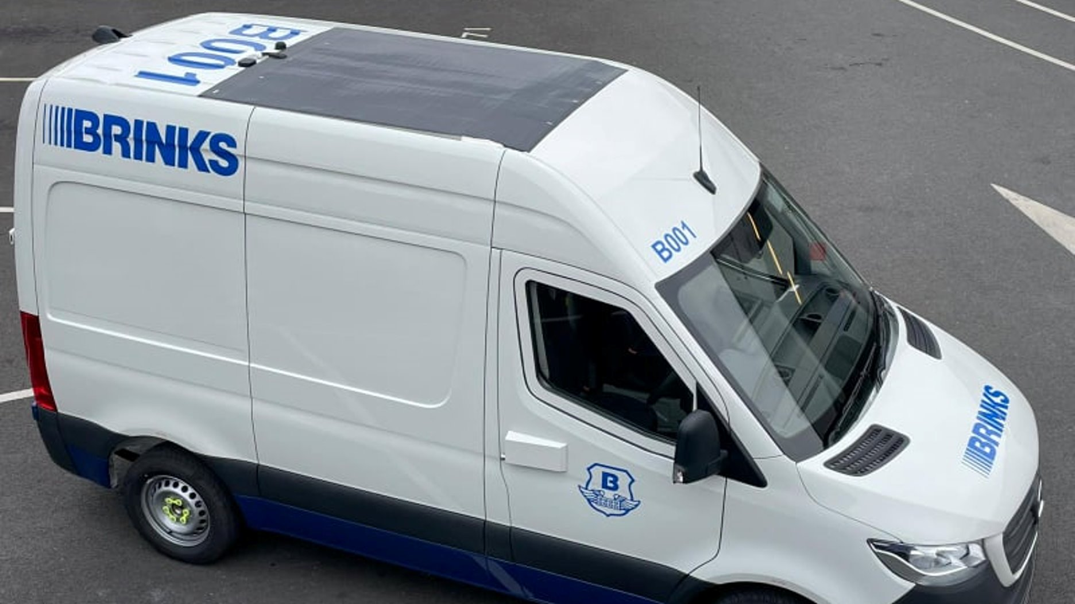
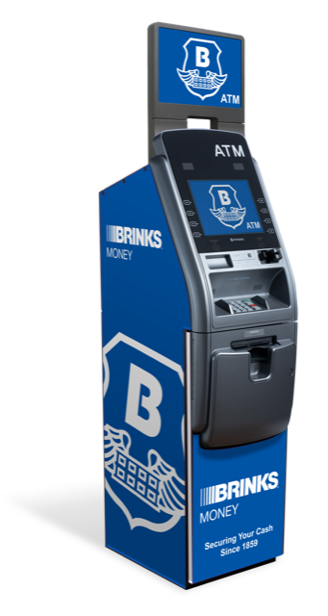
We’ve Come a Long Way Since 1859
1859
2024

Slide 4
We Have a Winning Strategy
Investing in areas that will help us grow and win in the marketplace
2024 Focus Areas
Winning with customers and driving operational excellence
Creating a better employee experience
Driving profitable growth and improving capital efficiency
Leverage our global scale
Confidential. For Internal Use Only – Do Not Duplicate or Distribute.

Slide 5
Now It’s Time to Shape Our Future
Build on our strengths and evolve to drive success
OUR STRENGTHS
OUR OPPORTUNITIES
Strong recent financial results
Entrepreneurial spirit with a drive to serve customers well and “win” in local markets
Deep working knowledge of in-country operations
Strong brand
85% of employees “proud to work at Brink’s”
Safety and integrity are powerful, pervasive behaviors
Significant progress made towards Lean initiatives
Work together as one team
Position ourselves as partners with customers and improve service
Take advantage of our global size and reach
Modernize and standardize our core infrastructure, technology and systems
Build capabilities in enterprise functions
Work and collaborate to sell solutions (AMS/DRS)

Slide 6
We Are Making Moves to Build a Better Brink’s
Three workstreams designed to better define who we want to be and how we’re going to get there
1
2
3
Purpose & Values
How We Work Together
Enhance Functional Capabilities
Define our ‘why’ – our purpose – as a company
Refresh our values and expected behaviors to ensure we drive our desired culture
Find opportunities to work together as one global team
Identify shared systems and tools, to allow us to make decisions consistently
Look for opportunities to share ideas across geographies
Build and scale functional impact with technology and improved capabilities
Leverage our scale to enable functional efficiencies
POWER THE CULTURE SHIFT TO DRIVE TRANSFORMATION
STRENGTHEN CONNECTION BETWEEN GLOBAL AND LOCAL, AND REDUCE COMPLEXITIES
DELIVER BETTER SERVICE AND RESULTS

Slide 7
The best is yet to come.

