Slide 1
Implementing Lean
A Global Rollout

Slide 2
Agenda
Where We Are
The current role of Lean
What Lean is … and what it is not
Where We’re Going
Transforming Brink’s
Lean accelerates our strategy
Timeline
Quick wins
How We Will Get There
Expectations
Training & implementing Lean
Support & resources

Slide 3
Where We Are
The Brink’s Executive Leadership Team is requesting all countries begin implementing Lean in January 2021 if they have not already done so.
Lean is well-established and has a track record of success in Latin American operations.
Brink’s is expanding Lean to help Brink’s be even stronger for:
our people
our customers
our shareholders

Slide 4
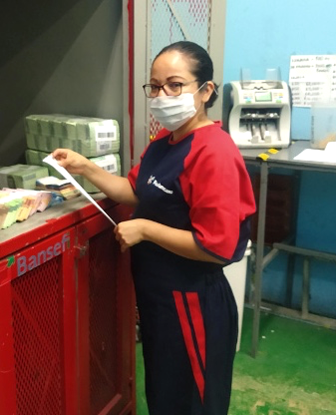
About Lean
Lean is a management methodology we use to evaluate and improve processes and performance
By deploying Lean, Brink’s will position employees to:
think differently about our work
see ways we can improve the way we work
fix or remove the frustrations we encounter as we go about our work

Slide 5
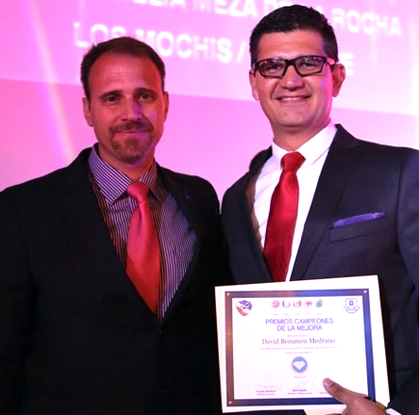
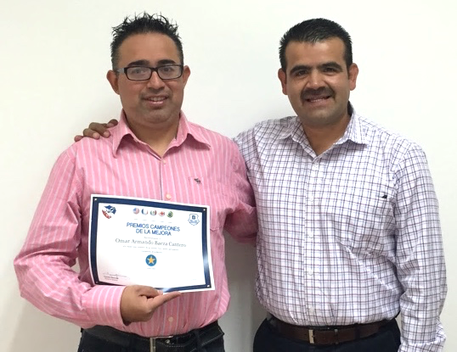
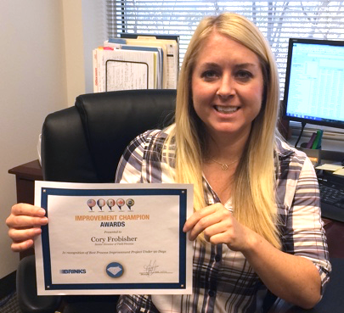
What Lean Is and What Lean Is Not
Lean is …
About people and leadership
The way we work at Brink’s
Everyone’s opportunity
Capacity building
Better for Brink’s and customers
Lean is not …
A program or initiative
Cost cutting
Temporary
Lean unlocks the potential within our people

Slide 6
Where We’re Going
Consistent with our mission, we want to be the primary partner for all aspects of the cash and valuables supply chain. To achieve this, we are transforming the way we do business to optimize our operations and provide complete cash management solutions.
We want to make bold moves to disrupt cash management and transform the customer experience

Slide 7
Operational Excellence Is a Key Component of Our Strategy
Introduce
Digital
Solutions
(IDS)
Accelerate Profitable Growth
(APG)
Deliver Operational Excellence (DOE)

Slide 8
Lean Drives Operational Excellence
Lean will improve margins, create capacity, improve our work environment and create a more valuable customer experience.

Slide 9
Lean Timeline
Our approach to Lean includes 4 phases over 3+ years. Every country will follow this approach:
Plan (3-6 months)
Apply the Principles (6-9 months)
Deploy (12-18 months)
Expand (3+ years)

Slide 10
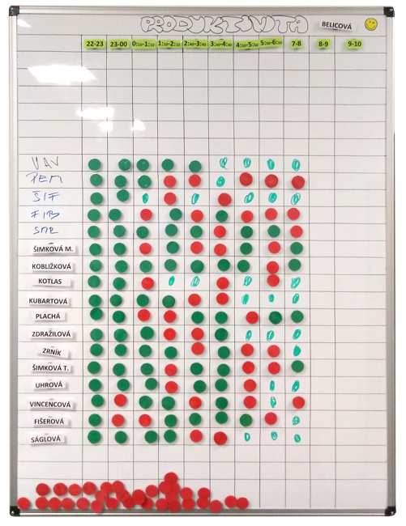
Lean Creates Immediate Results
Czech Republic launched simple Lean tools to boost performance in cash processing in August and saw dramatic improvement by September
In just two months …
BRANCH MARGIN INCREASED | MONEY PROCESSING PRODUCTIVITY INCREASED | ATM PRODUCTIVITY INCREASED
28% | 31% | 15%

Slide 11
How We Will Get There
Leaders are critical to driving Lean.
Leaders must become experts in Lean.
Leaders must create a work environment that supports and encourages Lean.
Lean is for every employee.
Transforming Brink’s requires the participation of every employee.
The people closest to the work are the best at figuring out new and better ways to do the work.

Slide 12
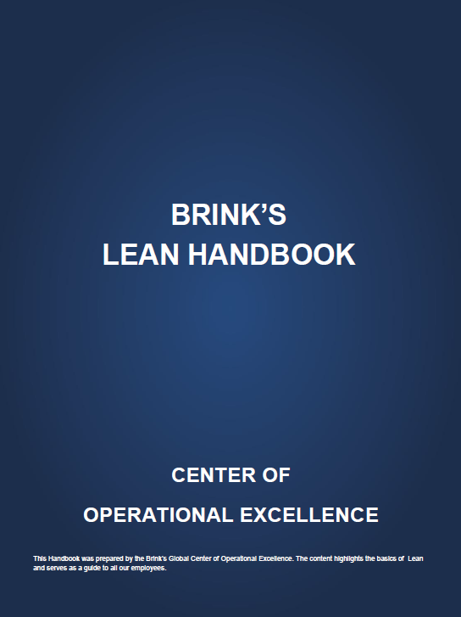
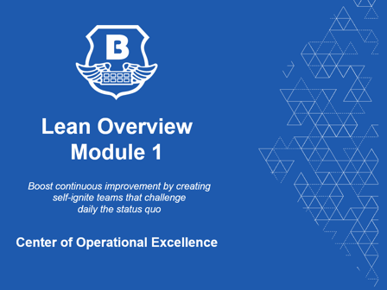
Tools to Support You
We’ll share all tools on the Center of Excellence site
PowerPoint Documents
Excel Tools
Dashboards
Webinars
Subject Matter Experts
We will launch a Global eLearning training module to support Lean certification

Slide 13
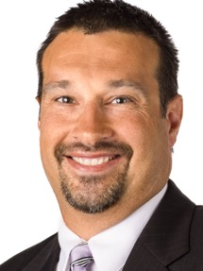
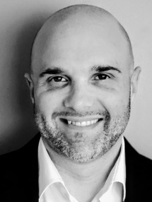
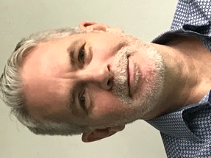
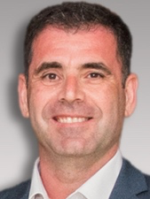
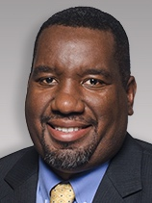
Expert Support
James Hennessy
BGS
Jeff Klabunde
United States
John McClymont
Canada
Raluca Meledjiev
Asia Pacific and BGS
Priscila Palhares Mendes
Latin America
Michalis Papakis
Brink’s Europe, Middle East and Africa
Jamal Powell
VP Operational Excellence
Contact your regional experts for help with planning and execution of Lean initiatives

Slide 14
What’s Next?
Add your own next steps and calls to action (such as signing up for training, scheduling a meeting with your team, etc.)

Slide 15
Questions?

