Slide 1
Brink’s Lean Recognition Program
What the program is and how to manage it at country and regional levels
Updated: Nov. 3, 2023

Slide 2
Table of Contents
What is the Lean recognition program and what are the benefits
Levels of recognition
How the recognition program works & criteria
Program timeline
Sample Diamond communications
Photo consent & release form
Recognition certificates
Note, this presentation is in A4 sizing format to facilitate the download and printing of the enclosed Lean recognition certificates.

Slide 3
About Lean Recognition
All regions are expected to have a recognition program
This recognition program celebrates success and recognizes employees who:
use Lean processes
exemplify our value of Continuous Improvement to achieve our strategic objective of Operational Excellence
All employees qualify, except direct reports of country General Managers.
All countries should have begun implementing their Emerald and Ruby recognition program in 2022, with the first regional Diamond winners chosen and recognized in early 2023. The program repeats annually moving forward.

Slide 4
Benefits of Lean Recognition
Motivate employees to actively participate in and build a Lean culture
Develop new skills in problem solving and innovative thinking
Support Lean change management with promotion and communication
Distinguish employees among their peers, and stimulate personal growth and promotion

Slide 5
Levels of Lean Recognition
Region
Regional presidents select winners from countries’ Emerald and Ruby nominations
Diamond
Country
Employees who make big improvements in applying Lean and
delivering results
Ruby
Employees who make small improvements in applying Lean and delivering results
Emerald

Slide 6
How to Earn Emerald & Ruby Recognition
Available to teams or individuals
Individuals or teams nominate themselves by documenting their improvements using the A3 problem-solving method.
They submit their A3s to [name or process]. Each country* chooses their own Lean Team to select the winners.
Country Lean Team evaluates submitted A3s, confirms results and selects winners on a quarterly basis.
At a minimum, Country Lean Team gives certificates to each of their winners; other prizes issued at the discretion of each country.
Taking photos of each winner when presented with their certificate is highly encouraged. Be sure to get the winner to complete the photo release form included in this toolkit. Keep a copy of the photo and completed release form in your files.
We also encourage announcing winners in your country’s Lean newsletter, in team meetings, or other country newsletter or correspondence.
A3s not selected remain eligible for future selection.
*Countries develop their own submission and review process based on the guidelines of the Lean Global Recognition Program.

Slide 7
How to Earn Diamond Recognition
For individuals only, not teams
Each country’s general manager will nominate individuals – from the country’s Emerald & Ruby winners – based on their full-year performance. Countries are not limited to one nominee, and every country is not guaranteed a winner.
Diamond recognition is based on the same criteria across the company. (See details on the next slide.) Country leadership and HR will share the criteria with employees.
Regional presidents will select the winners*.
Regional presidents will determine prizes for winners which may include an in-person celebration in the region.
*Regions develop their own submission and review process based on the guidelines of the Lean Global Recognition Program.

Slide 8
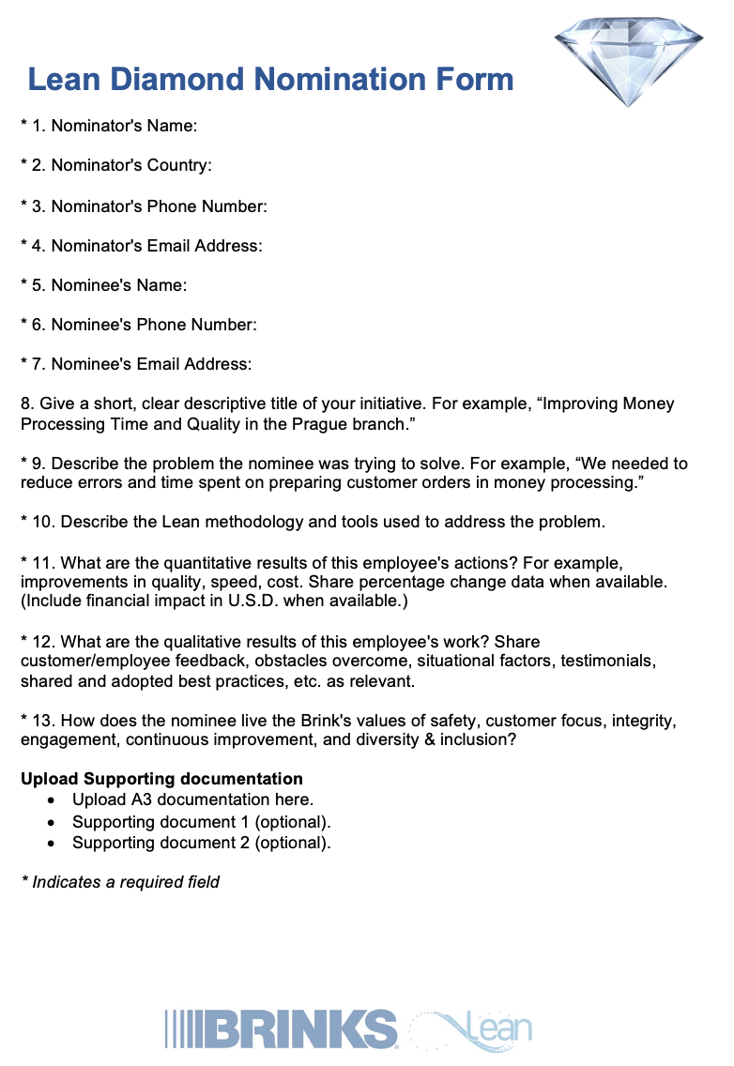
Sample Lean Diamond Nomination Form
Country GM to fill out form to nominate Emerald & Ruby winners for Diamond Award
A sample form is provided, right, so you can see the type of information needed for a nomination.
Each regional president has their own nomination form, though the same information is requested for each region. Country GMs should submit their nominations by filling out their region’s form, based on their regional president.
https://www.surveymonkey.com/r/2023-Diamond-Bossart (Argentina, Bolivia, Brazil, Chile, Colombia, Dominican Republic, Panama)
https://www.surveymonkey.com/r/2023-Diamond-Castillo (Canada, Mexico, U.S.)
https://www.surveymonkey.com/r/2023-Diamond-Parks (All other countries)

Slide 9
Diamond Recognition Selection Criteria
Eligibility for Diamond recognition requires achievement of one or more of the criteria
Technical accomplishment, breakthrough or process re-engineering
Creativity and/or initiative used in accomplishing work assignments, including problem definition and solution
Innovation by individual that contributes to progress toward the completion of a project or milestone
Exemplary performance in response to an important organizational need
Significant improvement of quality, efficiency, safety, productivity, cost, etc.
Administrative or management practices that have a positive organizational effect, including quantifiable results such as improvement in turnover, engagement survey results, etc.
Performance of other duties outside employee’s own expected job requirements

Slide 10
Timeline
Emerald and Ruby winners are chosen quarterly in each country. Emerald and Ruby winners in the current calendar year will be eligible for Diamond nomination and recognition in the first half of the following calendar year.
Countries
Country GMs submit Diamond nominees based on previous year Emerald & Ruby winners
January
Country leaders communicate about recognition program
Employees submit nomination based on previous quarter
Country leaders select & recognize Emerald & Ruby winners
Ongoing every quarter
Q1
Q2
Q3
Q4
Regional presidents select Diamond winners
February
Regional celebrations of Diamond winners, as determined by each region
May
Communicate with country GMs about Diamond selection criteria & process
November
Regions

Slide 11
Sample Communications

Slide 12
Instructions for Communications
The following slides are samples of communications to use for your Diamond Award nomination process and notification of winners.
Each sample can be customized for use in your region or country. While these communications are for the Diamond Award, you can customize them for the Emerald and Ruby awards, too.
If you have any questions, reach out to a Lean Champion or the Operational Excellence Council for more information.
When you take pictures of your award winners, you will need to have them complete a photo release form. You will find that included in this toolkit. Please keep a copy of the photo and completed release form in your files.

Slide 13
Sample Communications for Diamond Awards
Email Reminder about Diamond Nominations for Country GMs
[To be sent in November of each year from regional president]
Dear Leaders,
[Insert welcoming / introductory remarks]
20XX Lean Diamond Awards
As we finish out this year, I am writing to remind you of the Lean Diamond Awards. The award program is our opportunity to recognize individuals across our region who have created significant impact by implementing Lean methodology.
We have many deeply devoted and talented people working in our region, and throughout this past year, we’ve awarded them with Lean Emerald and Ruby awards. It is from this group of winners that we will select our highest achievers for the Diamond Award. I believe it’s always important to recognize a job well done. The deadline for nominations will be Jan. 31. Please fill out this form [insert link].
Please begin to think about who you would nominate from among your country’s Emerald and Ruby winners. I will reach back out in the coming weeks with additional details about the nomination and selection process. If your country has not selected Emerald and Ruby winners yet this year, this is your chance to do so before year’s end. This will allow you to participate in the upcoming Diamond Awards.
As a reminder, Lean Diamond Awards require achievement of one or more of the following criteria:
Technical accomplishment, breakthrough or process re-engineering
Creativity and/or initiative used in accomplishing work assignments, including problem definition and solution
Innovation by team or individual that contributes to progress towards the completion of a project or milestone
Exemplary performance in response to an important organizational need
Improvement of quality, efficiency, safety, productivity, etc.
Administrative or management practices that have a positive organizational effect
Performance of other duties outside employee’s own expected job requirements
Thank you,
[Insert Regional President’s Name]

Slide 14
Sample Communications for Diamond Awards
Email about Diamond Nomination & Selection Process for Country GMs
[To be sent in December or January of each year from regional president]
Dear Leaders,
The Jan. 31 nomination deadline for the 20XX Lean Diamond Awards is quickly approaching. I urge you and your teams to nominate employees from your Emerald and Ruby winners (based on their full-year performance) who used Lean processes and exemplified the spirit of Continuous Improvement to achieve Operational Excellence. Recognition is vitally important to employee engagement, workplace culture and business outcomes.
Submit your nominations by Jan. 31 using [insert your link]. Countries are not limited to one nominee each. The number of Diamond winners will be based on the quality and quantity of nominees. And every country is not guaranteed to have a winner.
As a reminder, Lean Diamond winners must be selected from your country’s Emerald and Ruby winners, and nominees should exemplify achievement in one or more of the following criteria:
Technical accomplishment, breakthrough or process re-engineering
Creativity and/or initiative used in accomplishing work assignments, including problem definition and solution
Innovation by team or individual that contributes to progress towards the completion of a project or milestone
Exemplary performance in response to an important organizational need
Improvement of quality, efficiency, safety, productivity, etc.
Administrative or management practices that have a positive organizational effect
Performance of other duties outside employee’s own expected job requirements
Contact [insert name and contact information] if you have questions.
Thank you for recognizing our hardworking employees and their Lean accomplishments. I appreciate your commitment to the care, development and safety of each other.
[Insert Regional President’s Name]

Slide 15
Sample Communications for Diamond Awards
Email to Country GMs about Diamond Winners
[To be sent in February of each year from regional president admin.]
Dear [GM],
Congratulations! The 20XX Lean Diamond Award winners have been selected, and it’s time to share the good news with the winners. The winner(s) from your country is/are: [insert name/title/Lean project]
Each winner will receive [award, prize or trip details included here].
What You Need to Do for Your 20XX Lean Diamond Winners
Customize the attached Diamond Award certificate.
Notify your winner(s) by [insert date] by giving them the attached “Winner Letter” and customized certificate.
Notify your winners of how to participate in or accept their award.
Be prepared to take the winners’ photos and obtain their signatures on the Brink’s photo release form. Send them to [insert details of regional president’s admin].
We look forward to hearing about how you celebrate this news, and we thank you for submitting nominations for the Lean Diamond Awards!
Many thanks,
[insert name of regional president’s admin]

Slide 16
Sample Communications for Diamond Awards
Letter from Regional President to Diamond Winners (use with email on previous slide)
[To be sent in February of each year to the country GM via email. GM to distribute to the employee. See previous slide.]
Dear [NAME],
Congratulations on being one of the Lean Diamond recognition winners for our region! Your country’s general manager [insert name] and I are very excited to give you this honor.
With this prestigious award, we honor people like you who use Lean processes and exemplify the spirit of continuous improvement to achieve operational excellence.
You were chosen for your achievement in [include details]. This is an excellent example of how it helps us to continuously improve the company's processes and people's performance through Lean methodology.
As a Diamond recognition recipient, [details about their award, prize or trip]. This award is our way of saying thank you for everything you've done to build our company. We are fortunate to have you as part of our team.
If you have any questions, please contact [name / contact information].
Thank you.
[Insert Regional President’s Name
Title]

Slide 17
Sample Communications for Diamond Awards
Email to Country GMs for those NOT Selected for Diamond Award
[To be sent in February of each year to GMs]
Dear [NAME of GM],
Thank you for nominating [insert name(s)] for the Lean Diamond Awards.
We are grateful for their accomplishments and are proud of the impact and efforts of their application of Lean methodology. As you know, the Diamond award is our highest honor for those who use Lean processes and exemplify the spirit of continuous improvement to achieve operational excellence.
All our nominees this year were inspiring and exhibit the best of Brink’s! However, your nominee(s) were not among the final winners of the Lean Diamond Award.
While they didn’t achieve recognition this year at the regional level, we appreciate their contributions and look forward to seeing their continued growth. And we hope to see their name on the list of nominees again next year!
Thank you.
[Insert Regional President’s Name
Title]

Slide 18
Group Consent & Release Form
When taking pictures or video of your Emerald, Ruby and Diamond winners, have them complete this form.
I hereby authorize Brink’s, Incorporated and its affiliates or those acting with its permission (collectively, “Brink’s”) to use, reproduce and distribute my name, voice, likeness, photograph and/or any other representation of me in connection with printed materials or other media it distributes, displays, transmits or exhibits. Such distributions, displays, transmissions or exhibits may include, but are not limited to, publications, newsletters, magazines, brochures, CD ROMs, websites and/or videos for internal or external purposes.
I understand that my authorization grants Brink’s the right to use, reproduce and distribute my name, voice, likeness, photograph and/or any other representation of me without compensation or further notice.
I certify that I am 18 years of age or older, and I hereby release and discharge Brink’s for any and all liability arising out of or relating to the foregoing.
I have read and understand this release. Acknowledged and Consented to:
Please fill out completely.
Name of Event | Lean Success Story
Date of Event | (Insert date story will be used, published or distributed)
Print Name | Signature | Address | Date

Slide 19
Certificates

Slide 20
Instructions for Certificates
The following slides are Lean Award certificates for each of our three categories of recognition:
Emerald
Ruby
Diamond
Countries can translate the certificates into their language and fill in the details for their award winners: name and project.
The design of the certificates should not be modified as we are trying to maintain consistency across all our Lean tools.

Slide 21
lean recognition award
Emerald award
Presented to:
<Name>
For successfully implementing the A3
<Name of A3>
<Date>
<Country General Manager> | <Country>

Slide 22
lean recognition award
ruby award
Presented to:
<Name>
For successfully implementing the A3
<Name of A3>
<Date>
<Country General Manager> | <Country>

Slide 23
Lean recognition award
Diamond award
Presented to:
<Name>
For successfully implementing the A3
<Name of A3>
<Date>
<Regional President Name> | <Title and Region>
<Country General Manager> | <Country>

